Slide 1
Unit4 Do you like candy?
人教精通版三年级下册
WWW.PPT818.COM

Slide 2
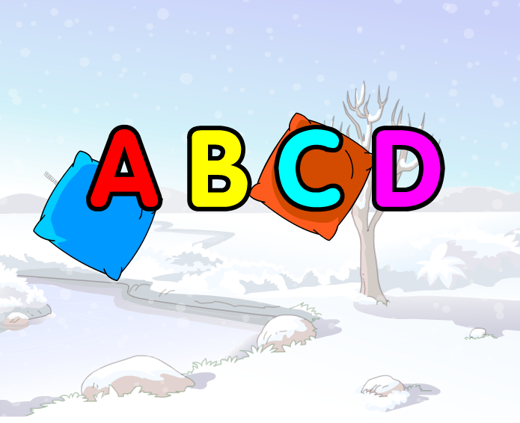
Warm-up
Let’s sing

Slide 3
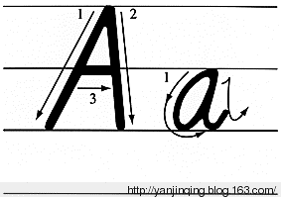
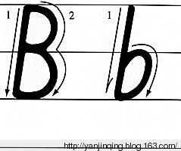
Presentation
Let’s learn

Slide 4
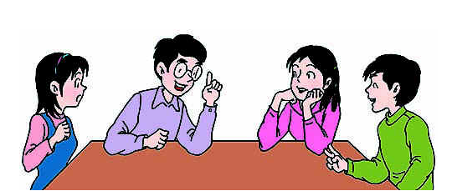
Presentation
Discussion
我们学过的哪些单词含有字母a或b呢？
class grade bag book father brother ……

Slide 5
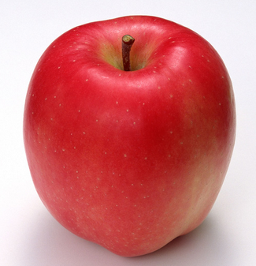
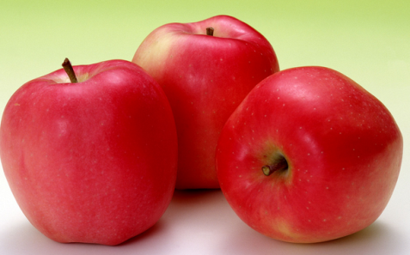
Presentation
Let’s learn
apple
apples

Slide 6
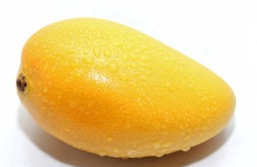
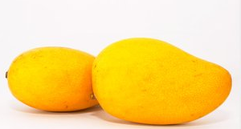
Presentation
Let’s learn
mango
mangoes

Slide 7
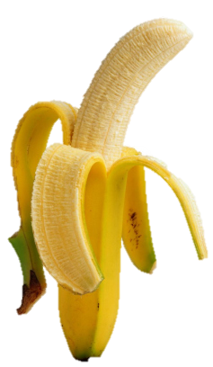
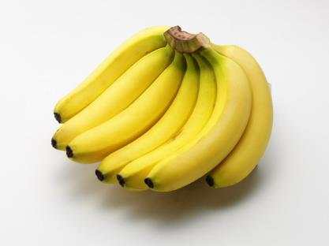
Presentation
Let’s learn
banana
bananas

Slide 8
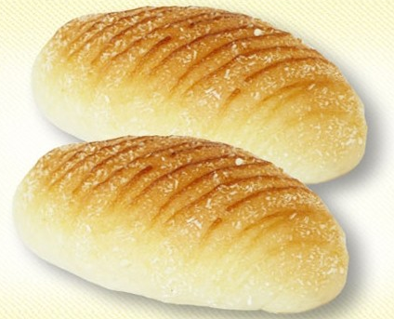
Presentation
Let’s learn
bread
不可数名词，单复数同形。

Slide 9
Practice
Game1
大小声
apple mango banana bread

Slide 10
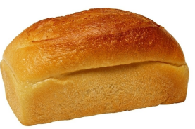
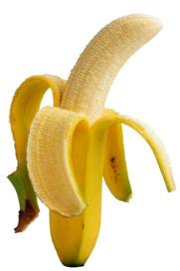
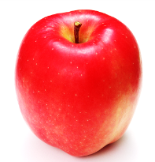
Practice
Game2
What’s missing?

Slide 11
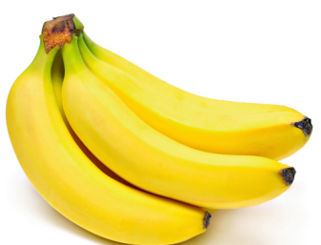
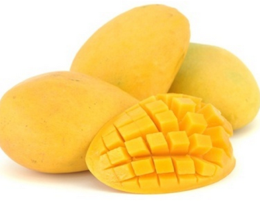
Presentation
Let’s learn
A: I like bananas, what about you?
B: I don’t like bananas, I like mangos.

Slide 12
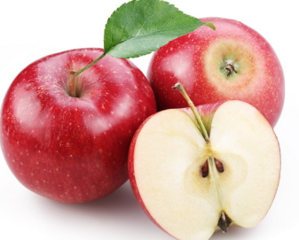
Presentation
Let’s learn
A: I like apples, what about you?
B: I don’t like apples, I like mangoes.

Slide 13
Practice
Let’s do
补全下列单词
_pple
_re_d
a
b
a
b_n_na
a
a

Slide 14
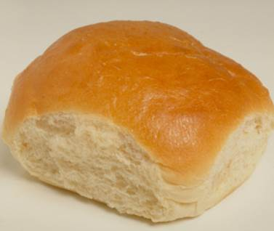
Practice
看图对话
A: I like apple,
____________?
B: I don’t like ____,
____________.
What about you
apple
I like bread

Slide 15
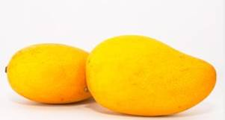
Practice
看图对话
A: I like banana,
____________?
B: I don’t like _____,
___________.
banana
I like mangoes
What about you

Slide 16
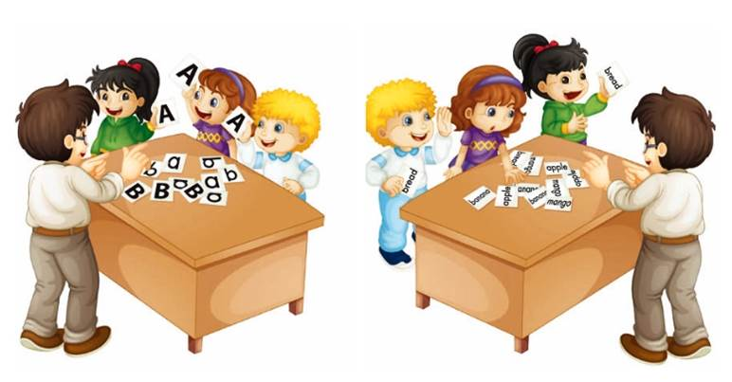
Practice
Let’s play
Show me the big letter “A”.
Show me the word “bread”.

Slide 17
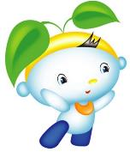
Summary
本课学到的重点单词：
apple mango banana bread
本课学到的重点句型：
What about you?
I like … / I don’t like …

Slide 18
Homework
1.跟读课文Just talk部分的录音，注意语音、语调。
2.用英语告诉你的朋友或家长你喜欢什么。
3.预习本单元Lesson 20的内容。
Close

