Slide 1
Module 8 Sports life
Unit 1 Daming wasn’t chosen for theteam last time.
WWW.PPT818.COM

Slide 2
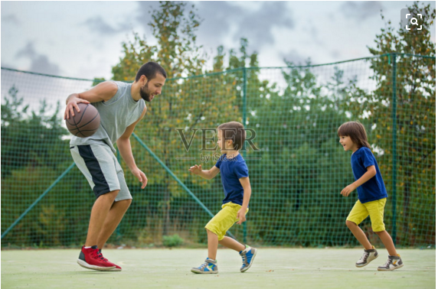
新课导入
Do you like playing basketball?

Slide 3
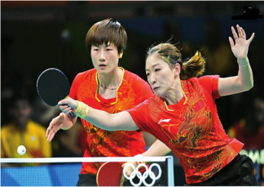
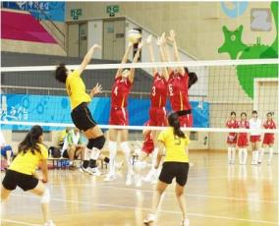
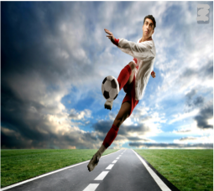
新课导入
Which kind of sports do you like?

Slide 4
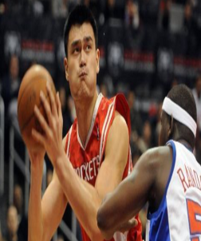
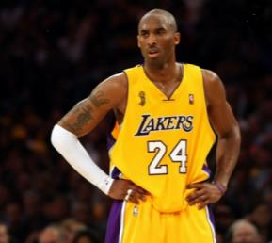
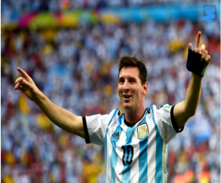
新课导入
Who is your favourite sports star?

Slide 5
新课讲解
1
Work in pairs. Look at the pictures and describe it.
What are they doing?
Do you like the game?
Who is your favourite sports star?
Are you in the school sports team?

Slide 6
新课讲解
2
Listen and complete the sentences.
1．Tony's basketball matches are held________ Saturday.
2．If a school team in Beijing wins its match or scores
over ________ points in a match, it can play in the
competition.
3．Tony's team BIG stands for Beijing ______________
Giants.
4．BIG's ________ think they are fantastic.
every
fifty
International
fans

Slide 7
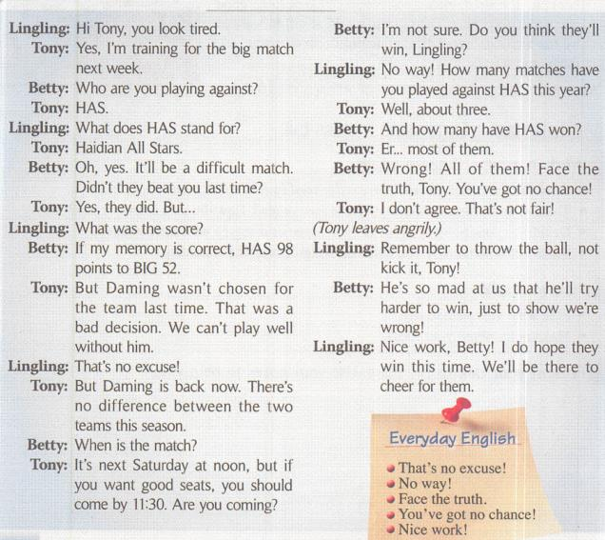
新课讲解
3
Listen and read.

Slide 8
新课讲解
Now complete the table.
Basketball competition
Teams | ________ against ________
Score of last match | __________ : __________
Time of next match | _______________________
Lingling’s favourite team to win | ___________
HAS BIG
HAS 98 BIG 52
next Saturday at noon
BIG

Slide 9
新课讲解
4
Complete the sentences
1．Tony looks tired because_________________________
_______________．
2．Betty has seen HAS play this season，and she
thinks_____________________．
3．Tony hopes BIG will_______________．
4．Betty and Lingling say that HAS will win because they
want Tony to_________________．
he is training for the big match next week
it’ll be a difficult match
win
try harder to win

Slide 10
新课讲解
5
Complete the passage with the words in
the box.
If Betty's (1)_________is correct, HAS won the last match. BIG did not play very well because Daming was left out of the team, and it was a bad (2)________. The coming match will start at (3)________next Saturday, so if Betty and Lingling want to watch the match and have good (4)________， they had better get there by 11：30.Lingling tells Tony he should not (5)________ the ball, but throw it. Tony is so (6)________ at Betty and Lingling that he will try harder to win.
decision kick mad memory noon seats
memory
noon
decision
seats
kick
mad

Slide 11
新课讲解
6
Listen and decide which words are weak and which words are strong.
1．Yes，I'm training for the big match next week.
2．It's next Saturday at noon, but if you want good seats,
you should come by 11：30.
3．He's so mad at us that he'll try harder to win, just to show
we're wrong!
Now listen again and repeat.

Slide 12
新课讲解
7
Work in pairs. Talk about your favourite
sports teams or sports stars.
Who they are
What sport they do
Why you like them
—My favourite sports team is… They always try hard to…
—Yes, I agree with you. And I think…

Slide 13
新课讲解
Language points 1
Point
stand for 是……的缩写；代表
(1) 指用字母、符号或数字来表示一个单词或某
个 概念的缩写名称。该短语不用于被动语态，
也不 用于进行时态。
eg: The American flag stands for freedom and justice.
美国国旗代表自由及公平。
(2)stand for意为“支持”，相当于support。
eg：Which team do you stand for?
你支持哪个队？

Slide 14
新课讲解
Language points 2
Point
decision /dɪ'sɪʒən/ n.决定
decision n. 决定 | the final decision 最终决定 make a decision 作出决定 eg: You must make a decision. 你必须作出决定。
decide v.决定 | decide to do sth.决定做某事 decide on sth.在某方面作出决定 eg：I have decided to go there by train. 我已经决定坐火车去那儿。

Slide 15
新课讲解
Language points 3
拓展关于way的短语：
on the way 在路上
by the way 顺便说一下
in the way 挡路
in this way 用这种方式
in many ways 在很多方面
Point
no way决不；没门儿
no way意为当“决不”，常在口语中表示断然 拒绝某事，当“不可能”讲，在口语中表示不 相信或惊讶。
eg：—Could you lend me some money?
你能借些钱给我吗？
—No way！ 没门儿！

Slide 16
新课讲解
Language points 4
Point
mad /mæd/ adj.生气的；恼火的
be mad about/on sth./sb.对某事/某人着迷 | eg：Most young people are mad on Jay Chou. 大部分年轻人迷恋周杰伦。
be mad at/with sb.生某人的气，相当于be angry with sb. | eg：He was mad at me for getting poor marks in the exam. 我考试得低分，他生气了。

Slide 17
新课讲解
Language points 5
Point
so...that...如此……以至于……
so＋adj./adv.＋that从句 | eg：He got up so late that he missed the train. 他起得如此晚以至于没赶上火车。
so that从句 目的是；为的是 | eg：He came to school very early so that he could look for the key to his house. 他来学校非常早是为了找家门钥匙。

Slide 18
当堂小练
一、根据句意及汉语提示完成句子
kicks
1.Tim always （踢）the ball with his left foot when he plays football.
2.I could not get even one ticket because all the （座位）were booked.
3.（中考·凉山）Has she made the （决定）yet？
4.（中考·连云港）Thomas Bach of Germany was （选择，选为） to be the ninth IOC president last year.
5. 【易错题】 Daming （代表） our school to take part in the meeting last week.
seats
decision
chosen
represented

Slide 19
当堂小练
二、从方框内选择适当的单词，并用其正确的形式完成句子
memory；win；angry；different；hold
6.There are some between British English and
American English in pronunciation.
7.（嘉兴）My desk­mate has an excellent for
telephone numbers.
8.Lucy is good at writing. I bet she will the writing
competition this time.
9.After hearing the bad news，Mr Green dropped the cup on the
floor and left the office .
10.The Olympic Games are every four years.
differences
memory
win
angrily
held

Slide 20
当堂小练
三、单项选择
11.She said that she was ill， but maybe it was just a（n）
I saw her going shopping just now.
A. work B. excuse C. matter D. expression
12.（南通）—Where are you going to spend your
summer holiday， Jenny？
—I haven't made a yet. I'm going to talk about
it with my family tomorrow.
A. decision B. promise C. journey D. suggestion
13.（中考·天津）Look at our new school. It last
year.
A. built B. was built C. is built D. will be built
B
A
B

