Slide 1
陕旅版英语五年级上册
Unit4 At Table
第2课时
WWW.PPT818.COM

Slide 2
教学目标
1. 能听懂、会用句型Use the fork with your left hand and use the knife with your right hand. Use the chopsticks with your right hand.和他人交流如何使用餐具。
2. 复习现在进行时的构成结构。
3. 能在教师的组织下完成Match and say部分以及Listen and number部分。

Slide 3
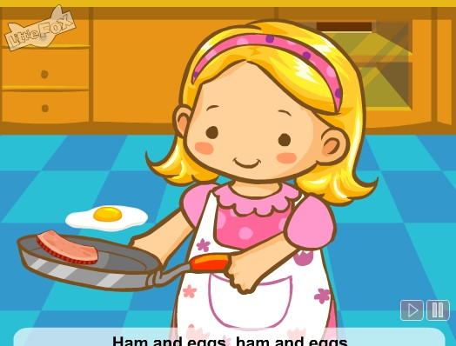
Song: Ham and eggs
听完歌曲，你能猜出本单元的话题了吗？

Slide 4
Review
flash cards

Slide 5
Ask and answer
What’s she doing?
She is drinking.

Slide 6
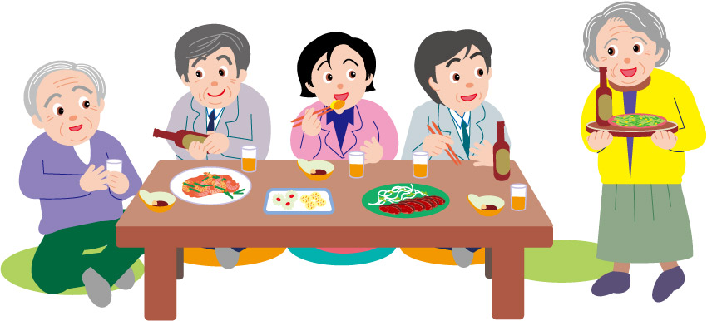
What are they doing?
They are eating.

Slide 7
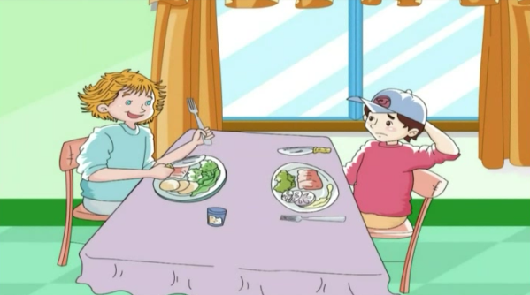
Who are they?
Where are they?
What are they doing?

Slide 8
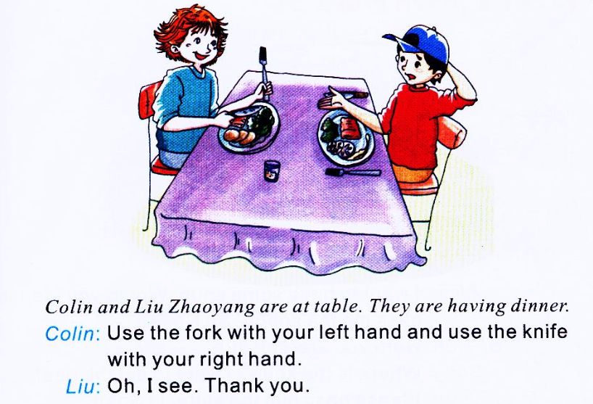

Slide 9
Question l：What are they having in Picture 1? Breakfast, lunch or dinner?
Question 2: How to use the knife and fork?

Slide 10
Role play

Slide 11
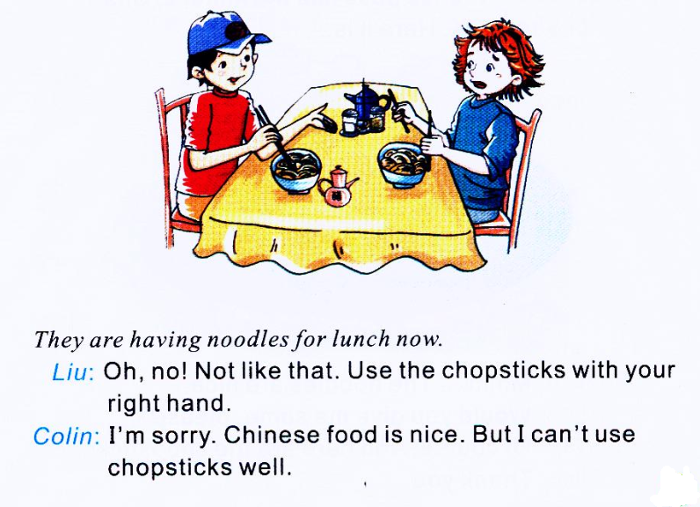

Slide 12
Question 1: What are they having in Picture 2? Breakfast, lunch or dinner?
Question 2: How to use the chopsticks?

Slide 13
Role play

Slide 14
Let’s talk
听读模仿秀

Slide 15
Summary
讨论如何正确使用餐具：
Use the fork with your left hand and use the knife with your right hand.
左手拿叉，右手拿刀。
Use the chopsticks with your right hand.
用右手拿筷子。

Slide 16
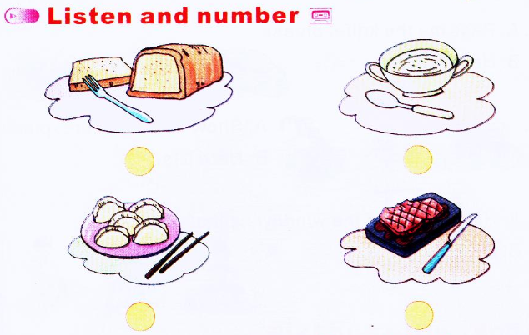
2
4
1
3

Slide 17
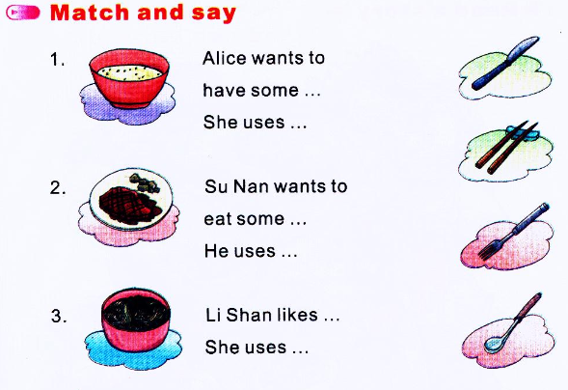

Slide 18
Good to know!
西方刀叉摆放礼仪
1. 餐巾Napkin
2. 鱼叉Fish Fork
3. 主菜叉Dinner or Main Course Fork
4. 沙拉叉 Salad Fork
5. 汤杯及汤底盘 Soup Bowl & Plate
6. 主菜盘 Dinner Plate
7. 主菜刀 Dinner Knife
8. 鱼刀 Fish Knife
9. 汤匙 Soup Spoon
10. 面包及奶油盘 Bread & Butter Plate
11. 奶油刀 Butter Knife
12. 点心匙及点心叉 Dessert Spoon and Cake Fork
13. 水杯 Water Goblet
14. 红酒杯 Red Wine Goblet
15. 白酒杯 White Wine Goblet

