Slide 1
陕旅版小学英语三年级上册
Unit3 Good Morning! 第2课时
WWW.PPT818.COM

Slide 2
教学目标
1．能正确认读、书写字母Oo, Pp, Qq，并通过相关词汇了解这些字母的基本读音规则。
2．能听、说、读、写单词orange, pear, question，并能在日常会话中熟练运用。

Slide 3
Let’s sing—
I Can Say My A B C

Slide 4
边看边想
Which letter is missing?
a b c d
e f g h
i j k l n
…

Slide 5
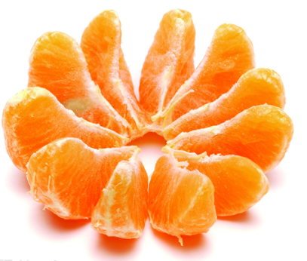
Look, boys and girls!
What’s this?
O, o, o, orange.

Slide 6
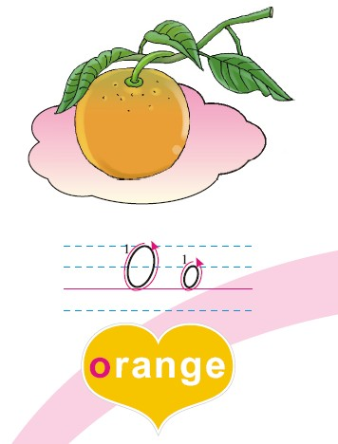
Let’s learn
This is Oo, Oo is in “orange”.

Slide 7
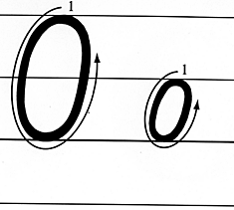

Slide 8
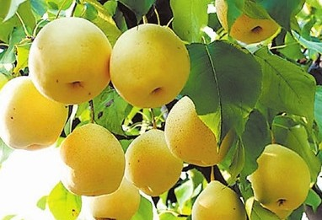
What’s this?

Slide 9
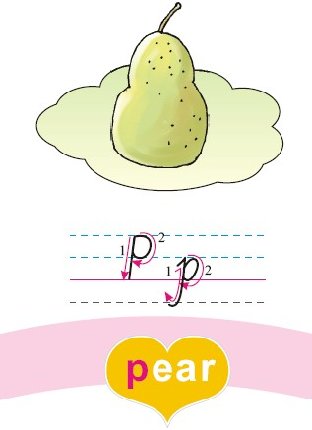
This is Pp, Pp is in “pear”.

Slide 10
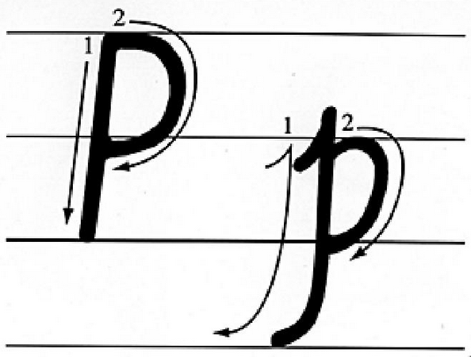

Slide 11
Do you have any questions?

Slide 12
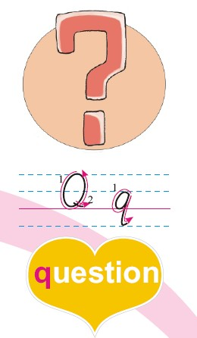
This is Qq, Qq is in “question”.

Slide 13
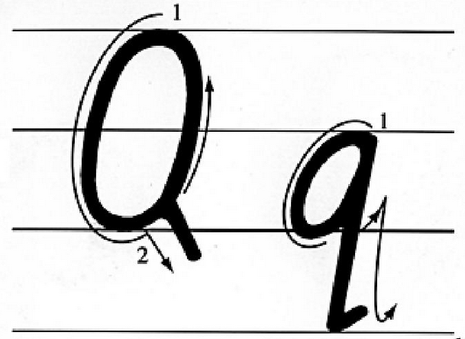

Slide 14
游 戏大小声
Practice:
Game:大小声（练习本部分单词）
游戏规则：教师领读单词，教师发大声，学生发小声，相反，教师发小声，学生发大声。错误的，大家“轰”一下。

Slide 15
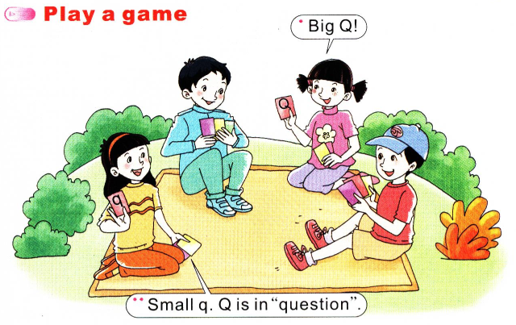
Play a game

Slide 16
Listen and draw
录音内容
录音内容

Slide 17
1. P is in “pear”. Pear, pear, pear.
2. O is in “orange”. Orange, orange, orange.
3. Q is in “question”. Question, question, question.
4. S is in “sun”. Sun, sun, sun.

