Slide 1
My friends
WWW.PPT818.COM

Slide 2
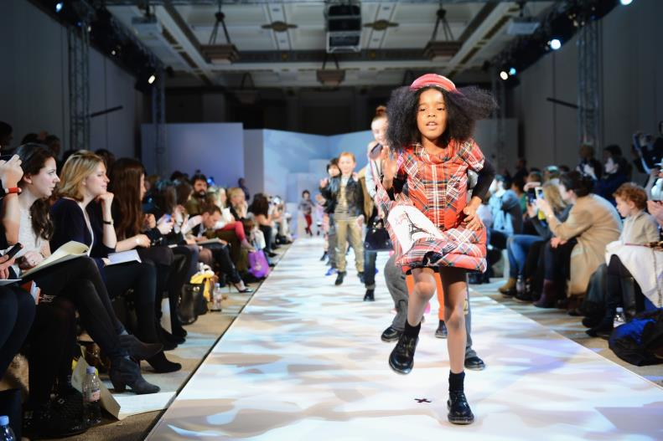
A fashion show

Slide 3
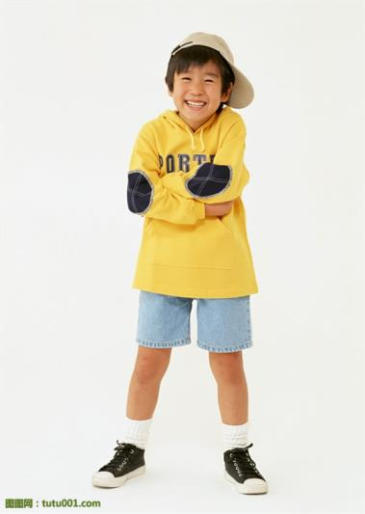
I have a yellow T-shirt and a pair of blue shorts.

Slide 4
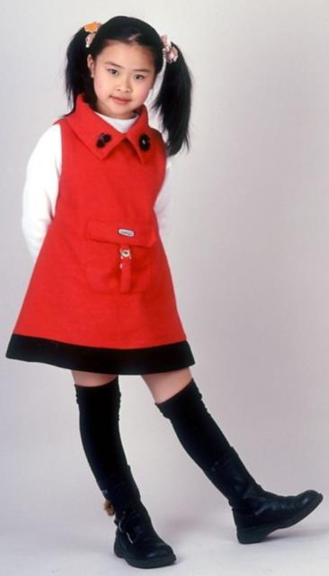
I have a red dress and a pair of black shoes.

Slide 5
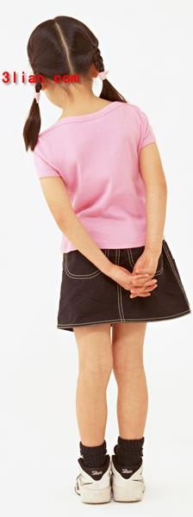
I have a pink T-shirt and a blue skirt.

Slide 6
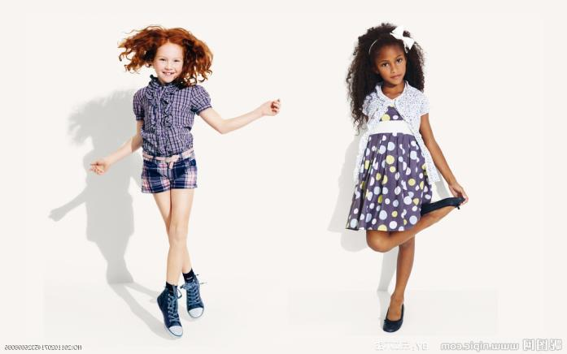
I have a pair of blue pants.
I have …

Slide 7
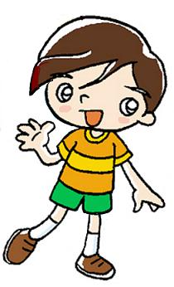
This is Ben.
He has an orange T-shirt and a pair of green shorts.

Slide 8
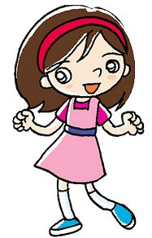
This is May.
She has a pink dress.

Slide 9
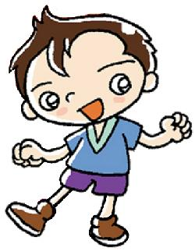
Now you try.
This is Paul.
He has _____ .

Slide 10
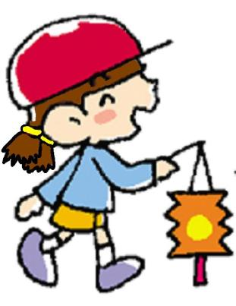
This is Gloria.
She has _____.

Slide 11
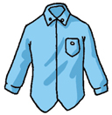
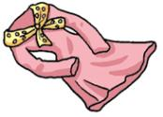
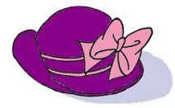
What colour
is
the dress?
the hat?
the shirt?
It
is
pink.
purple and pink.
blue.
dress
shirt
hat

Slide 12
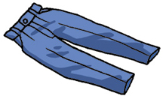
What colour
are
the pants?
the jeans?
the shorts?
They
are
blue.
green.
jeans
shorts
pants

Slide 13
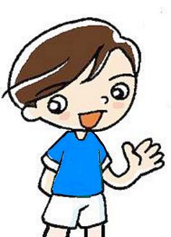
Tom has ____________.
a T-shirt and shorts
What colour is his T-shirt?
It is ________________.
What colour are his shorts?
They are _____________.
blue
white

Slide 14
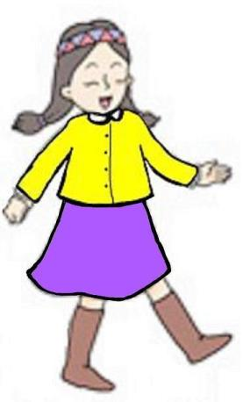
Amy has_________
____________________.
a shirt
and a skirt
What colour is her shirt?
It is _________________.
What colour is her skirt?
It is _________________.
yellow
purple

Slide 15
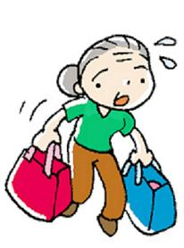
Grandma has_________
____________________.
a T-shirt
and a pair of pants
What colour ___ her T-shirt?
_____________________
What colour ____ her pants?
_____________________
is
It is green.
are
They are brown.

