Slide 1
陕旅版英语六年级上册
Unit8 New Year’s Party
第4课时
WWW.PPT818.COM

Slide 2
教学目标：
1.了解字母组合oa，ou在常见单词中的读音规则，并学习运用其读音规则拼读新单词。
2.能掌握动词过去式的变化规律并准确运用一般过去时态谈论、描述有关新年聚会的情境，做到会学、会用。

Slide 3
Free talk
When did you have your New Year’s party last time?
What did you do at the party?
What made you laugh? Why?
Were you excited?

Slide 4
听音写词

Slide 5
Part B Read the words

Slide 6
Summary
oa在重读音节中读双元音[əʊ]，发音同元音字母o的字母音。
字母组合ou在重读音节中读双元音[au]。

Slide 7
Try to read more

Slide 8
Part C Match and talk

Slide 9
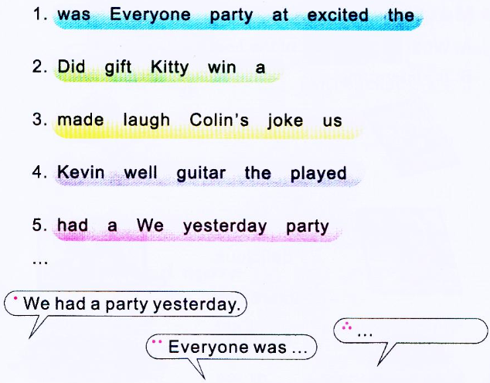
Part C Make up the sentences and reorder them to make a story

Slide 10
小练笔
以 We had a party yesterday. Everyone was excited at the party.开头运用一般过去时态描写聚会情境。

