Slide 1
Unit 5 It’s a parrot
WWW.PPT818.COM

Slide 2
review

Slide 4
learn

Slide 6
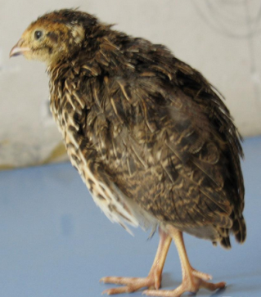
quail
鹌鹑

Slide 7
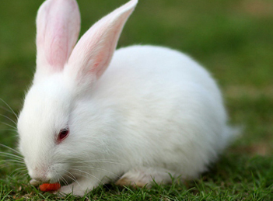
rabbit
兔子

Slide 8
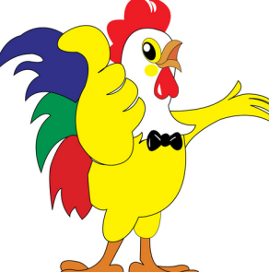
rooster
公鸡

Slide 9
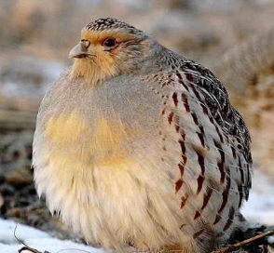
This is a quail.
这是一只鹌鹑。
Is it a quail?
这是一只鹌鹑吗？

Slide 10
This is a panda.
这是一只熊猫。
Is it a panda?
这是一只熊猫吗？

Slide 11
This is an owl.
这是一只猫头鹰。
Is it an owl?
这是一只猫头鹰吗？

Slide 12
肯定句式：This is ……
疑问句式：Is it……?

Slide 13
practice
用肯定句式和疑问句式分别描述下列图片。

Slide 14
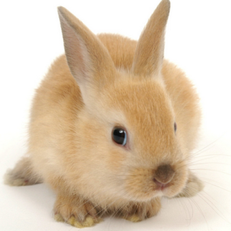
This is a rabbit.
Is it a rabbit?

Slide 15
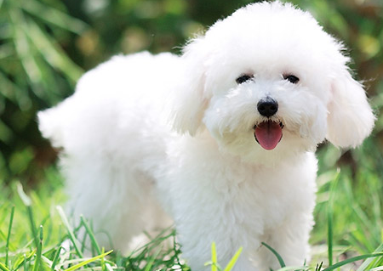
This is a dog.
Is it a dog?

Slide 16
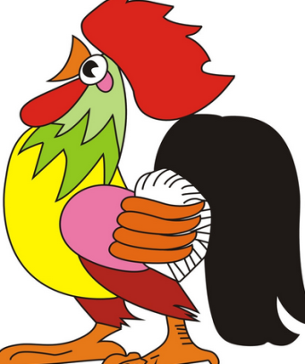
This is a rooster.
Is it a rooster?

Slide 17
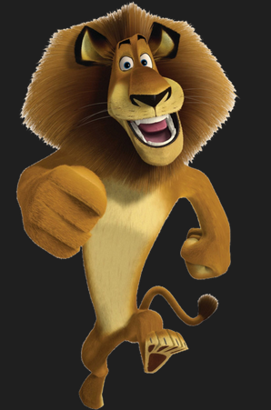
This is a lion.
Is it a lion?

Slide 18
Homework:
1.熟读本课句型;
2.抄写本课重点单词3遍。

Slide 19
Thank you

