Slide 1
精通版三年级–下册
Unit 1 Let’s go to school.
WWW.PPT818.COM

Slide 2
目录
CONTENTS
Lead-in
Presentation
Practice
summary

Slide 3
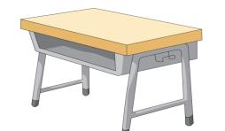
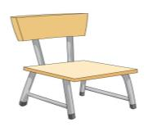
Presentation
is
What’s ?
A storybook .
in the bag
in
A storybook!
……
一本故事书 。
在 里面
书包
What’s ?
in the pencil-box
A marker!
An English book .
is
What’s ?
on the desk
on
An English book!
书桌
……
在 上面
一本英语书 。
on the chair
What’s ?
A Chinese book!

Slide 4
Presentation
A marker .
is
in the pencil-box
在 里面
一支马克笔 。
文具盒
……
is
on the chair
A Chinese book .
在 上面
……
椅子
一本语文书 。

Slide 5
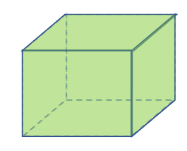
Presentation
方位介词：
1.
2.
in
on
在……里面
在……上面
A ball is in the box.
A ball is on the box.
球在盒子里面。
球在盒子上面。

Slide 6
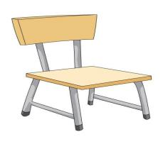
Practice
in
on
on
1.An apple is _____ the chair.
in
2.A cat is _____ the box.

Slide 7
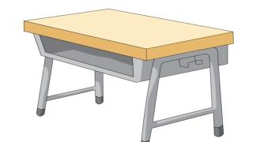
Practice
in
on
in
3.A book is _____ the bag.
on
4.A bag is _____ the desk.

Slide 8
Practice
No.1 A cat is in the box.
No.2 A cat is on the box.
1.
2.

Slide 9
Practice
No.1 A ball is in the box.
No.2 A ball is in the bag.
A box is on the desk.
A bag is on the desk.
1.
2.

Slide 10
Practice
in
on

Slide 11
Summary
区分in, on的位置：
in
on
在……里面
在……上面

