Slide 1
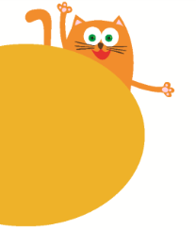
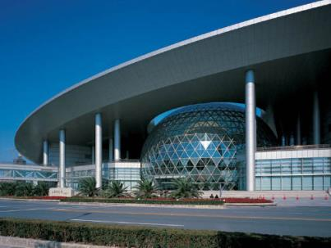
8
Visiting museums
WWW.PPT818.COM

Slide 2
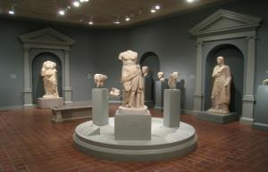
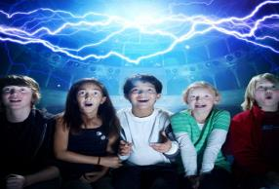
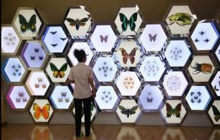
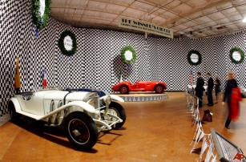
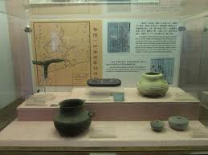
Look and guess
What museum is it?
art museum
science museum
insect museum
car museum
history museum

Slide 3
Look and say
railway museum
history museum
art museum
science museum
car museum
insect museum
film museum
toy museum
…

Slide 4
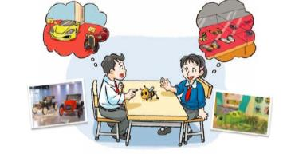
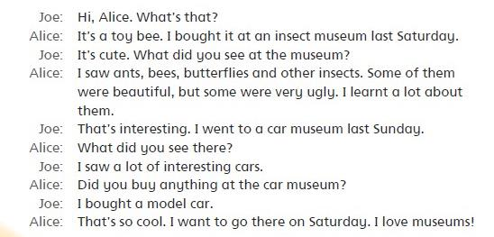
Read the dialogue

Slide 5
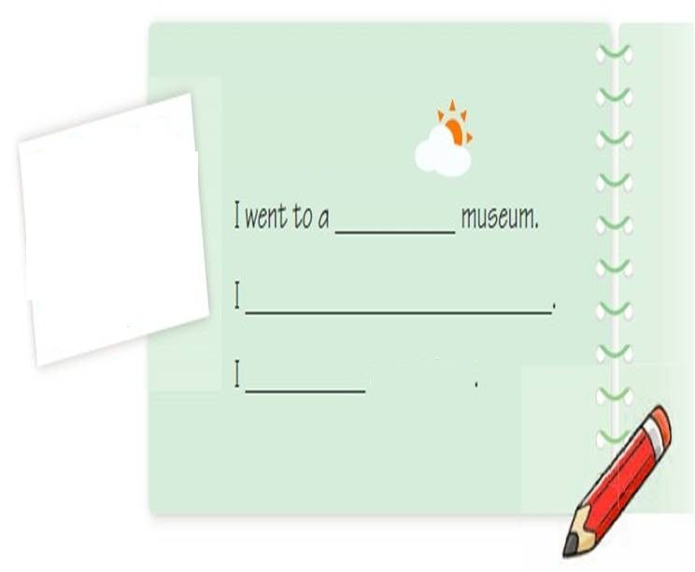
Write and say
Date:__________
Which museum did you visit?
What did you see at the museum?
visited saw bought

Slide 6
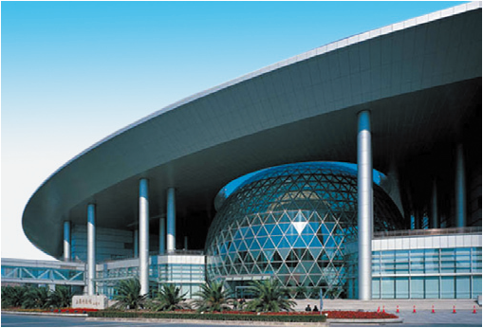
Read and guess
Children like this museum very much.
At this museum, people can see new technology.
People can learn a lot at this museum.
science museum

Slide 7
Think and say
science museum
Did you visit the science museum?
What did you see at the museum?
How did you feel at that time?

Slide 8
Watch and say
What can robots do?
教师可搜索并插入“会弹钢琴的机器人”片段视频。

Slide 9
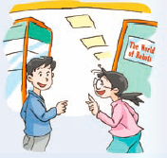
What time does the science museum open?
What did Ben and Kitty visit on the second floor?
What did they see in “The World of Robots”?
What can robots do there?

Slide 10
Read and answer
Step 1: Choose a question.
Step 2: Read and answer.
Step 3: Share.
What time does the science museum open?
What did Ben and Kitty visit on the second floor?
What did they see in “The World of Robots”?
What can robots do there?

Slide 11
Read and answer
What time does the science museum open?
It opens at ten o’clock in the morning every day.
What did Ben and Kitty visit on the second floor?
They visited “The World of Robots ”.
What did they see in “The World of Robots”?
They saw many kinds of robots there.
What can robots do there?
A robot was at the piano. He could play songs. His fingers moved fast.
A robot was a dancer. He could move his head and arms.

Slide 12
Think and retell
The science museum
It opens at ten o’clock in the morning every day.
They visited “The World of Robots ”.
They saw many kinds of robots there.
A robot was at the piano. He could play songs. His fingers moved fast.
A robot was a dancer. He could move his head and arms.

Slide 13
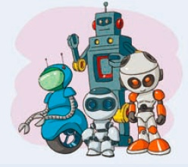
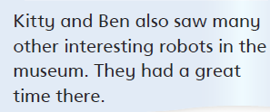
Think and retell
How did Kitty and Ben feel after they visited the science museum?

Slide 14
Think and retell
The science museum
It opens at ten o’clock in the morning every day.
They visited “The World of Robots ”.
They saw many kinds of robots there.
A robot was at the piano. He could play songs. His fingers moved fast.
A robot was a dancer. He could move his head and arms.
They had a great time there.

Slide 15
Think and say
The science museum …
…
They had a great time there.

Slide 16
Look and read

Slide 17
Look and read

Slide 18
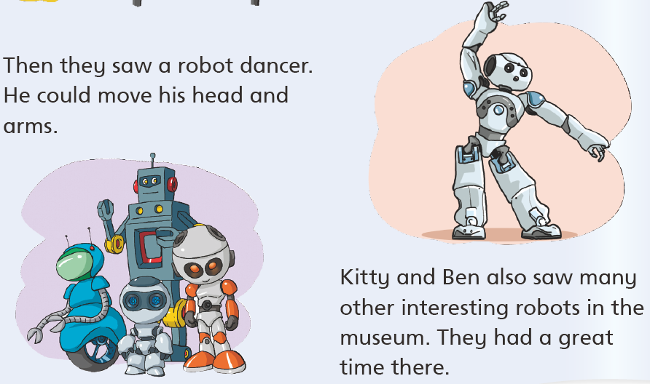
Look and read

Slide 19
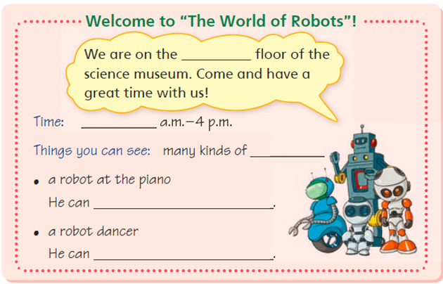
Step 1: Think and write.
Step 2: Share and check.
Step 3: Report.
Think and write

Slide 20
Make a poster
Step 1: Choose.
Welcome to the insect museum!
The insect museum opens at 9 o’clock every day.
We can see many kinds of insects there. The museum also shows different kinds of butterflies. Kids like to visit the insect museum because they can learn a lot about different kinds of insects. They can get to know the names and the life cycles of those insects.

Slide 21
Make a poster
Step 1: Choose.
Welcome to the car museum!
The car museum opens from 10 a.m. to 4 p.m. from Monday to Friday.
There are many floors in the car museum. On the first floor, we can see the photo shows of cars. On the second floor, there are a lot of old cars. We can learn about the history of cars there. On the third floor, we can see 22 different brands（品牌）of cars. The "Future Show" is on the fourth floor. We can see some future cars.
Step 2: Find friends.

Slide 22
Make a poster
Step 3: Underline and talk.
What time does it open?
What can you see at the museum?
What can you learn from the museum?

Slide 23
Make a poster
Step 4: Think and design.
________________________________________________________________________________________________

Slide 24
Make a poster
In class
Step 1: Choose.
Step 2: Find friends.
Step 3: Underline and talk.
After class
Step 4: Think and design.

Slide 25
Read and say
We're looking for some museum guides.
Please make sure that you know our museums very well, and you can introduce our museums to others.
Do you want this job?
Museum Union

Slide 26
Think and say
Welcome to the car museum …
On the … floor, we can see …
We can learn …
Come and visit! You will have a great time!
car museum

Slide 27
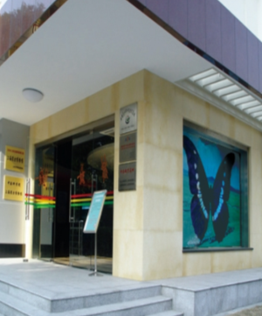
Think and say
Welcome to the insect museum …
Children like to visit this museum because we can see …
We can learn …
Come and visit! You will have a great time!
insect museum

Slide 28
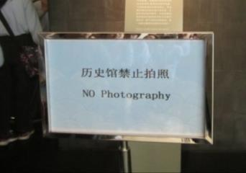
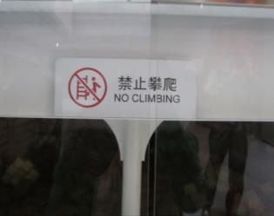
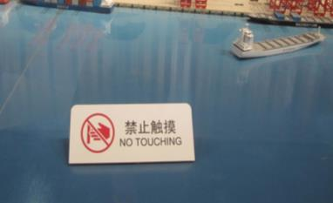
Look and say
Signs (don'ts)

Slide 29
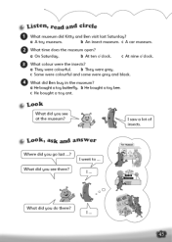
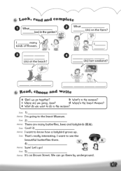
Homework
1. Finish writing the poster.
2. Read Student’s Book pages 52 to 55.
3. Retell “Look and read”.
4. Tell something about the car museum and the insect museum.
5. Finish Workbook pages 45 and 47.

