Slide 1
Unit 3
Could you please clean your room?
R 八年级下册
第1课时
WWW.PPT818.COM

Slide 2

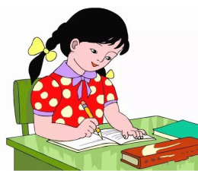


Lead-in
What do you usually do at home?
do homework
watch TV
sleep

Slide 3
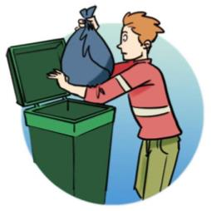
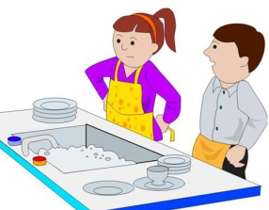
What do you usually do to help your parents?
do the dishes
take out the rubbish

Slide 4
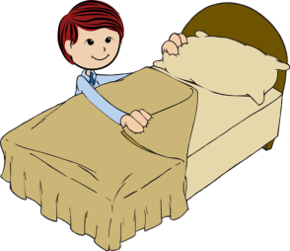
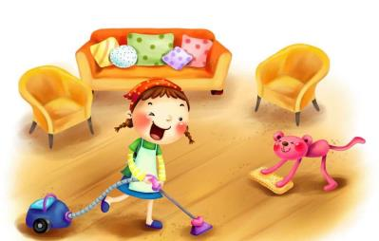
make your bed
clean the living room

Slide 5

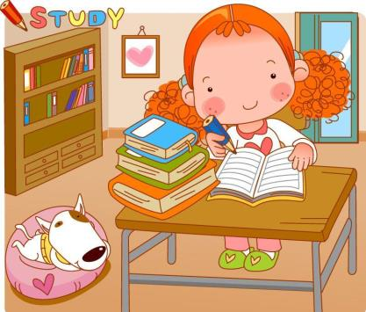


Slide 6
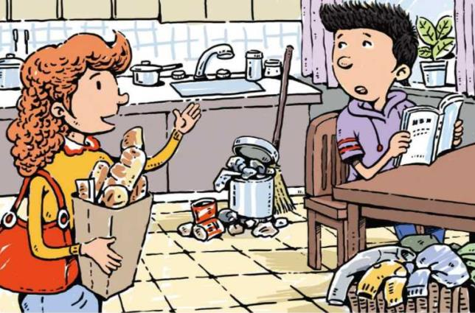
Sure, Mom.
Peter, could you please take out the rubbish?

Slide 7
Do you do these chores at home? Discuss them with your partner.
1a
1. do the dishes 2. take out the rubbish
3. fold your clothes 4. sweep the floor
5. make your bed 6. clean the living room

Slide 8


Do you do the dishes at home?
Yes, I do.

Slide 9
No, I don’t.
Do you sweep the floor at home?

Slide 10
Listen. Who will do these chores? Check (√) Peter’s mother or Peter.
1b
Chores | Peter’s mother | Peter
do the dishes
sweep the floor
take out the rubbish
make the bed
fold the clothes
clean the living room
√
√
√
√
√
√

Slide 11
1c
Make conversations about the chores in 1a.
Yes, sure. Can you do the dishes?
Could you please sweep the floor?

Slide 12
Well, could you please do them? I’m going to clean the living room.
No problem.

Slide 13
Interview
What chores do you do at home? How often do you do these things?
 | Who? | How often?
do the dishes
clean the floor
do the laundry
… |  | …

Slide 14
Report
Hello! I’m … In my group, … does the dishes and cleans ________________________________________
______________________________________________________________________________________________________________________________________________ .We think ... is the most able one at home.

Slide 15
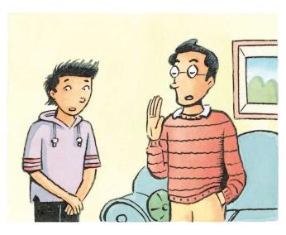
Listen. Peter asks his father if he can do four things. What does his father say? Check (√) “yes” or “no”.
2a
Peter wants to… | Peter’s father says…
go out for dinner. | Yes No
go to the movies. | Yes No
stay out late. | Yes No
get a ride. | Yes No
√
√
√
√

Slide 16
Listen again. Why does Peter’s father say “no”? Draw lines to the reasons.
2b
Peter wants to… | Peter’s father says… | His father’s reasons
go out for dinner. | Yes No | I have to do some work.
go to the movies. | Yes No | You have to clean your room.
stay out late. | Yes No | I need to eat breakfast.
get a ride. | Yes No | You have a basketball game.
√
√
√
√

Slide 17
2c
Make conversations between Peter and his father.
Could I use your computer?
Sorry. I’m going to work on it now.

Slide 18
Yes, you can, but first you have to clean your room.
Well, could I watch TV?

Slide 19
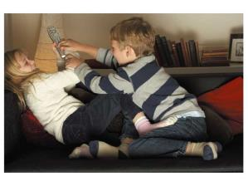
2d
Role-play the conversation.
Sister: Tony, could you please help
out with a few things?
Brother: Could I at least finish watching this show?
Sister: No. I think two hours of TV is enough for you!
Brother: Fine. What do you want me to do?

Slide 20
Sister: Could you take out the rubbish, fold the clothes and do the dishes?
Brother: So much?
Sister: Yes, because Mom will be back from shopping any minute now. And she won’t be happy if she sees this mess.
Brother: But the house is already pretty clean and tidy!
Sister: Yes, well, it’s clean, but it’s not “mother clean”!

Slide 21
Language points
1.Peter, could you please take out the rubbish?
“Could you please do sth.?”意为“请你做某事好吗？”，是一种表达请求、建议的问句，语气委婉，与“Would you please…？”句型可相互转换。
请你打开门好吗？
Could/Would you please open the door?

Slide 22
【拓展】
“Could/Would you please do sth.?”句型的否定句式为“Could/Would you please not do sth.?”，意为“请你不要做某事好吗？”。

Slide 23
take out “拿出来, 取出来”。
He took a dictionary out.
他拿出来一本字典。
take … out of … “把…从…拿出来”
He took a dictionary out of his bag.
他从书包里拿出来一本字典。

Slide 24
2. Sorry. I’m going to work on it now.
work on是一个动词短语，on为介词，表示“从事某项工作；做某项工作/研究；创作作品、作画；开机器等”。
我的爸爸正在写一部新小说。
My father is working on a new novel.

Slide 25
【拓展】：
work on sb./sth. “奏效，产生预期的结果”
The pills work on cough well.
医生开的药对治疗咳嗽很有效果。
His charm doesn’t work on me.
我不为他的魅力所动。

Slide 26
3.Could I at least finish watching this show?
finish在此为及物动词，意为“完成”，后常接名词、代词、动词-ing形式，不可接不定式。
你能在三天内读完这本书吗？
Can you finish reading the book in three days?

Slide 27
与finish一样，与动词连用时，只能接动词-ing形式作宾语的常见动词和动词短语还有：
喜欢（enjoy） 盼望（look forward to）
莫介意（mind） 愉快（have fun）
完成（finish） 勤练习（practice）
忙（be busy） 得考虑（consider）
想要（feel like） 放弃（give up）。

Slide 28
Exercise
floor
1.We can see a small dog on the ______ ．
2.My mother ______ the kitchen every day.
3.Your room is in a _____ , so please clean it before breakfast.
4.We should put our ________ in the dustbin.
5.She ______ the paper into two and put it away.
sweeps
mess
rubbish
folded

