Slide 1
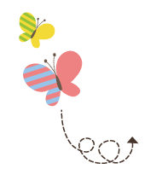
Unit 4 Li Ming Comes Home
六年级下册
Lesson 19 Buying Gifts
WWW.PPT818.COM

Slide 2
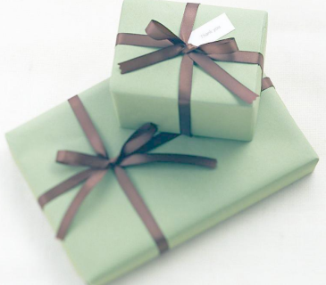
Have you ever received a gift?

Slide 3
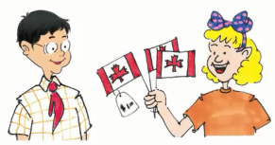
1. At the shop
Li Ming will fly home next week. He wants to buy some gifts for his family.
Jenny: How many gifts do you need, Li Ming?
Liming: I need eleven gifts. I need a gift for everyone in my family.
“Here are some little flags，”says Jenny.
“Good idea! I'll take three，” says Li Ming.
“What about these caps？” Jenny asks
“Okay, I'll take four，” says Li Ming.
“Look at these T-­shirts, ”says Jenny.
“These are good gifts from Canada.”
“Great! I'll take three T­-shirts. And I want a toy for my cousin，” says Li Ming. “I want to buy a surprise for Jenny. Is she looking？No? Okay. I will buy it now. ”

Slide 4
知识点1
buy sth. for sb.＝buy sb. sth.为某人买某物
例句：
I want to buy a gift for my mother.
＝I want to buy my mother a gift.
我想给我妈妈买一个礼物。
易错点
提示
如果该短语中的某物和某人都是代词，只能用短语buy sth. for sb.。
例句：
My mother bought it for me. 我妈妈为我买的它。

Slide 5
知识点 2
How many gifts do you need, Li Ming?
你需要多少个礼物，李明？
How many+可数名词复数+do you need?
句型结构：
I/We need+基数词（+可数名词单数/复数）.
答语：
用法：
此问句用于询问对方需要某种物品的数量。How many意为“多少”，后接可数名词复数形式。
答语：
—How many apples do you need?你需要多少苹果？
—I need three（apples）.我需要三个（苹果）。

Slide 6
知识点 3
Here are some little flags. 这儿有一些小旗。
这是一个以here开头的倒装句，句中的主语flags是名词，所以用的是完全倒装形式。
Here ＋ 谓语动词＋ 主语(名词)．
句型结构：

Slide 7
易错点
提示
谓语动词的数由后面的名词来决定，如果后面的名词是可数名词的单数或不可数名词，谓语动词要用单数形式；如果后面的名词是复数，谓语动词则用复数形式。
Here is some meat.这儿有一些肉。
Here are some apples.这儿有一些苹果。
短语：

Slide 8
知识点 4
What about these caps? 这些帽子怎么样？
What about...？＝How about...?意为“……怎么样？”表示建议、征求意见或询问消息。
What about后面跟名词、动名词、名词性物主代词、人称代词的宾格形式等。
用法：

Slide 9
例句：
—I like to read books. What about you?
我喜欢读书，你呢？
—I like to play sports.我喜欢运动。
—I will watch TV at home. What about you?
我将在家看电视。你呢？
—I will go to the park with parents.
我将和爸爸妈妈一起去公园。

Slide 10
2. Let's do it!
1. Read Part 1.Talk and write.
gifts |  |  |  |  | total 总共
How many？ | 3 |  |  |  | 11
How much？ | 3

Slide 11
2. Let's do it!
—How many gifts does Li Ming need for his family?
—Eleven.
What are the gifts?
Who will Li Ming give the toy to?
How much are the gifts?

Slide 12
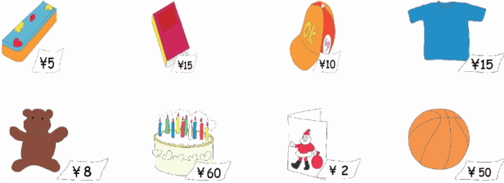
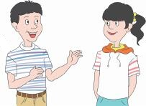
2. Let's do it!
2. Ask and answer.
What do you want to buy for your friends?
I want to buy two caps and a book.

Slide 13
一、问句答语对对碰。
( ) (1)How will Li Ming go home?
( ) (2)What does he want to buy?
( ) (3)How many gifts do you need?
( ) (4)How much is your pen?
B
C
A
D
A. Five. B. He will fly home.
C. He wants to buy some toys. D. It’s two yuan.

Slide 14
二、给单词宝宝排排队。
（1）many, do, need, caps, how, you(?)
______________________________
（2）blue，some，crayons，here，are（.）
______________________________
How many caps do you need?
Here are some blue crayons.

Slide 15
三、选出能替换画线部分的选项。
( ) I like red best. How about you?
A．When about
B．What about
C．Where about
B

Slide 16
本节课我们学习了以下知识，请同学们一定加强巩固，以便能和同学们进行灵活交流哦！
重点短语：buy sth. for sb.
重点句式：How many gifts do you need, Li Ming?
Here are some little flags.
What about these caps?

Slide 17
1 熟记本节课所学的句型、短语，必须会听、说、读、写。
2 将At the shop的对话朗读流利。
3 完成配套的课后作业。

