Slide 1
The food festival is now open!
Unit 7 Topic 3
Section A
WWW.PPT818.COM

Slide 2
n.客人，宾客
好心的
The kind-hearted children got ready for the food festival
two weeks ago. I think many guests will come to the food festival and the food for sale must be delicious.
待售，出售
Can you imagine what they will serve in the food festival?
I think that they will serve…

Slide 3
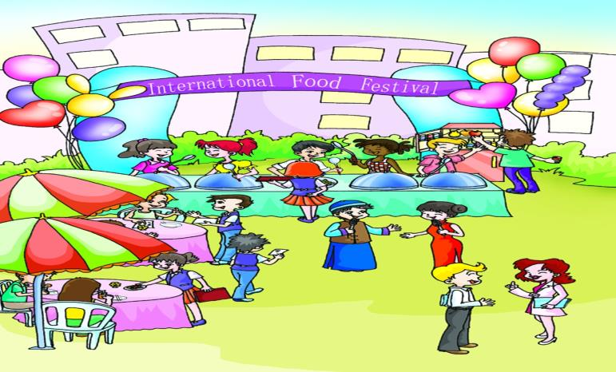
☆What can you see?
☆ How do they feel?
☆Can you tell me what food you heard?
☆There is a boy and a girl in the center.
Do you know what they say?

Slide 4
Useful expressions of 1
lady
n.女士，夫人
gentleman
n.绅士，先生
Ladies and gentlemen. Welcome to Beijing International School ! The first International Food Festival is now open! Thanks for coming! Let’s wish them success! Enjoy yourselves!

Slide 5
1b
Listen to 1a and fill in the blanks.
Event | The ________ International Food Festival
Place | Beijing International School
Action | prepare different delicious foods for sale, such as fried _______, __________ pies and _________ curries.
Purpose | raise________ to send to Free the Children for a school in Kenya.
first
rice
apple
Indian
money

Slide 6
1c
Read 1a and act out 1a as hosts with your partner.
1. Ladies and gentlemen, welcome to Beijing International School! The first International Food Festival is now open! Thanks for coming! I hope everyone has a wonderful time!
2. Look! Many different delicious foods are for sale, such as fried rice, apple pies and Indian curries. All the guests will enjoy them.
3. The students are very kind-hearted. They will send all the money to Free the Children for a school in Kenya. Let’s wish them success!
4. Enjoy yourselves!

Slide 7
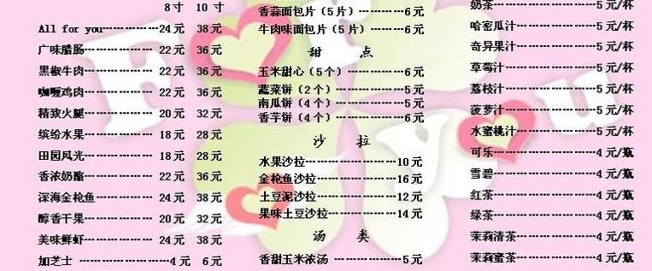
INTERNATIONAL
FOOD FESTIVAL
Beijing Roast Duck 38.00
Corn salad 5.00
Vegetable soup 3.50
Tsingtao beer 10.00
Tea 2.00
Rice(2) 2.00
TOTAL: ￥60.50
Thank you for coming!
menu
n. 菜单
bill
n. 账单
May I have the bill, please?
have the bill 付帐
还可以说 get/pay the bill

Slide 8
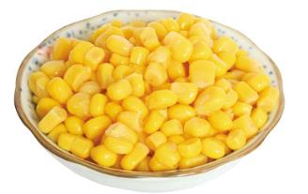
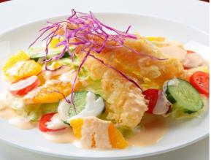
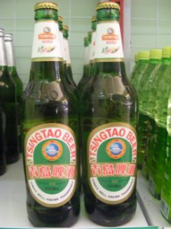
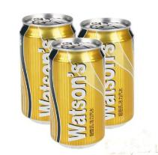
corn
n.谷物，谷粒
salad
n.蔬菜沙拉
soft drink
n.清凉饮料(不含酒精)
beer
n.啤酒

Slide 9
2a
Look at the bill and complete the conversation.Then listen and check.
(Mr. and Mrs.Yang come to the food festival.They are reading the menu.)
Waitress:May I take your order?
Mr.Yang:Sure.We'd like_______________,________and ___________.
Waitress:Which kind of drink would you like,beer or a soft drink?
Mr.Yang:I'd like a bottle of Tsingtao beer.
Mrs.Yang:I think I'll have ____________.
Waitress:Anything else?
Mrs.Yang:Two bowls of ______.
Waitress:OK.Thanks for your order.
(Twenty minutes later)
Mrs.Yang:Mm,how delicious! The Beijing Roast
Duck smells nice and tastes delicious.
(Forty-five minutes later)
Mr.Yang:May I have the bill,please?
Waitress:Let me see.It's ¥________.
Mr.Yang:Here you are.
Waitress:Here's your change.Thanks for coming!
Beijing Roast Duck
corn salad
vegetable soup
a cup of tea
INTERNATIONAL
FOOD FESTIVAL
rice
Beijing Roast Duck 38.00
Corn salad 5.00
Vegetable soup 3.50
Tsingtao beer 10.00
Tea 2.00
Rice(2) 2.00
TOTAL: ￥60.50
Thank you for coming!
60.50

Slide 10
Useful expressions of 2a
May I take your order?
Which kind of drink would you like,beer or a soft drink?
Anything else?
Thanks for your order.
May I have the bill, please?
Here's your change.
Thanks for coming!
Project

Slide 11
2b
Read 2a and fill in the blanks.
Mr. and Mrs. Yang came to the food festival. Mr.Yang ________ Beijing Roast Duck,corn salad and _____________. Mrs.Yang ordered two _________________. It took about ________ minutes to prepare the dishes.They thought that the Beijing Roast Duck was nice and______________. Mr.Yang drank _______________________, and Mrs.Yang drank ______________. Mr.Yang paid the _______.They enjoyed themselves.
ordered
vegetable soup
bowls of rice
twenty
delicious
a bottle of Tsingtao beer
a cup of tea
bill

Slide 12
3
Listen to the conversation and complete the table.
Person | Food | Drink
Lucy | a___________and a(n)__________pie | a glass of ___________
mother |  | a glass of ___________
father | two___________, a bowl of_______ | a bottle of___________
Total:¥_______
hamburger
black tea
cheese
milk
sandwiches
beer
rice
63

Slide 13
Project
每组抽一名学生扮服务员，带上菜单到其他组服务，将点菜结果记录下来。
Table
Name | Food |  |  |  |  |  |  | Drink
 | Rice | Chicken | Roast Duck | Vegetable soup | Beef curry | Fish curry | others | Beer | Coffee | Wine | Juice | others
Useful expressions

Slide 14
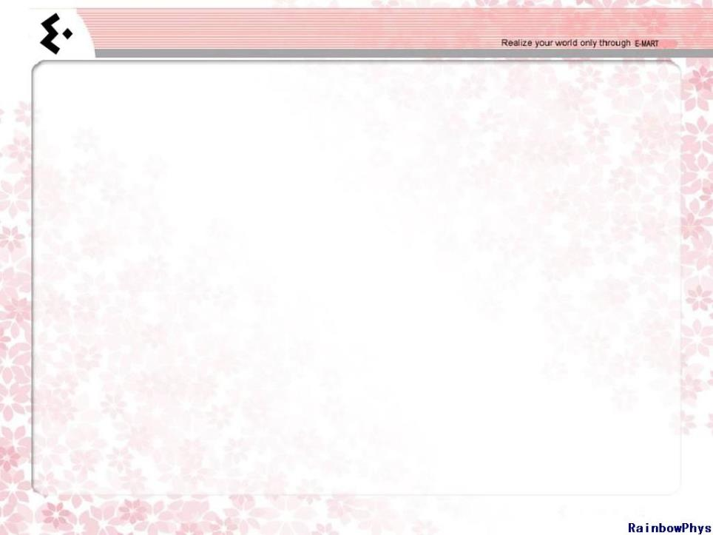
Exercises in class
根据句意、首字母或汉语提示填空。
1.Which kind of drink would you like, b____or a soft drink?
2.Where is the m_____of your restaurant? I want to order something to eat.
3.There are many things on s_____in the shop. Please come and have a look!
4.Many people obey “ L______first” in western countries.
5.— May I have the b_____?
— Let me see. It’s 78 yuan.
6.Some _________（绅士）are drinking beer in a bar.
7.I want to drink a glass of _________（软饮料）instead of beer.
8.The host is having dinner with his g______.
eer
enu
ale
adies
ill
gentlemen
soft drink
uests

Slide 15
Exercises in class
三分钟阅读
MENU
Food Drinks Desserts
Hamburger ＄3.50 Coke small ＄1.65 Ice-cream ＄3.05
Hot dog ＄2.85 large ＄1.85 Chocolate ＄3.10
Turkey ＄4.05 Orange juice Apple pie ＄4.15
Bread and butter ＄3.10 small ＄1.95 Fresh fruit ＄3.80
Egg sandwich ＄3.80 large ＄2.15
Vegetable ＄5.10 Coffee ＄2.10
Tea ＄2.00

Slide 16
根据短文内容，回答问题。
C
( )1.If you have only three dollars, which food can you buy?
A. A chocolate B. An egg sandwich
C. A hot dog D. An apple pie
( )2.Jeff has ordered a hamburger, a large orange juice and two
apple pies. How much will he have to pay?
A. ＄13.95 B. ＄13.75 C. ＄ 13.65 D. ＄9.80
( )3.If you want to eat healthily, which is the most proper meal?
A. Some vegetables, sandwiches and fresh fruit.
B. Lots of chocolate and some coffee.
C. Some fresh fruit and lots of ice-cream.
D. Nothing but meat.
( )4.The food on the menu above is a kind of ______ food.
A. Chinese B. Japanese C. Indian D. American
( )5.Which is the most popular drink in China?
A. Coke. B. Coffee. C. Tea. D. Milk.
A
A
D
C

Slide 17
Summary
We learn:
1. Some new words:
lady,gentleman,sale,guest,kind-hearted,
menu,soft drink,beer,bill,corn,salad
2.Some expressions about the food festival:
Ladies and gentlemen, welcome to Beijing International School!
The first International Food Festival is now open!
Thanks for coming.
Let’s wish them success!
Enjoy yourselves!
We can:
◆Order and offer food and drinks:
May I take your order?
We’d like Beijing Roast Duck ,corn salad and vegetable soup.
Anything else?
Thanks for your order.
May I have the bill, please?
Here's your change.

Slide 18
Homework
1.Collect the words about foods and drinks you know and classify them to make a list.
2.Read 1a and 2a aloud,try to repeat.
3.Finish Section A in your workbook.
4.Preview Section B.

Slide 19
Thank you !

