Slide 1
八年级 英语 上
Unit 3 A day out
Reading (1)
WWW.PPT818.COM

Slide 2
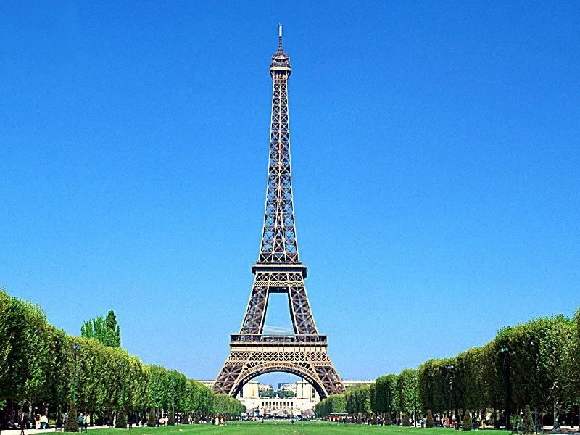
France
the Eiffel
Tower

Slide 3
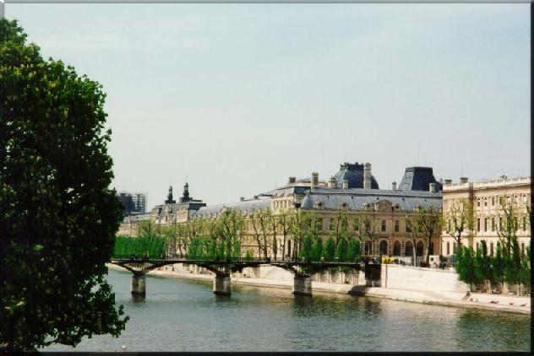
France
the River Seine

Slide 4
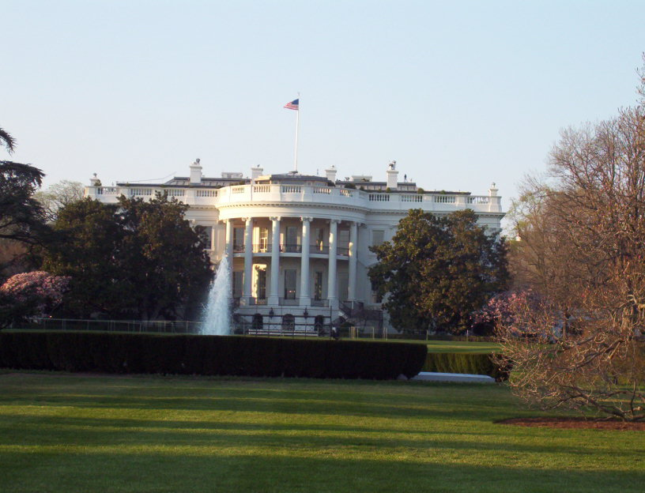
the U.S.A
the White House

Slide 5
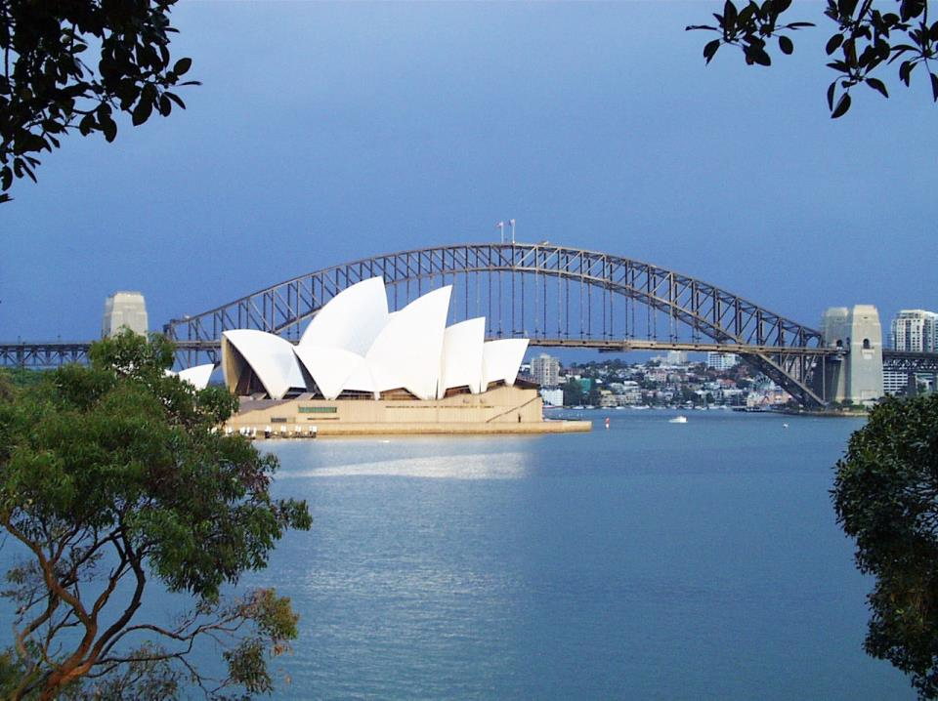
Australia
the Opera House
&
the Harbour Bridge

Slide 6
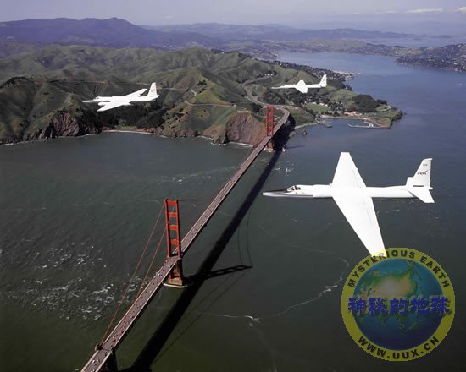
The Golden Gate Bridge
the U.S.A

Slide 7
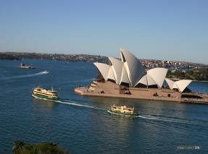
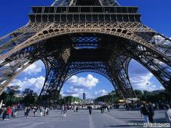
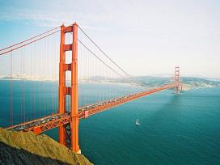
the Opera House
dream
the Eiffel Tower
the White House
the Golden Gate Bridge

Slide 8
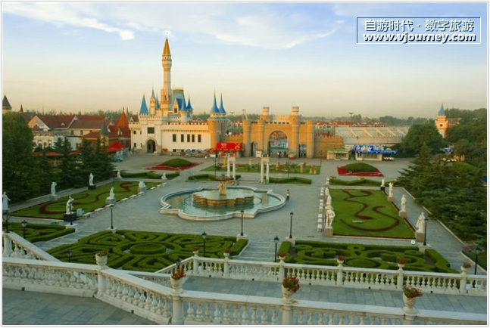
Around the world in a day
the World Park in Beijing

Slide 9
Read and answer these questions
1. Who invited Linda to join the school trip?
2. How long did it take to get to the World Park by bus?
3. What’s the model Eiffel Tower made of?
4. Was it an amazing day? Why?
Mr Wu.
About two hours.
It’s made of steel.
Yes, it was. Because they saw the main sights
of the world in just one day.

Slide 10
Mini dictionary
1. join
2. journey
3. boring
4. finally
5. arrive at
6. whole
7. main
8. sights
d
a. full
b. get to a place
c. places of interest
d. take part in
e. not interesting
f. a long trip
after a long time
h. most important
f
e
g
b
a
h
c

Slide 11
Scanning
Read Para1-2 and fill in the table
A trip to the World Park in Beijing
Who
Weather
How
How far
Linda and the Class 1, Grade 8 students
a fine warm day
by bus
two hours by bus

Slide 12
Scanning
Read Para3-5 and answer the questions
What did Linda see in the World Park?
Models of more than a hundred places of interest from all over the world.
small and wonderful
The model Eiffel Tower.
steel, tall
The model Golden Gate Bridge.
great
The song and dance shows.
wonderful

Slide 13
after the trip
1. How can Linda’s mother know more about the
trip?
She can see some photos of the trip on the Internet.
2. Who put the photos on the Internet?
Daniel.

Slide 14
True or False
1
7
2
6
3
5
4

Slide 15
( ) 1. Linda and Kitty went to World Park by themselves.
F
_____________
With Kitty’s classmates

Slide 16
F
( ) 2. Linda didn’t enjoy the day very much.
__________
enjoyed

Slide 17
F
2 hours
( ) 3. It took half an hour to get to the World Park from school.

Slide 18
( ) 4. The models in the park are small but wonderful.
T

Slide 19
F
( ) 5. The model Eiffel Tower is made of wood.
______
steel

Slide 20
( ) 6. The model Golden Gate Bridge looked just like the real one in the USA.
T

Slide 21
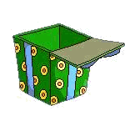
The students are talking with Daniel in their QQ Group. Complete the missing parts.

Slide 22
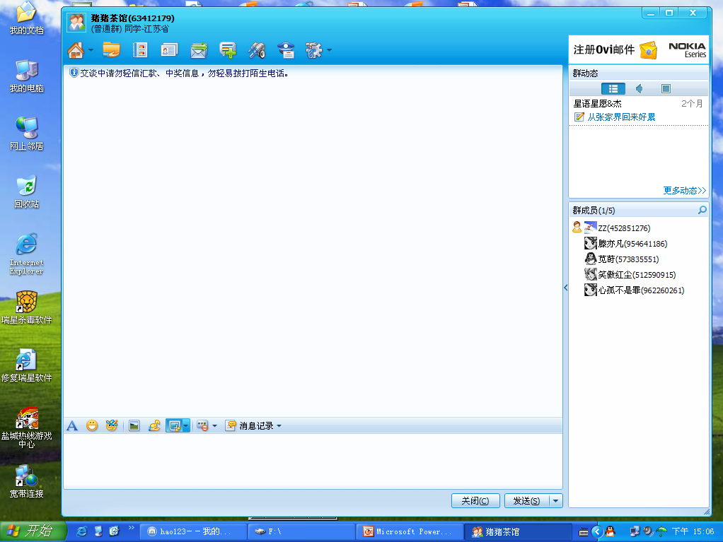
David 19:56:12
Hi, everyone, come out!
Mary 19:56:35
Who did you go with today?
David 19:56:40
I went to the World Park with Linda and my classmates.
Mary 19:56:45
Great. How did you go there?

Slide 23
David 19:57:18
By bus.
Rose 19:57:22
Did Linda enjoy it?
David 19:57:58
Yes, but it was a little boring on the way. There was too much traffic.

Slide 24
Rose 19:58:00
How long did it take to get there?
David 19:58:04
Two hours.
Rose 19:58:26
Great! How many models of places of interest are there?
David 19:59:02
Over one hundred.

Slide 25
Peter 19:59:58
Which places of interest did you see?
David 20:00:15
The model Golden Gate Bridge, the model Eiffel Tower and many other interesting places.

Slide 26
Tom 20:01:35
What did you learn from the trip?
David 20:02:18
We learnt a lot about different cultures.
Tim 20:02:35
Did you take any photos ?
David 20:02:48
Yes, of course.

Slide 27
Discussion
Why do people like travelling?
Travelling is not just for fun.
It helps us know people, nature, history…
It can open our eyes, learn more knowledge and
improve ourselves.

Slide 28
Homework
1. Tell Linda’s trip to your friends .
2. Find out more places of interest in the world and talk about them with your friends.
3. Finish the exercises on Page 33-34.

