Slide 1
Unit 8 Save Our World!
Protect Our Environment
WWW.PPT818.COM

Slide 2
Learning Targets
1. Be able to use the words and phrases:
leak, tap, beer, truck, recycling, factory, unlike, take a shower, again and again, put...in... , ride a/one's bike to… , make a change, make a difference
2. Learn to protect the environment around us
3. Be able to write a passage about protecting environment
4. Learn some key sentences:

Slide 3
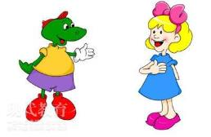
· We use them again and again, or we put other
garbage in them.
· I ride my bike to school every day.
· Unlike other types of transportation, a bike
doesn't make any pollution.
· In fact, if each of us makes a small change in
our life, we can make a big difference to our
environment.

Slide 4
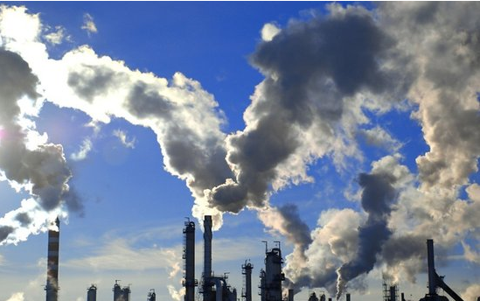
Lead in
Look at the picture below. How do you feel?

Slide 5
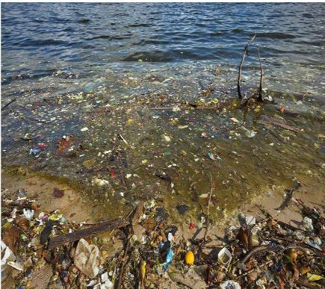
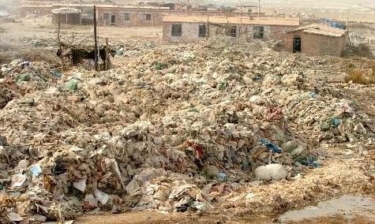

Slide 6
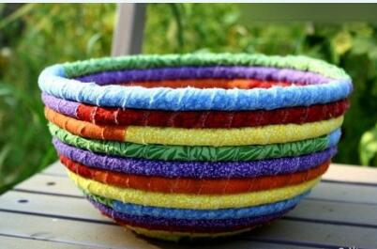
There are some ideas for reducing waste.
The recycling symbol
The recycling of the old cloth

Slide 7
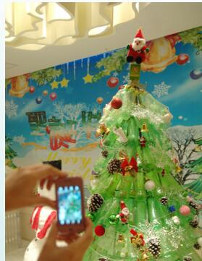
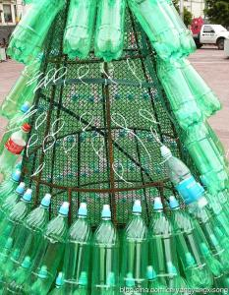
Christmas Trees Made With Recycled Bottles

Slide 8
Words and expressions
leak
tap
beer
truck
recycling
factory
unlike
v. & n. 漏；渗漏
n. 龙头；阀门
n. 啤酒
n. 货车；手推车
n. 回收利用
n. 工厂
prep. 不像；与……不同

Slide 9
take a shower
again and again put...in...
ride a/one's bike to
make a change
make a difference
淋浴
再三地；反复地
把……放在……里
骑自行车去……
做出改动/改变
有影响;起（重要）作用

Slide 10
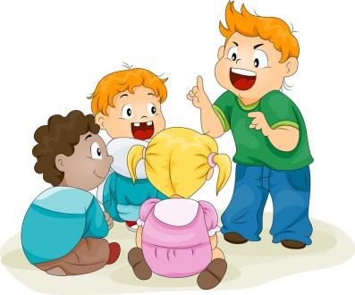
THINK ABOUT IT
Is your hometown clean enough?
Do you have any ideas for reducing waste?

Slide 11
Presentation
Listen and read the passage.
My name is Katie.
I think everybody should take care of the environment. I live in Edmonton. It is a city in Canada. The air and water are clean in Edmonton, but sometimes people waste a lot.
What do we waste the most？Paper, I think. People waste water, too. I don't want to waste

Slide 12
water. I try to save water in many ways. I take short showers. I often check to make sure there aren't any leaks, and I never forget to turn off the tap.
Do we recycle at home？Yes！We sort our pop cans, beer bottles and waste paper. A truck picks up our recycling every week. It is made into new things. We reuse our plastic bags, too. We use them again and again, or we put other garbage in them.
Cars and factories make the most pollution. I

Slide 13
think there are too many cars in Edmonton. More people should ride bikes or take buses. I ride my bike to school every day. Unlike other types of transportation, a bike doesn't make any pollution. Buses make some pollution, but lots of people can travel on a bus. Buses make less pollution than cars.
In fact, if each of us makes a small change in our life, we can make a big difference to our environment.

Slide 14
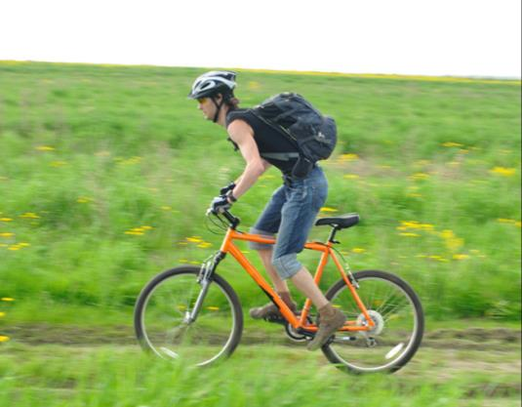
It's not too hard to protect the environment. We just need to try.

Slide 15
Let’s Do It!
Read and tick the points mentioned in
the lesson.
1
 sort garbage at home
 reuse plastic bags
 bring your own bag when you go shopping
 ride bikes or take buses
√
√
√

Slide 16
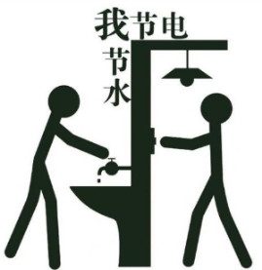
 pick up rubbish off the street
 turn off the lights when you leave a room
 turn off the television and shut down the computer when you are not using them
 take short showers
√

Slide 17
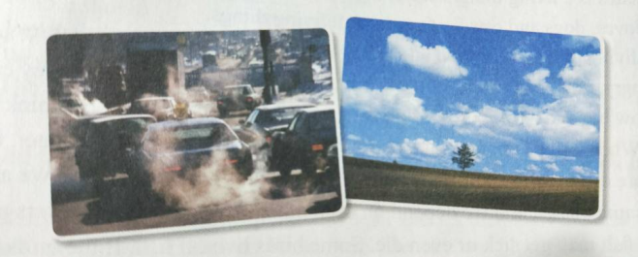
Compare the two pictures.Tick the words to describe the differences.
2
pollution clean garbage air car sky
transportation travel tree environment

Slide 18
What can we do to help the
environment？Read and match.
3
open a window instead of turning on the air conditioning.
We should
use both sides of the paper.
throw garbage on the ground.
sort the waste before throwing it away.
We shouldn't
cut down trees in forests.
turn off the tap when we are brushing our teeth.

Slide 19
Language points
1.We use them again and again，or we put other garbage in them.
(1)again and again是固定搭配，意为“反复地，再三地”。
例：I like this novel very much，so I read it again and again.
我非常喜欢这本小说，所以我读了一遍又一遍。

Slide 20
(2)put…in…把……放在……里。
例：Please put your shoes in the shoe cabinet.
请把你的鞋子放进鞋柜。

Slide 21
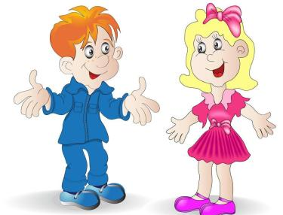
2. I ride my bike to school every day.
ride a/one's bike to…骑自行车去…… 它相当于go to…by bike或go to…on a bike。
例：My mother rides a bike to work every day.
我妈妈每天骑自行车去上班。

Slide 22
3. Unlike other types of transportation, a bike doesn't make any pollution.
unlike prep.不像。它是like(像)的反义词。
例：Unlike her mother, she doesn't like watching TV.不像她妈妈，她不喜欢看电视。

Slide 23
4. In fact, if each of us makes a small change in our life，we can make a big difference to our environment.
(1) make a change 意思是“做改动，改变”
例：Can I make a change in my reservation?
我能改变预定吗？
I think we need to make a change.
我觉得我们得做些改变。

Slide 24
(2) make a difference意为“有影响；起(重要)作用”。
例：As teachers, you must believe that you can make a difference to the lives of your students.
身为教师，你们必须坚信你们能够影响学生的一生。

Slide 25
Writing
如何写关于环保的文章：
第一，确定环保主题。
第二，寻找问题事物的问题。
第三，如何去解决这些环保问题。
第四，人们都做了哪些环保活动，取得了怎么样的成效。
第五，说明环保需要长久的坚持下去，结尾倡导人们都来环保。

Slide 26
Example
在学校，一些同学不注意保护学校环境，使学校环境受到了损害。请你根据所给内容要点，以 “Keep Our School Clean” 为题用英语写一篇80词左右的短文。
内容要点：1.学校环境越来越差。2.随地吐痰和乱扔垃圾。3.毁坏花草树木。4.多植树，循环使用教材。5.保护学校环境。(广西玉林、防城港、崇左中考)
参考词汇：1. worse 2. spit (吐痰) 3. destroy(破坏) 4. do something to protect…

Slide 27
Keep Our School Clean
As we all know, it's very important for us to keep our school clean and tidy. Because we are middle school students, it's our duty to keep the school clean. However, our school environment is becoming worse and worse. We can see that there is much waste on the ground, such as plastic bags, cans, old batteries and so on.

Slide 28
Therefore, we have to protect the environment as soon as possible. We can't spit anywhere and we shouldn't throw rubbish anywhere, for it's very rude. We should protect the trees and keep off the grass. At the same time, we need to plant more trees. We can also reuse our books. it is a good way to reduce the waste of natural resources. In this way, I'm sure that our school will be more and more beautiful in the future.

Slide 29
Exercises
根据汉语提示完成句子。
make a difference
What you do now can _________________ (起重要作用) to your future.
My grandmother tells me the story ______________ (再三地).
She knew in that moment that she needed to _____________ (做出改变).
Whether he _____ ___ _____(骑车) or takes a bus, he always attends class on time.
again and again
make a change
rides
a
bike

Slide 30
Summary
1. Learn some new words and expressions.
2. Be able to understand the passage .
3. Be able to give suggestions on how to protect our environment.

Slide 31
Homework
1. Finish the exercises of Lesson 46.
2. Preview next lesson.
3. Make a poster about "begin from us" to introduce how to protect the environment.

