Slide 1
Unit 7
Teenagers should be allowed to choose
their own clothes.
Section A Period 1 1a-2d
WWW.PPT818.COM
Notes:
1

Slide 2
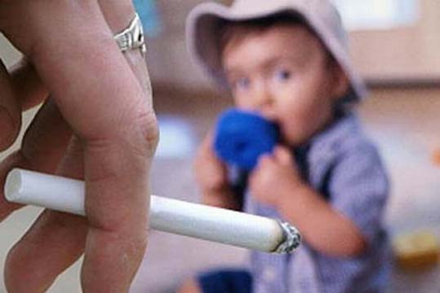
Look at these pictures below, what should teenagers do or not do?
smoke

Slide 3
drink

Slide 4
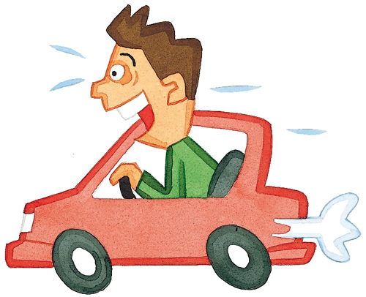
drive

Slide 5
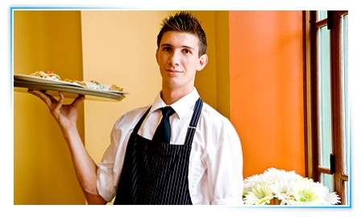
have part-time jobs

Slide 6
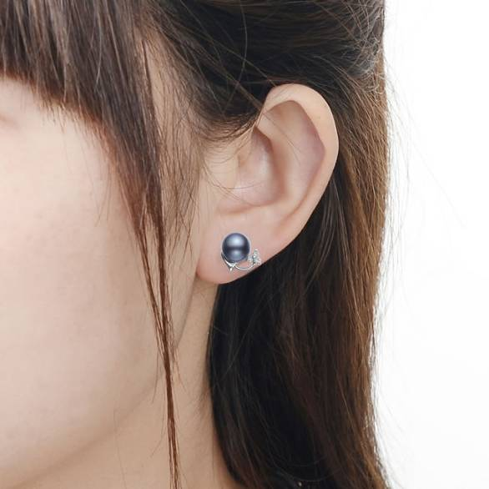
choose clothes
get ears pierced

Slide 7
Read the statements below. Circle A for agree or D for disagree.
1a
1. Teenagers should not be allowed to smoke.
2. Sixteen-year-olds should be allowed to drive.
3. Students should not be allowed to have part-time jobs.
4. Sixteen-year-olds should be allowed to get their ears pierced.
5. Teenagers should be allowed to choose their own clothes.
A D
A D
A D
A D
A D

Slide 8
1b
Listen and circle T for true or F for false.
1. Anna can go to the shopping center by
bus.
2. Anna wants to get her ears pierced.
3. Anna wants to choose her own clothes.
T F
T F
T F

Slide 9
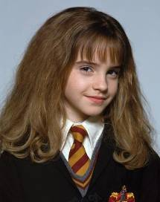
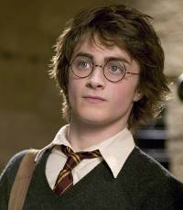
Look at the statements in 1a and make conversations.
1c
I don’t think sixteen-year-olds should be allowed to drive.
I agree. They aren’t
serious enough.

Slide 10
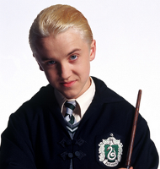
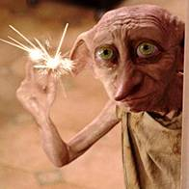
I don’t think twelve-year-olds should be allowed to get their ears pierced.
I agree. It’s too silly to wear earrings in the school.

Slide 11
Do you agree or disagree? Why?
Parents should allow teenagers to make their own decisions.
Teenagers should be allowed to go out with their friends.
Parents should allow sixteen-year-olds to smoke.
Sixteen-year-olds should be allowed to drive.
Parents should allow fourteen-year-olds to have part-time jobs.
Fifteen-year-olds should be allowed to choose their own clothes.

Slide 12
What does Molly think of Kathy’s statements? Listen and circle A for Agree, D for Disagree or DK for Doesn’t Know.
2a
Kathy
Molly
1. Sixteen-year-olds should not be allowed to work at night.
A D DK
2. Larry shouldn’t work every night.
A D DK
3. He should cut his hair.
A D DK
4. He should stop wearing that silly earring.
A D DK
5. He doesn’t seem to have many friends.
A D DK

Slide 13
Listen again. What are Kathy’s and Molly’s reasons? Number their reasons in the correct order.
2b
__ It looks cool.
__ Young people need to sleep.
__ He needs to spend time with friends.
__ He needs time to do homework.
__ It doesn’t look clean.
4
1
5
2
3

Slide 14
Make a list of things teenagers should and should not be allowed to do. Discuss your list with your partner.
2c
My list
should be allowed | should not be allowed

Slide 15
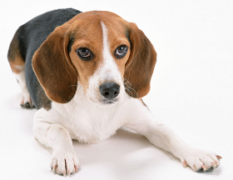
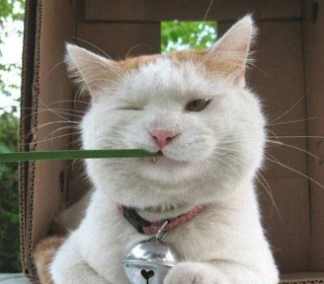
2c
Do you think teenagers should be allowed to work at night?
Oh, I disagree with you. Teenage boys never get tired.
Well, maybe. But I think they should not work every night.
That’s true. But they need time to have a rest.

Slide 16
2d
Role-play
1. Role-play in groups;
2. Role-play in front of the class.

Slide 17
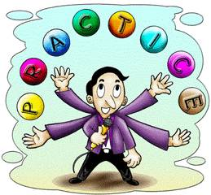
Fill in the blanks and try to retell the text.
Sandy and Wu Lan are really ________
about ________ the famous paintings by Picasso. Sandy wants to bring her new camera to take _______, but it is not _________ to take photos in the museum. Sandy thinks that she may be allowed to take photos ______ she doesn’t _______a flash.
excited
seeing
photos
allowed
if
use

Slide 18
sixteen-year-olds 名词
Eighteen-year-olds should be allowed
to drive. 年满十八岁者应该被允许开车。 Even five-year-olds do not want a party every day. 就算是5岁的孩子也不想天天聚会。
sixteen-year-old 通常只做形容词
Sixteen-year-old Hans stepped forward. 十六岁的汉斯向前走着。 Mike is a sixteen-year-old boy. 迈克是一个16岁的男孩。

Slide 19
Sixteen-year-olds should be allowed to get their ears pierced.应该允许16岁的孩子穿耳洞。
get是使役动词，get something done是一个常见的固定搭配，常用来表达“请别人做某事；使某事完成(自己也可能参与)”，something与done逻辑上为动宾关系。
Go and get your hair cut.
去找人理一下发。

Slide 20
get sb. to do sth. 使某人干某事
I can't get anyone to do the work properly.
have sb. do sth让某人去做某事
I had him arrange for a car.
have sb. doing sth.让某人持续做某事
He had us laughing all through lunch.
have sth. done 让某事做成
We had the machine mended just now.

Slide 21
Homework
Use the sentence pattern “should be allowed to” to write five sentences to show what you want most to be allowed to do and the reasons.

Slide 22
Thank you!

