Slide 1
Unit5 I like those shoes.
人教精通版四年级上册
WWW.PPT818.COM

Slide 2
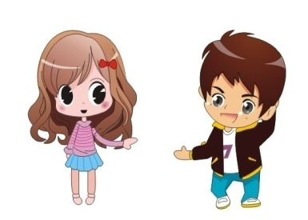
Review
Play a game
Show me your cap.
I say you do

Slide 3
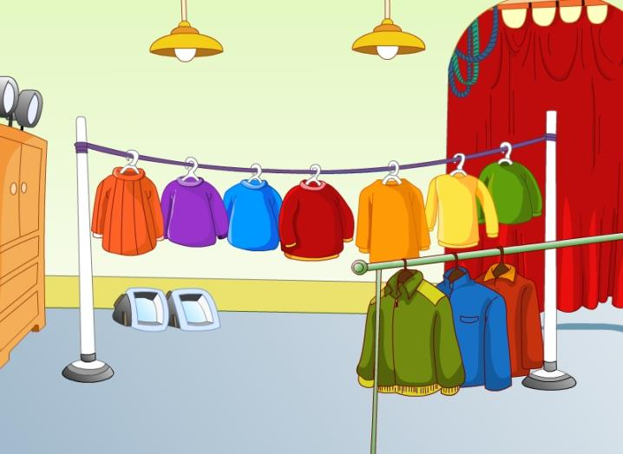
Lead-in
Free talk
What clothes can you see?

Slide 4
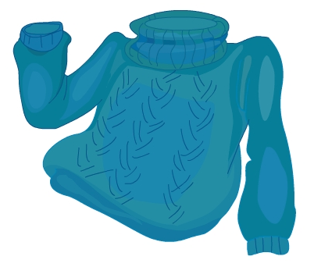
Presentation
Let’s learn
sweater
Do you have a sweater? What colour is it?

Slide 5
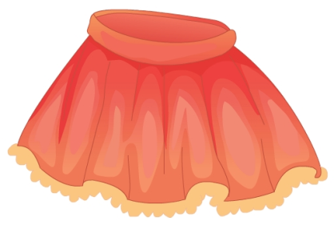
Presentation
Let’s learn
skirt
Do you have a skirt? What colour is it?

Slide 6
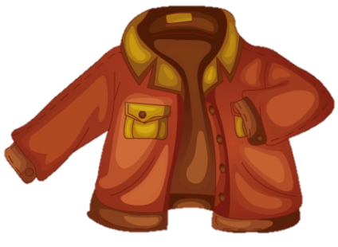
Presentation
Let’s learn
jacket
Do you have a jacket? What colour is it?

Slide 7
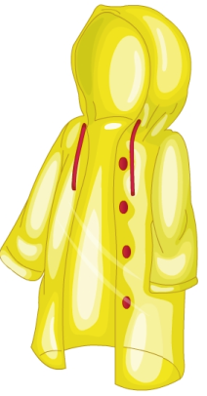
Presentation
Let’s learn
raincoat
Do you have a raincoat? What colour is it?

Slide 8
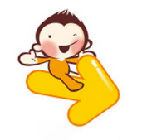
Practice
Game 1
大小声
skirt sweater jacket raincoat

Slide 9
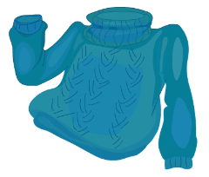
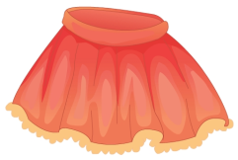
Practice
Game 2
What’s missing?

Slide 10
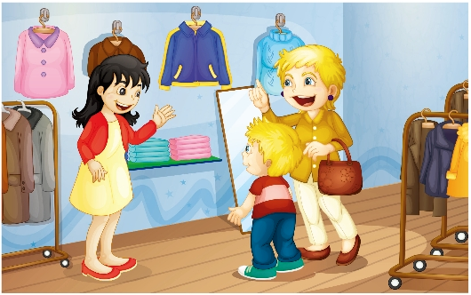
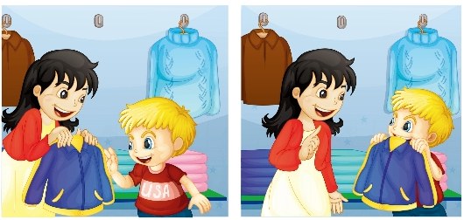
Presentation
Guess! What are they talking about?

Slide 11
Presentation
Listen and imitate
2
1
Please show me that jacket.
Can I help you?

Slide 12
Presentation
Listen and imitate
3
Here you are.
5
Can I try it on?
4
Thank you.
Sure!
6

Slide 13
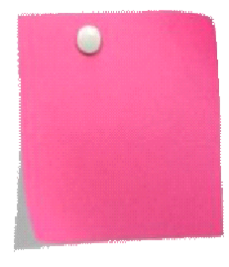
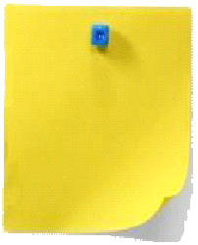
Practice
Let’s read
1
2
3
Read together.
(齐读)
Read in roles.
（分角色读）
Read in groups.
(分组读）

Slide 14
Show time
三人一组试着来表演，其他同学来评价。
 | 模仿录音中的语音语调，有感情地朗读。
 | 可以脱离课本，适当改动其中部分，语音地道。
 | 适当添加内容，意思完整，有创新，表演生动。
Good
Great
Excellent

Slide 15
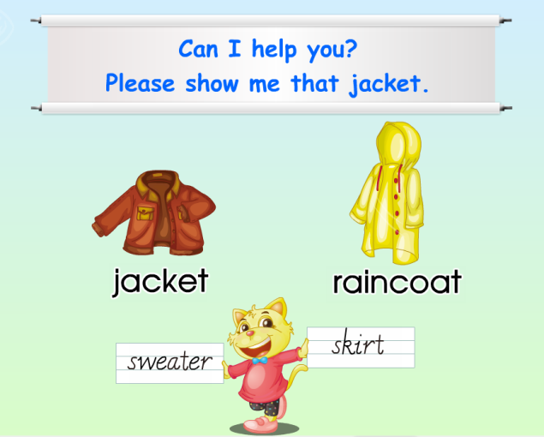
Practice
Just read and write

Slide 16
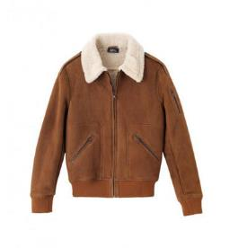
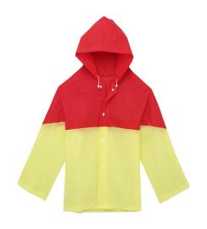
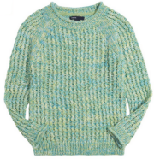
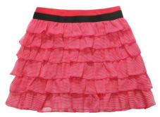
Practice
Look and match
raincoat
jacket
skirt
sweater

Slide 17
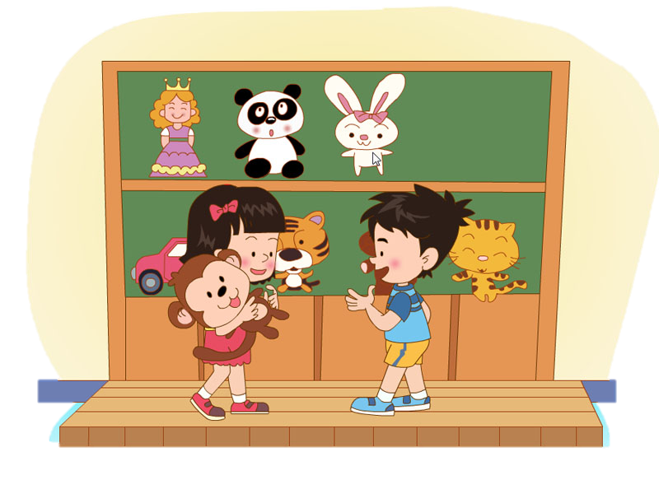
Practice
Look and say
Please show me that toy ______.
monkey
____________?
Can I help you
_________!
Here you are.
Thank you

Slide 18
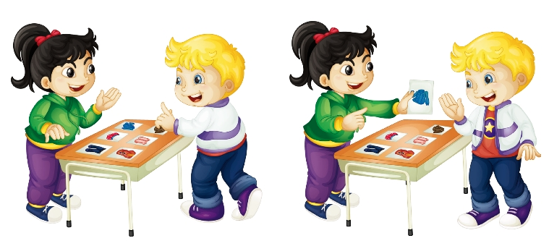
Practice
Let’s play
1
2
Can I help you?
Please show me the sweater.
3
Here you are.
4
Thank you.

Slide 19
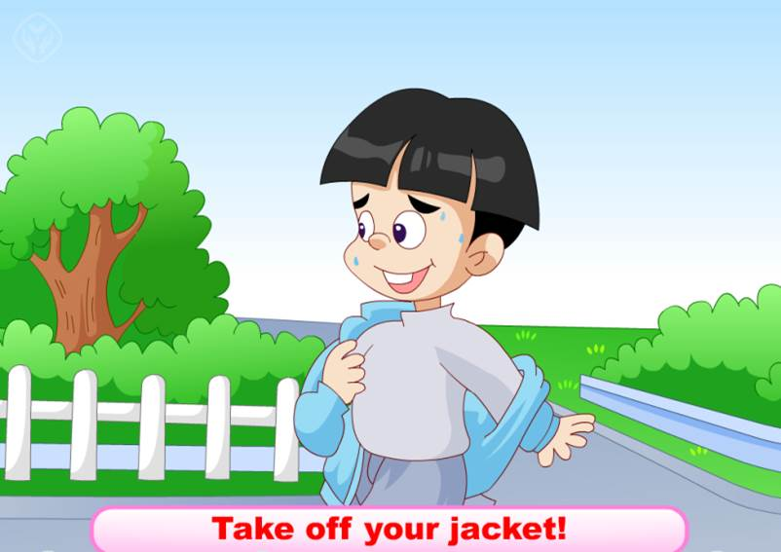
Practice
Look and do

Slide 20
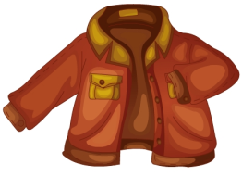
Summary
本课学习的着装类的单词有：
jacket
raincoat

Slide 21
Summary
本课学习的有关购物常用的礼貌用语是什么？
—Can I help you?
—Please show me ...

Slide 22
Homework
1. 跟读Just talk部分的课文录音，并注意语音、语调。
2.试着用所学的购物用语，和同桌一起编一个简短的有关购物的口头对话。
3. 预习Lesson 28。
Close

