Slide 1
Lesson 29
How to Push a Product
WWW.PPT818.COM

Slide 2

Think about it!
• What is important for pushing a
product?
If you had your own product to sell,
how would you push it?

Slide 3


What does “push a product” mean?
Warm-up
It means “to try to sell it”.

Slide 4
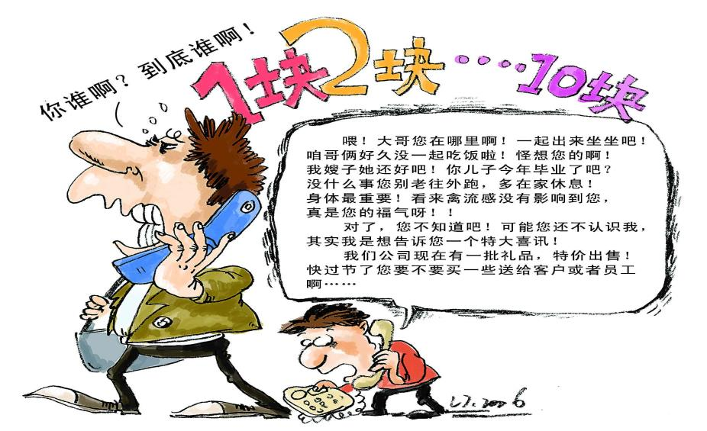
How would you push your product?

Slide 5



Advertisement

Slide 6


Advertisement

Slide 7

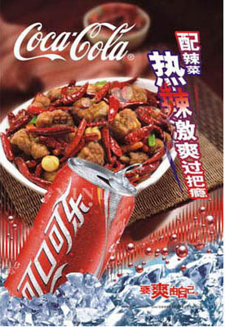
What do we do advertisements?
We use them to push products or ideas.
That’s a good way to push them.
There are some very famous advertisements that
help the sell the product very well.

Slide 8

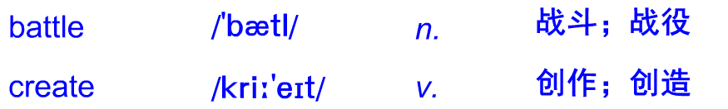
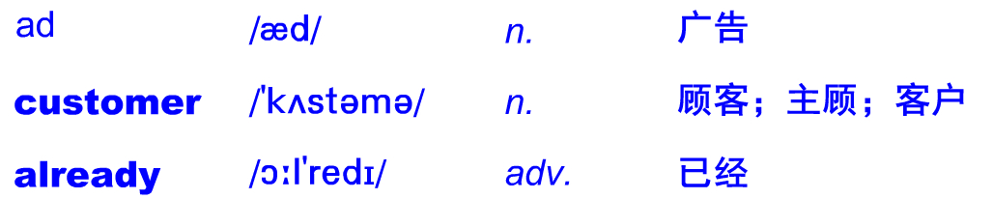
Words & expressions

Slide 9
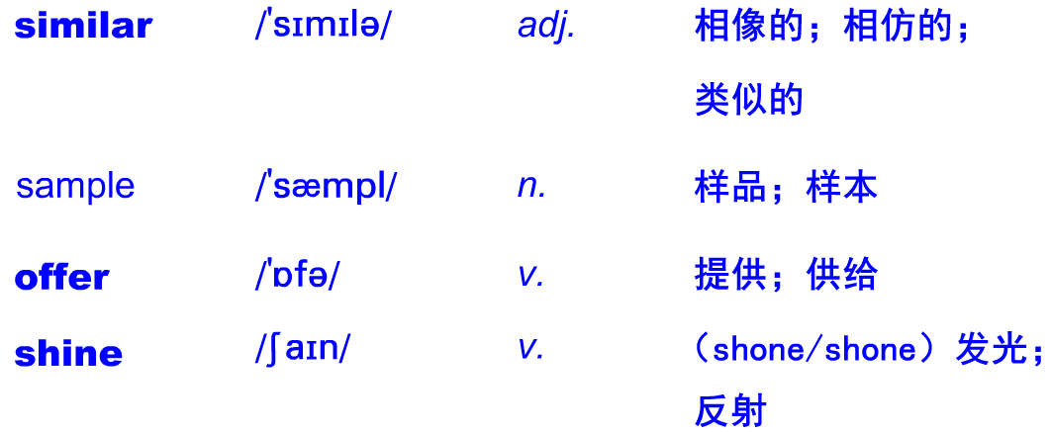
Words & expressions

Slide 10
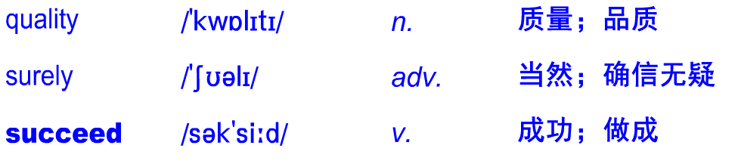
Words & expressions

Slide 11
Listen to the dialogue.
After a lot of hard work, you finally have your product. But that’s only half the battle. Now you have to get people to buy it.
Is your product easy to use? How can your product improve people’s lives? Why should people buy YOUR product? Remember, you need to make your product stand out. So tell people what is special about it. How can you do that? Here are a few suggestions.

Slide 12
Create an ad. First, study your customers’ ages, interests and other information. Second，choose a type of ad — TV, bus, magazine, newspaper or Internet. Third, decide what your ad will tell people about your product. Find ways to catch their eye.
Go to trade shows and present your product. People coming to trade shows already have an

Slide 13
interest in similar products. They can experience your product, enjoy it and even come to love it.
Push your product using samples and good deals. People get to know the advantages of your product after they experience using it. Offering samples and deals will get you more customers.
These suggestions can make your product

Slide 14
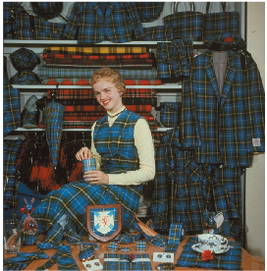
really shine. However, good quality is the
most important thing. With a good quality product and excellent advertising, you will surely succeed.
May I help you?
What would you like to buy?

Slide 15
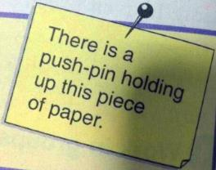

Learning Tip
If you “push” a product, what are you doing? Well, if it’s a push-pin, you may be really pushing it. But if you’re “pushing ” a product, you are trying to sell it.

Slide 16
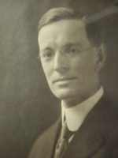

Can you guess who he is?
Push-pin
他就是发明图钉的发明家。
He was the inventor who invented the push-pin.

Slide 17
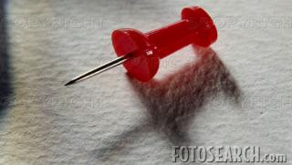
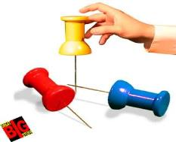
Who’s Edwin Moore?
埃德温 摩尔 发明了世界上第一个图钉。
the first
push-pin
Edwin Moore invented in the world.
What’s a push-pin?
图钉就是你用来“推”的“钉子”。
pin
push
A push-pin is a “ ” that you “ ”.

Slide 18

Where do we use a push-pin?
bulletin boards
“You push it into or .”
walls
你把它推进墙或者广告板。
Why do we use a push-pin?
posters, maps and other papers
“To hold up .”
为了固定住海报、地图和其他文件。
There’s a push-pin holding up this piece of paper.

Slide 19
Language points

Slide 20
Remember, you need to make your product stand out.记住，要使你的产品引人注目。 stand out意思是“引人注目;显眼”。例如：They were all pretty, but she stood out among them. 她们都很漂亮，但她却特别突出.
Red flags stand out brightly, set against the blue sky. 红旗在蓝天的映衬下显得分外艳。
stand out还可以表示“伸出:突出”。例如:
The pot has two handles standing out.
这个壶有两个突出的柄。

Slide 21
2. Find ways to catch their eye.
想办法吸引大家的 目光。
catch one’s eye意思是“引人注目;吸引某人注意； 吸引……的目光”，同义词组为：draw one’s attention (to)...例如：
Can you catch that girl’s eye?
你能引起那位女孩的 注意吗？
That postcard, a present from my grandfather, caught everyone’s eye.
那张明信片，一件来自我 祖父的礼物，吸引了每个人的注意。

Slide 22
3. People coming to trade shows already have an interest in similar products.
来贸易展览的人们己 经对类似的产品有了兴趣。
have an interest in意思是“对… 感兴趣”。
例如:
We all have an interest in playing chess.
我们都对下棋感兴趣。
The child has no interest in drawing.
这个孩子对绘画没兴趣。

Slide 23
4. Push your product using samples and good deals.
提供样品和优惠的条件来推广你的产品。
push one’s product意思是“推广某人的产品”。
例如：
It’s difficult to push their product in this area.
在这个地区推广他们的产品很难。
using samples and good deals 是现在分词短语，
在句中作方式状语，表示“以样品和提供优惠
条件的方式”。例如：
We can reach the apples on the tree using this
ladder. 我们可以用梯子来够到树上的苹果。

Slide 24
5. Offering samples and deals will get you more customers.
提供样品和优患条件会使你获得更多 的顾客。
offer此处为动词，意思是“提供”。例如：
He offered me a glass of wine.
他端给我一杯酒。
offer还可以表示“愿意;试图（做某事)” 。例如: They offered to help me.
他们农示想意帮助我。
He offered to lend me some books.
他表示要借给 我几木书。

Slide 25
6. With a good quality product and excellent advertising, you will surely succeed.
拥有优质的产品和完美的广告，你肯定会获得成功。
succeed为不及物动词，意思是“成功”，常 用结构：succeed (in) doing sth.成功做成某事；
succeed with sth. 在某方面获得成功。例如：
After so many years of hard work, he succeeded (in) being a famous scientist.
经过数年的努力，他终于成为一位著名的科学家。
He succeed with that difficult problem.
他成功地解答出那道难题。

Slide 26
Let’s Do It!
Read the lesson and write true (T) or
false (F)
1
Making your product is just half the
battle. ( )
2. There are only three ways to push a product. ( )
3. Customers learn the advantages of a product by using it. ( )
4. Only excellent advertising can help you succeed. ( )
T
F
T
F

Slide 27
Write down the topic sentences of
paragraph 3, 4 and 5.
2
 | Topic Sentence
Paragraph 3
Paragraph 4
Paragraph 5
Create an ad.
Go to trade shows and present your product.
Push your product using samples and good deals.

Slide 28
Complete the passage with the correct
forms of the words or phrases in the box.
3
customer similar offer
excellent stand out catch one’s eye
It’s not easy to make your product succeed. Because there are always ________ products on the market, you have to put in more effort. You should choose _________ customers, then
similar
specific

Slide 29
customer similar offer
excellent stand out catch one’s eye
create a perfect ad to _______________.
When they buy your product, ______ them good service. Remember, _________ advertising will always make your product __________ .
catch their eye
offer
excellent
stand out

Slide 30
Time for Reflection
push a product
stand out
catch one’s eye
have an interest in
推销产品
出色，杰出
吸引某人的目光
在…方面有兴趣

Slide 31
Exercise

Slide 32
Rewrite the sentences using “Simon says that...”
1. Will Danny improve his invention?
Simon says that Danny will improve his invention.
2. Will your product succeed?
_____________________________________
Simon says that your product will succeed.

Slide 33
3. Does he work hard in school?
_______________________________________
4. Is the girl going to buy Brian’s cookies?
_______________________________________________
5. Does Jenny have any ideas?
_____________________________________
Simon says that he works hard in school.
Simon says that the girl is going to buy Brian’s cookies.
Simon says that Jenny has some ideas.

Slide 34
Homework
A product is something that you sell. In small group, think of a new product. It can be a funny product or a product that helps people. Think hard and have fun! Create an advertisement for your product. You can get useful information from TV, newspapers or the Internet. Here are some ideas:

Slide 35
What does your product do?
Who would want to buy it?
What kind of ad would sell your product best?
A TV ad? A radio ad? A newspaper ad?
How much money would people pay for your
product?
As a group, present your ad to the class.

