Slide 1
Unit 7
It’s raining!
Section A 第2课时
WWW.PPT818.COM

Slide 2
Lead-in
How is the weather?
What are they doing?

Slide 3
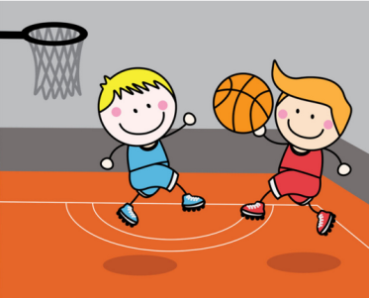
They are playing basketball.
It’s sunny.

Slide 4
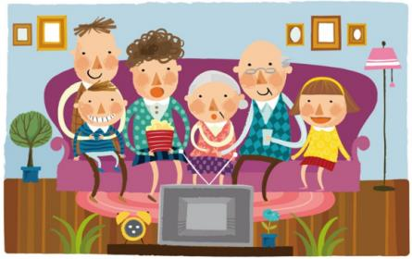
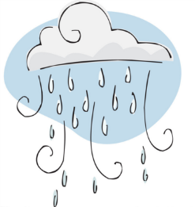
It’s raining.
They are watching TV.

Slide 5
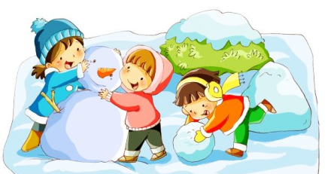
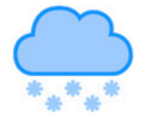
It’s snowing.
They are making snowman.

Slide 6
Grammar Focus
How's the weather? | It's cloudy. / It's sunny. It's raining.
What are you doing? | I'm cooking.
What are they doing? | They're playing basketball in the park.
What's he doing? | He's studying at his friend's home.
How's it going? | Great! / Not bad. / Terrible!
询问天气如何
询问他人正在做什么
询问近况如何

Slide 7
一、现在进行时(二）
1. 现在进行时常用的时间状语及提示词：now, at present, at this moment等或有look, listen 等提示语。
例：现在正在下雨。
It's raining now.

Slide 8
2.现在进行时的基本用法
(1)表示说话时动作正发生或进行。
例：他们正在打篮球。
They are playing basketball.
(2)表示现阶段或不限于说话时特定的时间范围内进行的动作。
例：今年他们正在努力学习。
They are working hard at their lessons this year.

Slide 9
(3)有些动词的现在进行时用来表示按计划或安
排将要进行的动作。常用的动词有：come,
go, arrive, leave, start, stay 等。
例：你要待到下星期吗？
Are you staying till next week?

Slide 10
(4)现在进行时和always, constantly, continually
等副词连用，表示反复出现的问题，常常带有
一种不赞赏、不满等感情色彩。
例：这个男孩总是问些愚蠢的问题。
The boy is constantly asking silly
questions.

Slide 11
有些动词如 know, lie, stand, have, own, belong to, like, love, want, hope 等，通常不用于进行时。
例：她想回家。
She wants to go home.

Slide 12
二、谈论天气
1. 询问天气的句型有：“How's the weather?”
“What's the weather like?”。
两个句型后面都可以加“in+地点”，用以询问“某地天气如何”。
例：深圳的天气怎么样？
How's the weather in Shenzhen?

Slide 13
2.回答询问天气状况的问句时，通常用：It's+表示
天气的形容词.”，也可以用现在进行时进行回答。
常见的该类形容词有：
fine (晴朗的) dry (干燥的) warm (温暖的)
cold (寒冷的) cool (凉爽的) hot (热的)
rainy (下雨的) snowy (下雪的) sunny (晴朗的)
cloudy (多云的)

Slide 14
3a
Fill in the blanks with the correct forms of the verbs in the box. Then practice the conversations with a partner.
be play study talk do make
1. A: What are you doing?
B: I _________ my homework. I always ___ my
homework in the evening.
am doing
do

Slide 15
be play study talk do make
2. A: What’s John doing right now?
B: He __________ soccer. He ______ soccer
every Saturday.
3. A: ___ Julie ________ English right now?
B: No, she isn’t. She __________ Chinese.
is playing
plays
Is
studying
is studying

Slide 16
be play study talk do make
4. A: What are Julie and Jane doing?
B: They __________ soup. They can _____ very
good soup.
5. A: ____ Lisa ________ on the phone again?
B: Yes, she ______ on the phone for three hours
every day!
are making
make
Is
talking
talks

Slide 17
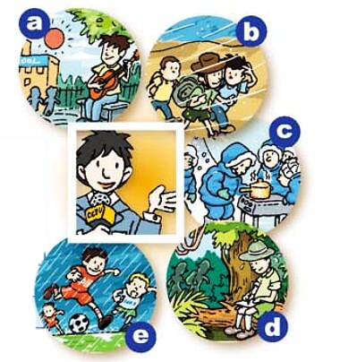
Yuan Yuan from CCTV is interviewing people in five different places. Fill in the chart below.
3b

Slide 18
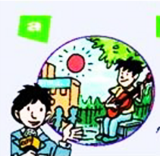
A: How is the weather in picture a?
B: It’s sunny and warm.
A: What’s he doing?
B: He’s playing the guitar.

Slide 19
A: How is the weather in picture ____?
B: It’s _____.
A: ______________?
B: ______________.

Slide 20
How’s the weather? | What are they doing?
sunny and warm playing the guitar
windy hiking
snowy cooking
hot and humid writing
rainy playing soccer

Slide 21
You are a reporter from CCTV. Make a report to your group.
Hi, everybody. Here are five pictures from different places. It’s sunny in picture a and the boy is playing…
… …
Thank you!

Slide 22
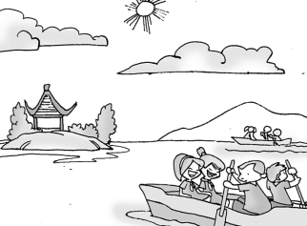
Exercise
A: ______ the weather?
B: It’s ______.
A: What ____ they _______?
B: They ____ ________ on the lake.
How’s
sunny
are doing
are boating

Slide 23
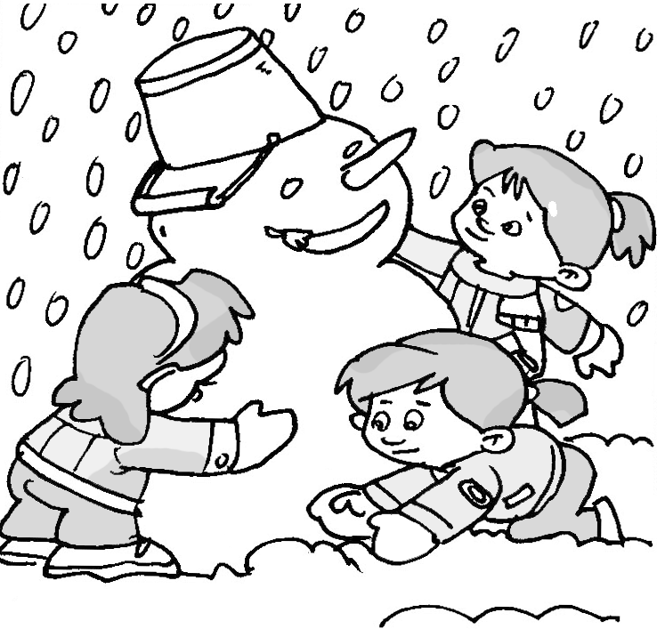
A: _______ the ________?
B: It’s ______.
A: _____ are _____ doing?
B: _____ are ________ a _________.
How’s weather
snowy
What they
They making snowman

Slide 24
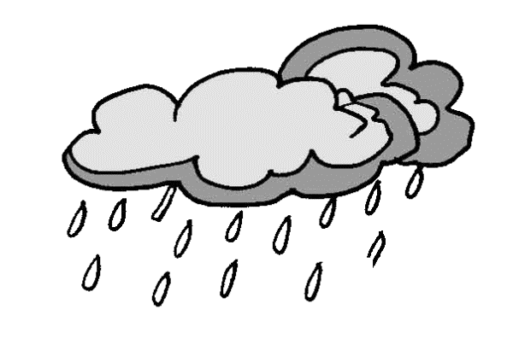
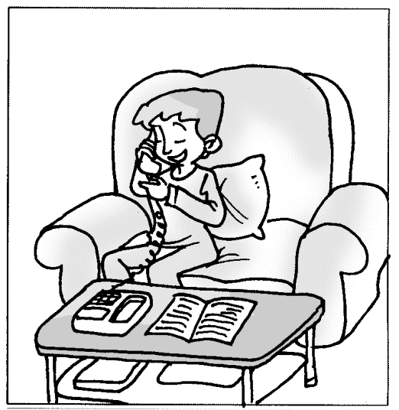
A: _______ the ________?
B: It’s ________.
A: _______ is _____ doing?
B: ____ is ________ on the _______.
How’s weather
raining
What he
He talking phone

Slide 25
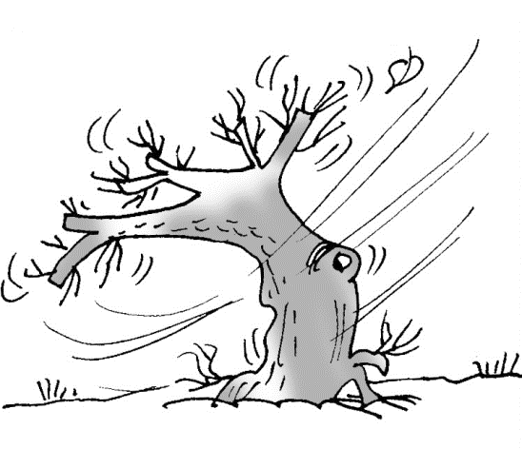
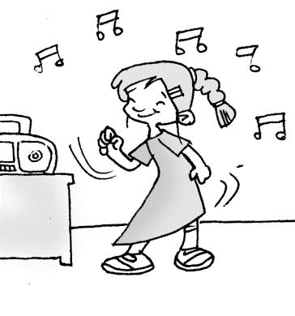
A: _______ the ________?
B: It’s ______.
A: _______ she doing?
B: ____ is __________ to _______.
How’s weather
windy
What’s
She listening music

