Slide 1
陕旅版英语六年级上册
Unit4 Let’s Go on a Picnic
第2课时
WWW.PPT818.COM

Slide 2
教学目标：
1. 能听懂、理解Let’s talk部分的对话。
2. 能灵活运用shall和will表达将要做的事情，理解shall在第一人称疑问句的结构中还可表示提出建议，征求意见的用法。
3. 能在日常生活中灵活运用以下句型进行交流。
—Are you free next Saturday?
—Yes. What’s up?
What shall we take?
Shall we meet at the gate of the park?
When shall we meet, 8:00 or 8:30?

Slide 3
Let’s sing

Slide 4
Free talk
What do you often do on weekends?

Slide 6
The weekend is coming, what will you do on Saturday and Sunday?
Will you play sports?
Will you go on a picnic?

Slide 7
Tomorrow is Saturday, shall we go on a picnic?
What shall we take?我们要带些什么呢？
Shall we take some food and drinks?
我们要带一些食物和饮料吗？

Slide 8
Tips
句中所用的shall是动词的将来时态，用来表示将要做的事或将要出现的情况。只用于第一人称。
例如：
We shall go on a picnic tomorrow.
我们明天要去野餐。

Slide 9
Please read the dialogue and try to answer the questions.
1. Is Alice free next Sunday?
2. Where will they have the picnic?
3. When will they meet? Why?

Slide 10
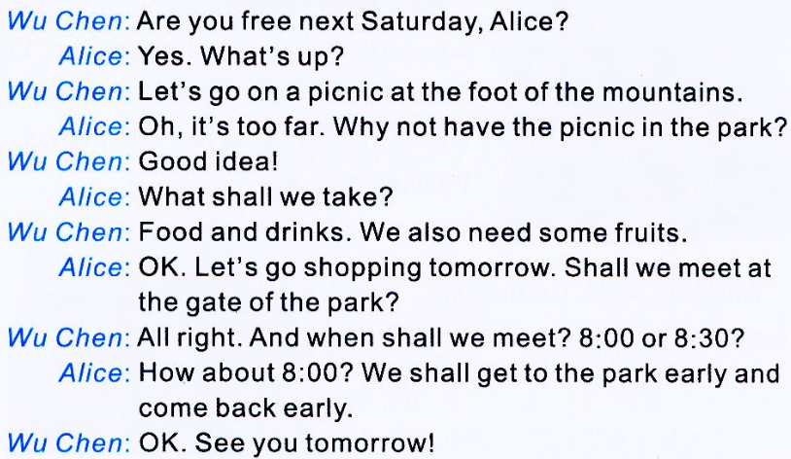

Slide 11
Answers
1. Is Alice free next Sunday?
2. Where will they have the picnic?
3. When will they meet? Why?
Yes, she is.
They will have the picnic in the park.
They will meet at 8:00. Because they want to get to the park early and come back early.

Slide 12
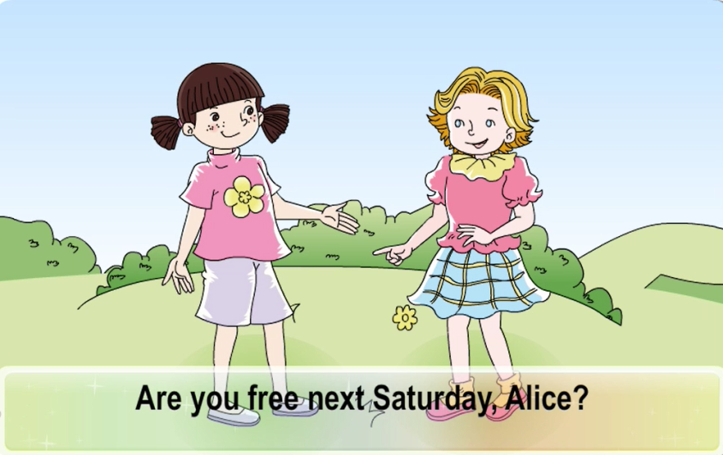
观看课文动画并大声跟读

Slide 13
疑难讲解
---Are you free next Saturday?
你下周六有空吗？
---Yes. What’s up?
有。怎么了？
What’s up?什么事？怎么啦？口语交流中用以询问对方有何需求或建议等。
例如：
---Can you help me?
---Yes. What’s up?

Slide 14
Listen and match

Slide 15
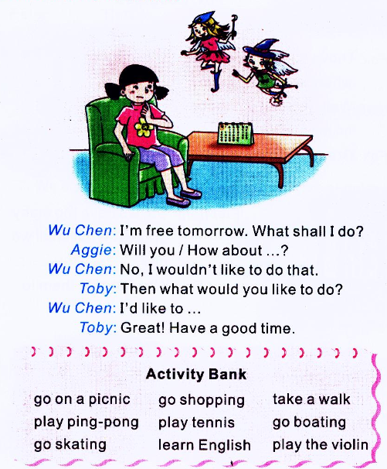
Ask and answer

Slide 16
What shall I do?
不知自己未来活动应该怎么安排。
Will you...? 给人提建议。
I wouldn’t like to do that. 表明自己不喜欢的活动。
What would you like to do? 询问对方的喜好。
I’d like to... 表明自己的喜好。
.

Slide 17
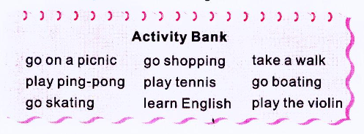
Pair work
两人一组，根据个人的活动安排及喜好，从Activity Bank中选择短语做对话。
.

