Slide 1
七年级英语（JJ下）教学课件
Unit 7 Sports and Good Health
Know Yourself
WWW.PPT818.COM

Slide 2
Learning Targets
Key words & phrases:
step, towards, brush, tooth, organized, mess, develop, work for, write down, improve myself, brush one's teeth, make one's bed, lead the way to, work on
Key sentences:
1.This is the first step towards success.
2.Take a piece of paper and write down a list of your habits.

Slide 3

3.I brush my teeth three times a day.
4.I am not organized.
5.And my room is always a mess.
6.Good habits lead the way to good health and success!
7.I tried it and it worked for me.

Slide 4
Lead in
Do you know yourself?
Did you finish your homework yesterday?
Do you always help your mother with housework?

Slide 5

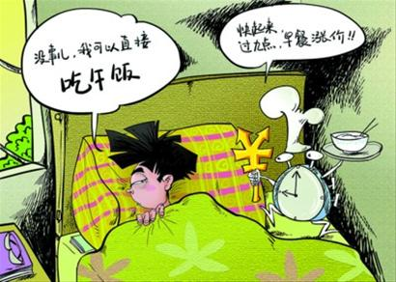


Good habits or bad habits?

Slide 6



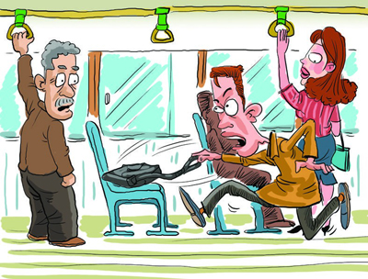

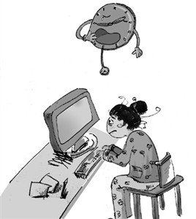
Good habits or bad habits?

Slide 7

Words and expressions
step n. 步骤；脚步
Listening is the first step towards success.
倾听是通向成功的第一步。

Slide 8
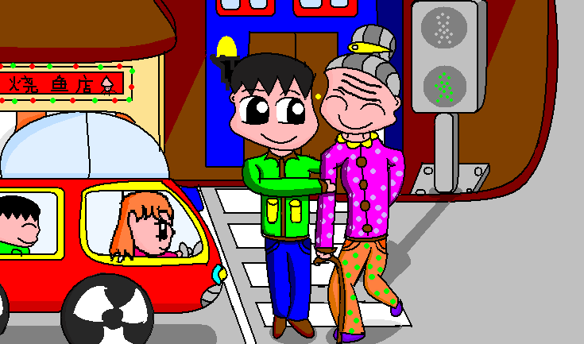
towards prep. 向；朝向
He helped an old woman walk across the street and then ran towards me.
他帮助一位老妇人过马路，然后就向我跑来。

Slide 9

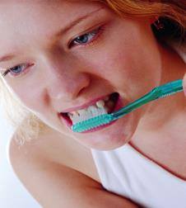
brush n. 刷子 v . 刷
She painted the wall with a brush.
她用刷子涂墙。
We should brush our teeth at least twice a day.
我们每天应该至少刷两次牙。

Slide 10

tooth n. (pl. teeth) 牙齿
I brush my teeth three times a day. 我每天刷三次牙。

Slide 11

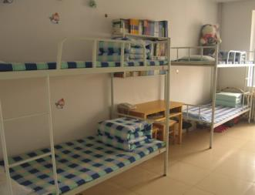
organized adj. 做事有条理的； 有组织的
Are you a very organized person?
你是一个做事非常有条理的人吗？
Is it clean and organized?
它干净、有条理吗？

Slide 12
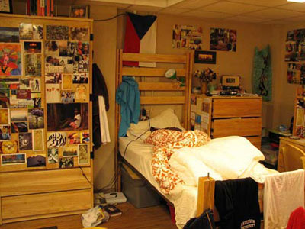
mess n. 杂乱；肮脏
The room is in a terrible mess.
房间里脏乱不堪。
I made such a mess of my life.
我把自己的生活弄得一团糟。

Slide 13

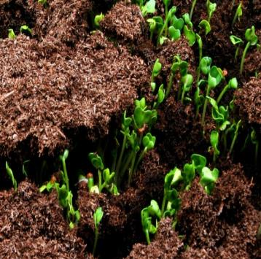
develop v. 发展；使形成；培育
Modern music developed in Italy.
现代音乐是在意大利发展起来的。
Plants develop from seeds.
植物由种子发育而成。

Slide 14
work for
write down
improve myself
brush one's teeth
three times a day
eight glasses of water
make one's bed
lead the way to
a few times
work on
对......有效果
写下
提高自己
刷牙
一天三次
八杯水
整理床铺
带路/引领……之路
几次
致力于

Slide 15

Presentation
Listen and read.
Know yourself! This is the first step towards success. But how? Try this! Take a piece of paper and write down a list of your habits.
I made two lists. There is a list of my good habits and a list of my bad habits.

Slide 16
Good Habits
·I usually get up early.I often wake up at
6：30 in the morning.
·I always eat breakfast.
·I brush my teeth three times a day.
·I drink eight glasses of water a day.
Bad Habits
·I don't get enough exercise.
·I spend too many hours watching TV.
·I don't always make my bed.
·I am not organized.And my room is always a
mess.

Slide 17
Good habits lead the way to good health and success! Look at your lists. Are there any bad habits? How can you change those habits?
Develop your good habits and improve yourself! I tried it and it worked for me.
Now I watch TV only a few times a week. I often play basketball after school. And I keep my room clean and organized. I still don’t always make my bed, but I’m working on it.

Slide 18
Let’s Do It!
1
Read the lesson and fill in the blanks.
1. Know yourself! This is the _______ step towards success.
2. I _______ too many hours watching TV.
3. Good habits _______ the way to good health and success!
4. Look at your lists. Are there any bad _______?
5. We should _______ our rooms clean and organized!
first
spend
lead
habits
keep

Slide 19



2
Listen to the statements and match the people with the habits. Then Draw for good habits or for bad habits.
I brush my teeth three times a day. ( )
I always get up early. ( )
I spent too much time on the computer.
( )
I often play basketball with my friends
after school. ( )
I always keep my room clean and
organized. ( )

Slide 20
Fill in the blanks with thee phrases in the box.
3
write down make my bed work on improve myself work for
1. Will you be my partner? Then we can _______the project together.
2. He is very sick. Are you sure this medicine will ________him?
3. I was in a hurry this morning and I didn’t have time to ______________.
4. I am changing my bad habits. I want to ____________.
5. Please ____________your e-mail address. I will send you the pictures.
work on
work for
make my bed
improve myself
write down

Slide 21
4
Work in pairs. Do you know yourself? Talk about your habits. Make a list of your good habits and a list of you bad habits. Talk about them.
My good habits
_______________________
_______________________
_______________________
_______________________
My bad habits
_______________________
_______________________
_______________________

Slide 22
Language points
1．This is the first step towards success.
(1)step 作可数名词，意为“步骤，脚步”。
常用短语：step by step一步步地；take steps to do sth.采取措施做某事。如：We should deal with this problem step by step.我们应该一步一步地解决这个问题。
(2)towards 作介词，意为“向，朝向”，可与to替换使用。如：The house is towards south.这栋房子朝南。

Slide 23
2．Take a piece of paper and write down a list of your habits.
write down是动词短语，意为“写下，记下”。因为down是副词，其后面的宾语如果是代词，则要放在down的前面；如果后面的宾语是名词，则放在down的前面或者后面均可。如：This rule is very important.You must write it down.这条规则很重要。你必须把它记下来。

Slide 24
3．I brush my teeth three times a day.
(1)brush作动词，意为“刷”。常用短语：brush one's teeth刷牙。如：You should brush your teeth every day.你应该每天刷牙。
【拓展】brush作名词，意为“刷子”，其复数形式为brushes。
(2)teeth是可数名词tooth的复数形式，意为“牙齿”。注意tooth在变复数形式时，是把中间的oo改为ee。如：How many times do you brush your teeth every day？
你每天刷几次牙。

Slide 25
4．I am not organized.
organized作形容词，意为“做事有条理的，有组织的”。其动词形式为organize(组织)。如：Our class is an organized group.我们班是一个有条理的集体。
5．And my room is always a mess.
mess作名词，意为“杂乱”。常用短语：make a mess弄得一团糟；in a mess一团糟。如：Your room is really in a mess.你的房间真的是一团糟。

Slide 26

6．Good habits lead the way to good health and success！
lead the way to意为“引领；带领”。其中to是介词，后跟表示成功、希望等的名词。它后面还可跟地点名词，表示“通往某地”。
如：The star leads the way to the right direction.那颗星星指引着通向正确的方向。

Slide 27
Exercises
一、用所给词的适当形式填空。
1. My mother ________ (wake) me up at 6:00 yesterday.
2. I walk to school ________(one) a week. I usually ride my bicycle.
3. You need to eat ________ (few) donuts than before.
4. It takes me half an hour ________ (do) my homework every day.
woke
once
fewer
to do

Slide 28

二、单项选择。
1.Don’t spend too much time ____ computer games.
A. play B. playing C. to play D. plays
2. She brushes her ___ three ___a day.
A. tooth; time B. teeth; time
C. teeth; times D. tooth; times

Slide 29
3. He went shopping and bought ___books.
A. few B. a few C. little D. a little
4.I’m not organized. And my room is always a ___.
A. clean B. tidy C. mess D. clear
5.We should develop our good habits and improve ___.
A. myself B. yourself
C. ourselves D. themselves

Slide 30
三、根据汉语意思完成句子。
1. 保持平静是在考试中获胜的第一步。
Keeping peaceful is ________________ to become
winners in the exam.
2. 刷牙的时候请关掉水。
Please turn off the water when you ________________.
3. 我没有参与任何有组织的犯罪。
I didn't have any connections to ________ crime.
4. 团结在一起，我们甚至将迈向更大的成功。
Together, we will ________________ even greater
success.
the first step
brush your teeth
organized
lead the way to

Slide 31
Teacher's advice
Knowing ourselves is the first step towards success.
“First we make our habits, then our habits make us.” Everyone has both good habits and bad habits. Develop your good habits, change your bad habits and improve yourself. In this way, you can be close to success. And you will succeed if you try your best.

Slide 32

Summary
  1. Learned some new words and phrases: step, towards, brush, tooth, organized, mess, develop, work for, write down, improve myself, brush one's teeth, make one's bed, lead the way to, work on
2. Learned to talk about your good habits and your
bad habits.

Slide 33

Homework
1. Review and recite the imporant
points of Lesson 42.
2. Try to write down a list of your bad habits and find out how to get rid of (改掉) them.
3. Preview Unit 8, Lesson 43.

