Slide 1

Unit11
Do you have a pencil？
WWW.PPT818.COM

Slide 2

Let's sing a song
Do you have a little plane,
Little plane, little plane?
Do you have a little plane?
Yes,I do.
Do you have a little car,
Little car, little car
Do you have a little car?
No,I don’t

Slide 3
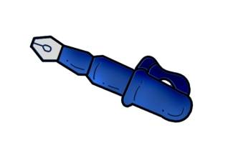
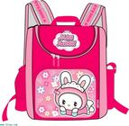
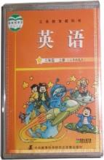
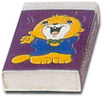
Let's sing a song
I have a ,
I have a ,
It's new ,It's new
Here is my pencil
Here is my pencil
It's new,It's new

Slide 4
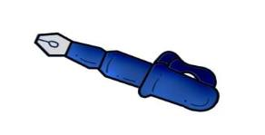
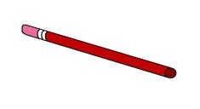

Words:文具类单词：
pen
pencil
bag
ruler
rubber
book
其他：do may use here sorry

Slide 5


Let’s revise:
What’s missing?

Slide 6

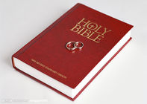
pen
pencil
bag
ruler
book
rubber

Slide 7
pen
pencil
bag
ruler
book
rubber

Slide 8
pen
pencil
bag
ruler
book
rubber

Slide 9
Show you some school things.

Slide 10
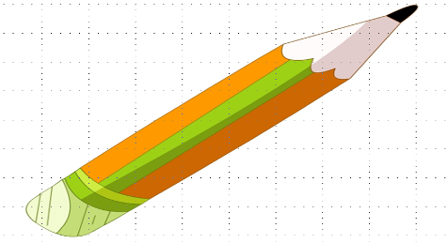
pencil
I have a pencil.
Do you have a pencil?

Slide 11
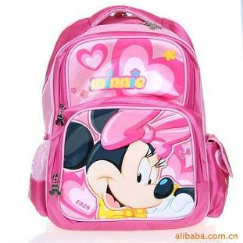
bag
I have a bag.
Do you have a bag?

Slide 12

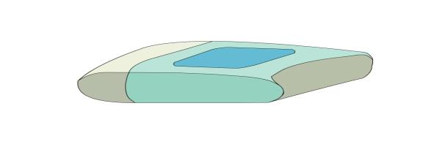
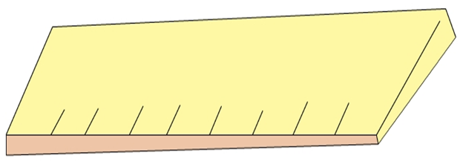
rubber
ruler
rubber, rubber,
do you have a rubber?
I have a ruler.
Do you have a ruler ?
12

Slide 13
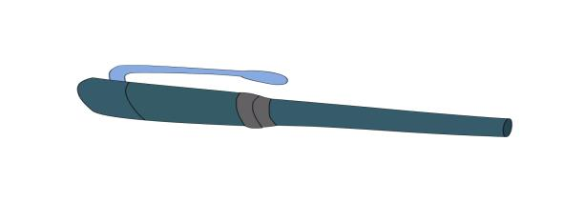
pen 钢笔
I have a pen.
Do you have a pen?

Slide 14
rubber
I have a rubber.
Do you have a rubber?

Slide 15

book
I have a book.
Do you have a book?

Slide 16
情景设计：
Read the dialogue after me.
Where is my book?
I don’t have a book.
Do you have a book?
May I use your book?
Here you are.
Sorry.

Slide 17
一般疑问句
Do you have … ? 你有…… 吗？
肯定回答：Yes, I do.
否定回答： No, I don’t.

Slide 18
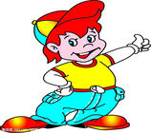
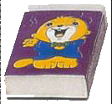

table
,
Do you have a rubber?
Yes, I do.

Slide 19


Do you have a pen?
No, I don’t.

Slide 20
May I use it?
OK. Here you are.

Slide 21
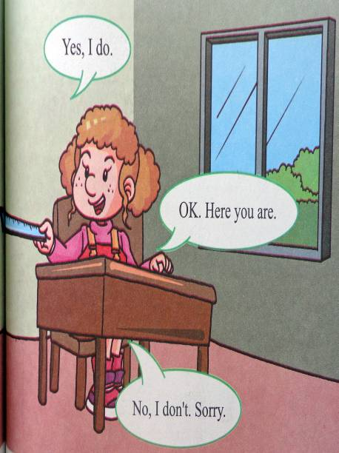
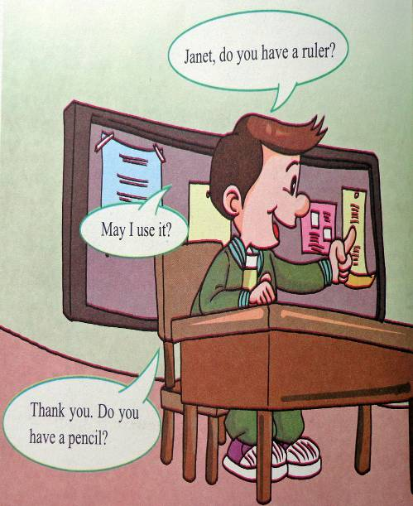

Slide 22

Sing along where is the pencil
Do you have a …
Do you have a ...? Yes,I do.
Do you have a ...? No,I don't.
May I use it? OK.Here you are.

Slide 23
Listen,read and act out

Slide 24
Do you have a rubber?
Yes,I do.
Do you have a pen?
No, I don’t.
May I use it?
OK. Here you are.

Slide 25
选择最佳答案, 把大写字母编号写在题前的括号内。
（ ）1.____ you have a pen?
A.Do B.Is
( )2.-Do you have a book?
-_______
A.Yes,I do B.No,I do
( )3.- Do you have a dog?
- __________
A.No,I don't B.Yes,I don't
( ) 4.- Do you have a bag?
-Yes,I ____
A. do B.don't
( ) 5. - Do you have a car?
- No,I ____
A.do B.don't
A
A
A
A
B

Slide 26

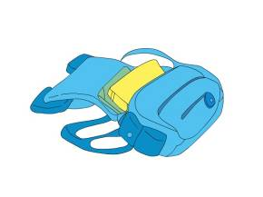
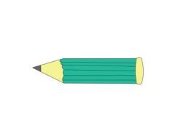
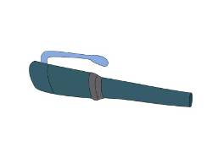
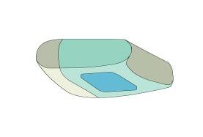
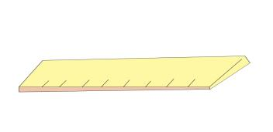
new words
school things(学习用具)
pencil
book
bag
pen
rubber
ruler
其它词：do（助动词， may（可以） use （ 使用） here（这里 ） sorry（ 对不起）
2023-01-17

Slide 27
key sentences:
肯定回答：yes, I do.
否定回答：No, I don’t.
注意：I（我），这个单词永远要大写！！！
May I use it?
OK..
Here you are..
Thank you.
Sorry.

Slide 28

1、抄写单词pencil、pen、rubber、book、bag每个写一行，一行写6遍，边写边读。
2、听录音，跟读课文。

Slide 29


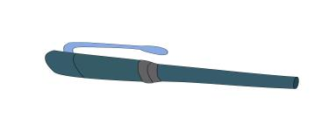



Let’s play a game
Do you have a……?
Yes, I do
No,I don’t.Sorry

Slide 30

