Slide 1
精通版小学英语五年级下册
Unit4
What's wrong with you?
WWW.PPT818.COM

Slide 2
目录
CONTENTS
导入
新课讲授
随堂练习
知识小结

Slide 3
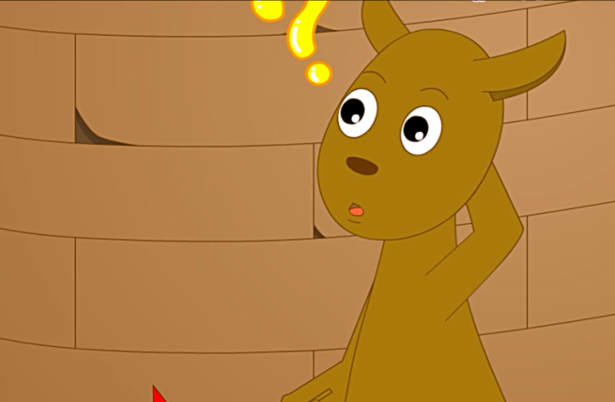
导入
What’s wrong with you?
l don't feel good. I have a toothache.

Slide 4
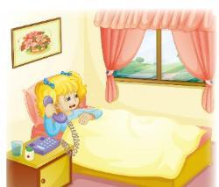
新课讲授
Kate: May l speak to Miss Liu,please?
Miss Liu: This is Miss Liu speaking.
Kate: Good morning,Miss Liu.This is Kate.l'm ill today.l have a headache.
Miss Liu: Oh dear!Do you have a cold?

Slide 5
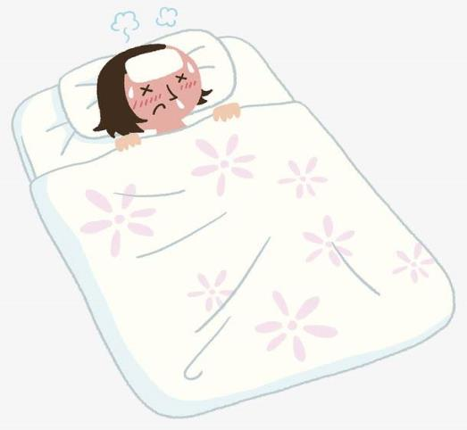
新课讲授
l'm ill today
ill
adj. 有病的，不舒服的

Slide 6
新课讲授
Oh dear!Do you have a cold?
dear
adj. 亲爱的，宝贵的

Slide 7
新课讲授
l have a headache.
headache
n. 头痛，麻烦

Slide 8
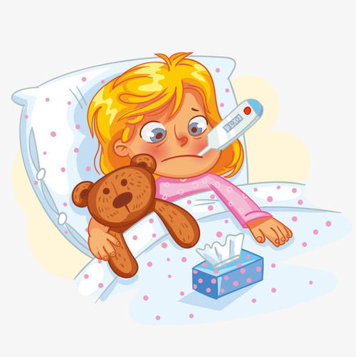
新课讲授
Who's on the phone?
Kate is calling Miss Liu.
What's wrong with Kate?
She is ill.
She has a headache.

Slide 9
新课讲授
Kate: Yes,l have a bad cold.l'm afraid l can't go to school today?
Miss Liu: Don't worry about your lessons.
You should go to a doctor.
Kate: Yes.My mum will take me to the doctor.
Miss Liu: Ok.Take good care of yourself.
Kate:Thank you.

Slide 10
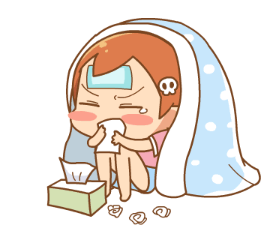
新课讲授
l have a bad cold.
bad
adj. 坏的；令人不快的
bad cold 重感冒

Slide 11
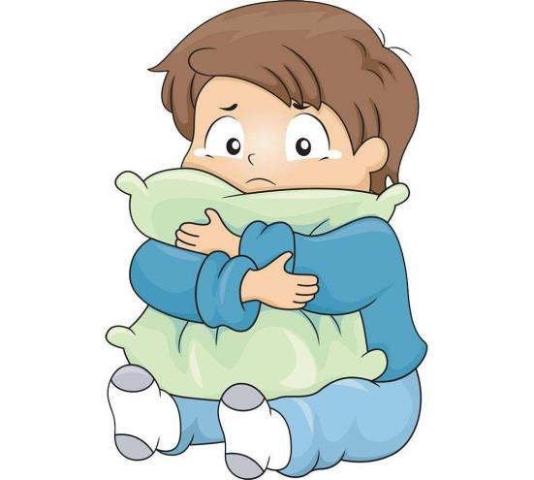
新课讲授
l'm afraid l can't go to school today?
afraid
adj. 担心；害怕

Slide 12
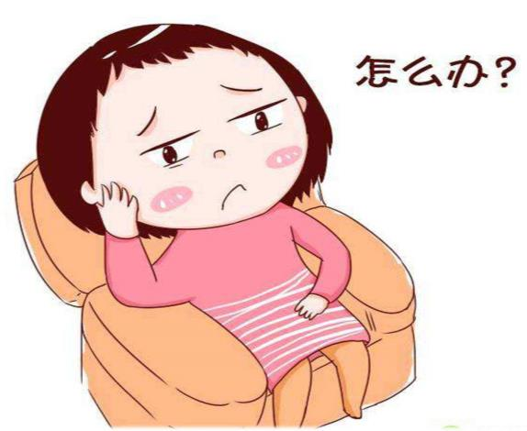
新课讲授
Don't worry about your lessons.
worry
v. 担心；发愁

Slide 13
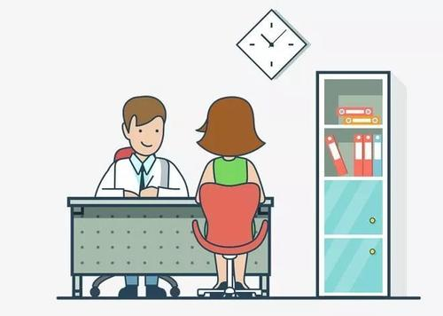
新课讲授
Can she go to school today?
No, she can’t.
Will she go to a doctor?
Yes, she will.

Slide 14
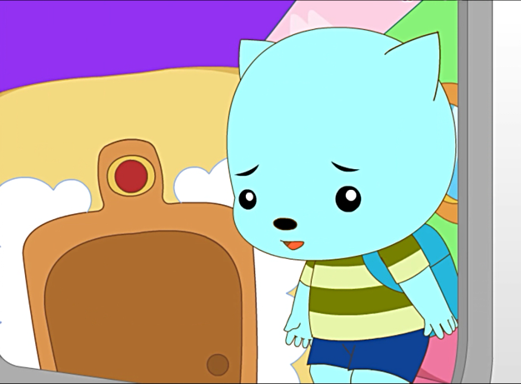
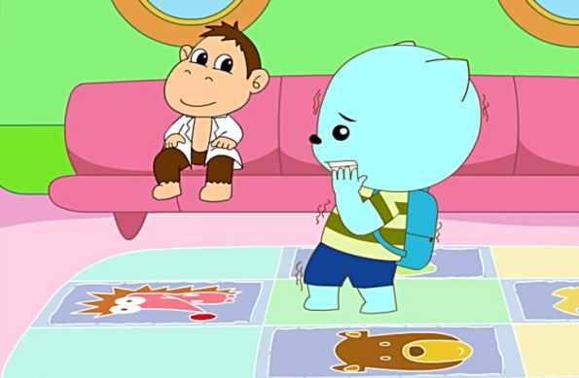
蓝蓝的跳伞日记
新课讲授
What else can he say?

Slide 15
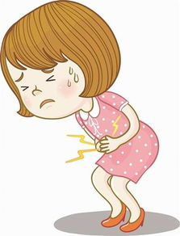
课堂练习
have a bad cold
have a stomachache
重感冒
胃疼

Slide 16
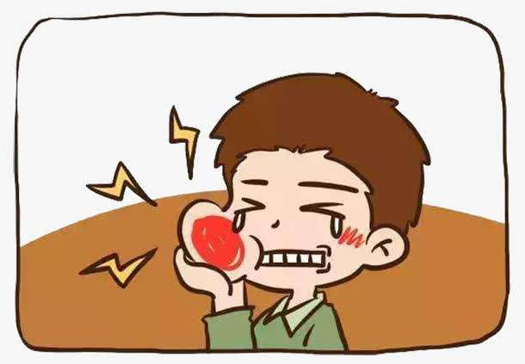
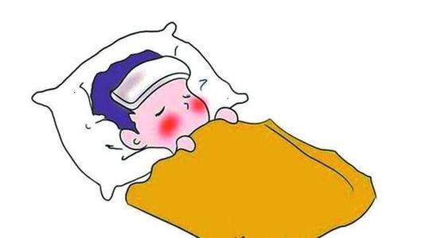
课堂练习
have a fever
have a toothache
发烧
牙疼

Slide 17
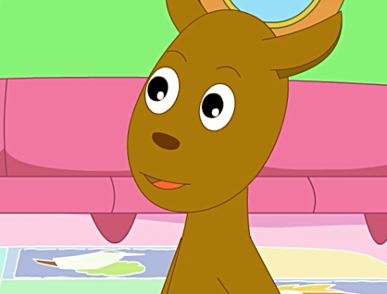
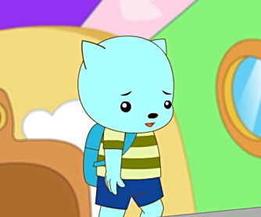
课堂练习
请同学们小组合作，模拟蓝蓝和教练的对话吧！
What's wrong with you?
l have a stomache.

Slide 18
课堂练习
What's wrong with you?
l have a fever.

Slide 19
知识小结
单词篇
句型篇
ill 生病
dear 亲爱的
headache 头疼
bad cold 重感冒
afraid 担心
worry 发愁
如何询问和回答病情：
What’s wrong with you?
I have ......

