Slide 1
人教版八年级上册
Unit 4
What’s the best movie theater?
Section B（第1课时）
0
WWW.PPT818.COM
0

Slide 2
学习目标
一、功能： Make comparisons by listening and
talking about a school talent show.
二、词汇和常用表达：
1. Learn to use the superlative forms of adjectives like best, most creative, funniest, worst, loudest … to describe some people and their performances.
2 . My cousin Li Jing is the funniest person I know.
三、文化知识 ：Learn about talent Show. Believe that everyone has talent.

Slide 3
自学互研
新词自查
根据句意及汉语提示完成句子
1. He is a creative (有创造力的) boy. He can make some
new things.
2. The performer (演出者) is form USA. He is also
popular in China.

Slide 4
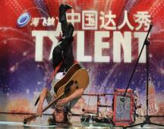
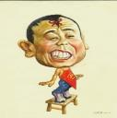
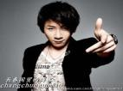
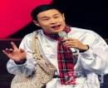
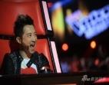
情景导入
Yu Heqing
He is the most creative performer I know.
He can play the guitar upside down.
（倒立）.
If there is a school talent show (一场学校才艺展示）in our School ? Do you want to invite him?
What other performers do you want to invite?

Slide 5
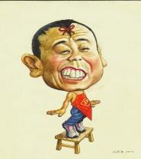
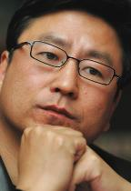
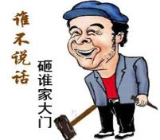
Huang Hong is very funny
Pan Changjiang is _________ than Huang Hong .
funnier
Xiao Shenyang is ____________ of them
the funniest
opposite (反义词）
Bai Yansong is _________________ of the four .
the most serious

Slide 6
1a
Write these words and phrases next to their opposites in the chart.
funniest most creative quietest best
opposites
A
B
most boring | most creative
loudest
worst
most serious
quietest
best
funniest

Slide 7
Say you, say me
My cousin Li Jing is the funniest person I know.
My friend
My teacher
My brother
------
is the person that I know.
the smartest the greatest
the funniest friendliest the busiest
the most beautiful the most popular
the most helpful the most excellent

Slide 8
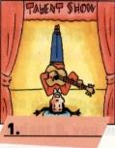
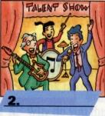
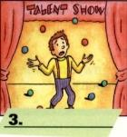
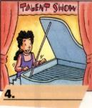
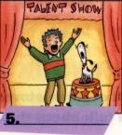
A school talent show.
一场校才艺表演
Names of the performers(表演者)
Eliza /I'laIzə/ 伊丽莎
Vera /'vIərə/ 薇拉(女子名)
Steve /sti:v/ n. 史蒂夫（男子名）
Dennis /'denIs/n. 丹尼斯（男子名）
The math teachers

Slide 9
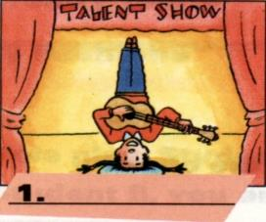
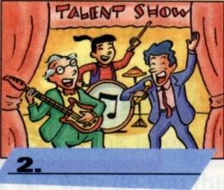
She is playing the guitar upside down.
They are singing
and dancing.
倒立

Slide 10
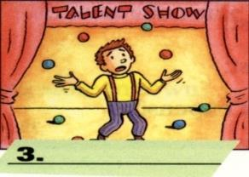
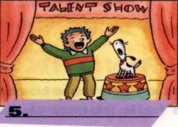
He is playing with many balls.
She is playing the piano.
He and his dog are doing funny things.

Slide 11
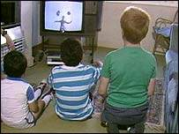
Listen for the general idea（大意）.
The general idea of the conversation is that _____
A. the school talent show was very successful.
B. people talked about the performers in the show.
C. the performers acted very well.
1c
B.

Slide 12
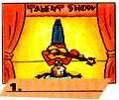
Listening for the specific ideas
1c
Listen and match the pictures with the performers.
e
a
Names
Eliza ____Vera___
Steve____ Dennis___
The math teachers___
d
a
e
c
Vera
b
Steve
1.________
5.________
b
d
c
Dennis
Eliza
The math teachers
3.________
4.________
2.________________

Slide 13
Listening for the specific ideas
1d
Listen and fill in the chart with the adjectives you hear.
Names | What people say
Eliza | best
Steve
Vera
Dennis
The Math Teachers
excellent, great
funniest
most creative
worst
loudest

Slide 14
Listen again and fill in the blanks.
A: Wasn’t that a great talent show? B: Yeah!
A: Who did you think was the _________ act?
B: Oh, I thought Eliza was the best. She’s an excellent piano player.
A: Yeah, she’s great. And I thought Steve and his dog were _____________.
B: Me too! I couldn’t stop laughing! And how about Vera? Wasn’t she creative?
A: Yeah, I’d say she was _________________act! I don’t know many people who can play the guitar upside and down.
B: Who did you think was the worst?
A: Oh, Dennis! He was _______. He kept dropping the ball.
B: I know!
A: What did you ___________The Math Teachers?
B: Well, they were ______________ for sure!
best
the funniest
the most creative
terrible
think of
the loudest

Slide 15
Free talk
most creative
funniest
worst
Steve
Vera
Dennis
best .
excellent great
loudest
talent
show
Eliza
The Math Teachers
A: I’m a reporter from Zhishan Middle School.
Can I ask you some questions?
B: Sure.
A: Who was the best performer ?
B: Eliza was the best performer.

Slide 16
most creative
funniest
worst
Steve
Vera
Dennis
best .
excellent great
loudest
talent
show
Eliza
The Math Teachers
A: I’m a reporter from Zhishan Middle School.
Can I ask you some questions?
B: Sure.
A: Who was the best performer ?
B: Eliza was the best performer.

Slide 17
Make a report
most creative
funniest
worst
Steve
Vera
Dennis
best .
excellent great
loudest
talent
show
Eliza
The Math Teachers
In last week’s school talent show, I think Eliza was the best performer---

Slide 18
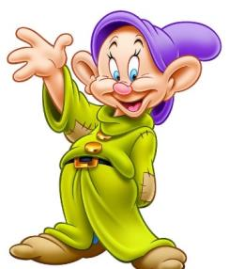
Show your talent
Everyone is good at something
Everyone has talent!
Believe in yourself !
（相信自己）

Slide 19
the stars of our class talent show
in my class
in my group
I know
I think --- is ---
the funniest
the smartest
the friendliest
the busiest
the best
the most creative,
the most popular
the most talented
the most excellent

Slide 20
问题探究
一、My cousin Li Jing is the funniest person I know.
汉译：______________________________
此处用funny最高级，因后有表范围的句子______,
类似表范围的如____、_____ 引导的介词短语。
Eg:
1.He is __________ ( tall) in our class.
2. Tom is _____________ (heavy) of the three students.
3. I think Liu Qian is _______________ (creative) person I know .
我表妹李静是我知道的最滑稽的人
I know
in
of
the tallest
the heaviest
the most creative

Slide 21
课堂评价
一、用所给词的适当形式填空
1. The _______________(perform) in the evening looks very nice .
2 Li is _______________ (quiet) of the three
3. He was ________________ (thin )
person that I know.
4. Who is the_____________ (funny) student in your class?
5. Mr. Li is _________________ (serious) teacher that I have seen.
二、 请翻译下列句子。
1. 谁是最佳演员？
2.我认为她是我所知道最有创意的人。
performer
the quietest
the thinnest
funniest
the most serious
Who is the best performer?
I think she is the most creative person (that) I know.

Slide 22
Summary
What have you got in this class?
Key words
Sentences
Emotion(情感）
希望你的智慧树越来越茂盛

Slide 23
Homework
(1) Review the words and sentences they have learned in this lesson.
(2) Preview Section B 2b and read it.

