Slide 1
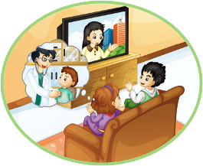
Unit4 Where do you work?
人教精通版五年级上册
WWW.PPT818.COM

Slide 2
>>Review
Let’s sing

Slide 3
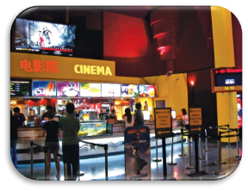
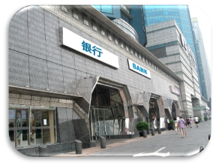
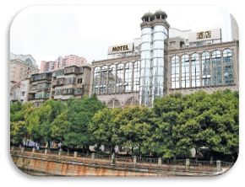
>>Review
Look and say
—Where do you work?
—I work in/at …
cinema
bank
hotel

Slide 4
>>Lead-in
Free talk
What does your father do? Where does he work?
What’s your mother’s job? Where does she work?

Slide 5
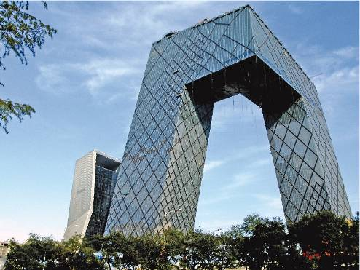
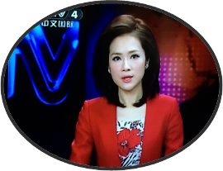
>>Presentation
Look and say
CCTV
She is a TV reporter. She works at CCTV.

Slide 6
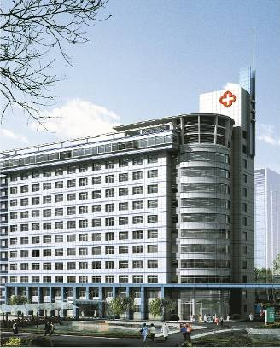
>>Presentation
Look and say
hospital
He is a doctor. He works in a hospital.

Slide 7
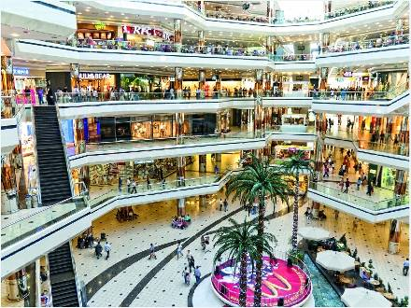
>>Presentation
Look and say
shopping mall
She is a saleswoman. She works in a shopping mall.

Slide 8
>>Presentation
Let’s watch

Slide 9
>>Presentation
1. What’s Yang Ming’s mother’s job?
2. Where does she work?
Read and answer
She is a TV reporter.
She works at CCTV.

Slide 10
>>Presentation
3. What’s Yang Ming’s father’s job?
4. Where does he work?
Read and answer
He is a doctor.
He works in Beijing Hospital.

Slide 11
>>Presentation
Just talk
Listen and imitate
Yang Ming: Look, Lisa. That’s my mother.
She’s on TV.
Lisa: Really? What’s her Job?
Yang Ming: She’s a TV reporter.
Lisa: Where does she work?
Yang Ming: She works at CCTV.
Lisa: Is your father a TV reporter, too?
Yang Ming: No, he’s a doctor.
Lisa: Where does he work?
Yang Ming: He works in Beijing Hospital.

Slide 12
>>Practice
Read it by yourself for one minute .
自读对话一分钟。
一分钟倒计时
60
Learning tip :
10
10
50
自己读对话，比一比看谁能在一分钟内读完，并且读得准确、流利！
20
20
40
30
30

Slide 13
>>Practice
Show time
小组合作，练习对话并表演，其他同学评价。
Pronunciation (语音) |  | Fluency (流利) | Cooperation (合作)
OK!
Great!
Super!

Slide 14
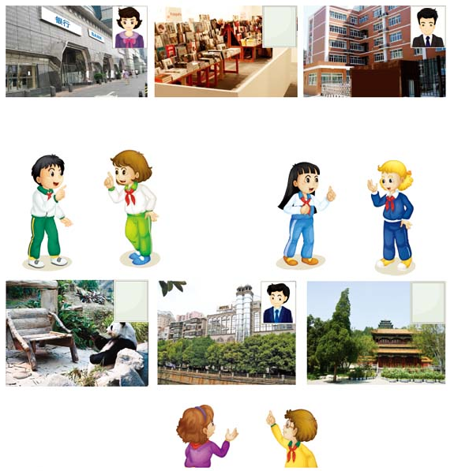
>>Practice
Let’s talk
Where does your aunt work?
She works in a bank.
Where does your uncle work?
He works in a school.
Where does your father work?
He works in a hotel.

Slide 15
>>Practice
活动
猜猜看
教师将学生分为两组，分别发给各组一定数量的职业图片，一名学生根据自己手中的图片做出相关的动作，本组学生问：Where does he/she work? What does he/she do? What’s his/her job?请另一组同学猜出该职业的单词：He/She works … He/She is ... 猜中的同学得到一张图片，最后根据各组所得图片的数量判断胜利的一方。

Slide 16
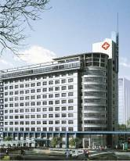
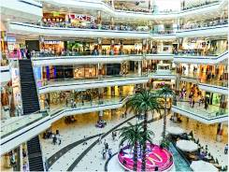
>>Summary
本课的重点单词是：
CCTV
hospital
hotel

Slide 17
>>Summary
如何询问他人的职业和工作场所？
(1) —What’s (his/her) job?
—(He/She) is a/an …
(2) —Where does (he/she) work?
—(He/She) works in/at …

Slide 18
>>Homework
1.观看课文动画，按照正确的语音、语调朗读课文对话。 2.运用本课所学句型，询问你身边的亲人关于他们的职业和工作场所。
3.预习 Lesson 23。

