Slide 1
Unit 3
I can swim very fast
WWW.PPT818.COM

Slide 2
Let's chant:
read, read, read, read fast.
jump, jump, jump, jump high.
write, write, write, write well.
swim, swim, swim, swim fast.
sing, sing, sing, sing well.

Slide 3
Summary
can 作为情态动词，表示能力，后面须跟动词原形。
我们可以用副词well, fast, high等修饰动词，表示动作完成的程度。
be good at 表示擅长...，后接动名词或名词。

Slide 4
I can read fast.
But I can't dance.

Slide 5
I can swim fast.
But I can't run fast.

Slide 6
I am good at doing the high
jump. But I am not good at
playing football.

Slide 7
The boy is good at writing. But he isn't good at running.

Slide 8
We know:
表示会做某事用：主语+can+动原。
表示不会做某事用：主语+can't+动原。
询问他人能力用句子：
What can ... do?
主语+can+动词短语、动原。
询问他人是否会做什么：
Can you....?
肯定回答：Yes, I can.
否定回答：No, I can't.

Slide 9
Practise:选词填空。
can, can't, is, isn't, are, aren't
(1)They___ fish. They ___ swim.
(2)Look, the children ___ playing ball games now.
(3)Mike ___ good at swimming.
He ___ swim very fast.
(4)____ they playing tennis in the playground? No, they _____.

Slide 10
can, can't, is, isn't, are, aren't
(5)___the boy running now? Yes, he____.
(6)____a bird run? No, it ___.
(7) My hobby ____ drawing animals. I ___ draw very well.
(8)I ____ play football, but I ____ play basketball.

Slide 11
请在文中划出以下重点句：
I'm very good at drawing.
She draws very well.
I can swim very fast.
Let's go swimming together.

Slide 12
Group work:
请3人一组表演对话。

Slide 13
Hello, my name is Lina.
I am reading a book.My hobby is reading books.
I do some reading every
evening. I can read fast.
Lina is good at
reading.

Slide 14
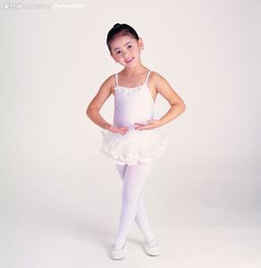
Hi, I'm Linda. I am dancing. My hobby is dancing. I dance every day.I can dance well.
Linda is good at dancing.

Slide 15
Hello, my name is Yan.
I am swimming. I like
swimming very much.
I swim every Sunday.
I can swim fast.
Yan is good at
swimming.

Slide 16
Hello, I am Jack. I am
writing. I love writing.
I write every afternoon.
I can write well.
Jack is good at
writing.

Slide 17
Hi, I am Adam. I am running. Running is my hobby. I often run after school. I can run fast.
Adam is good at
running.

Slide 18
Hi, I'm Tony. I am jumping. Doing the high jump is my hobby. I often jump after school. I can jump high.
Tony is good at
jumping.

Slide 19
Brain-storm
What about you? Say something about yourselves.
(请大家仿照以上例子说说自己的情况）

Slide 20
Look at these sentences and tell me what you find:
I can dance well.
I can swim fast.
I can write well.
I can read fast
I can run fast.
I can jump high

Slide 21
We find:
can 作为情态动词，表示能力，后面须跟动词原形。
我们可以用副词well, fast, high等修饰动词，表示动作完成的程度。

Slide 22
Practise:用can完成句子。
can fly high
1. The bird ______________.
2. The fish ______________.
3. The boy ______________.
4. The girl ______________.
can swim fast
can draw well
can draw well

Slide 23
Look at these sentences and tell me what you find:
Lina is good at reading.
Adam is good at running.
Yan is good at swimming.

Slide 24
We find:
be good at 表示擅长...，后接动名词或名词。

Slide 25
Practise:用be good at完成句子。
is good at flying
1. The bird ______________.
2. The fish ______________.
3. The boy ______________.
4. The girls ______________.
are good at swimming
is good at drawing
are good at dancing

Slide 26
What can the man do?
He can help sick people.

Slide 27
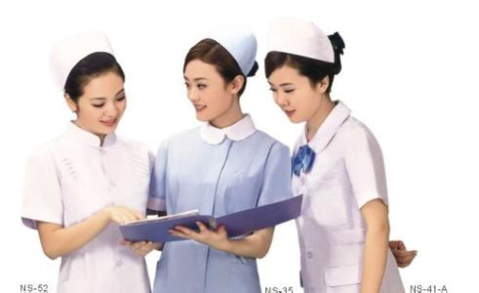
What can the women do?
They can help sick people.

Slide 28
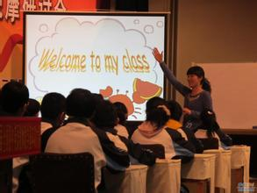
What can the woman do?
She can help children learn.

Slide 29
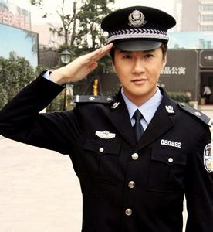
What can the man do?
He can stop bad people.

Slide 30
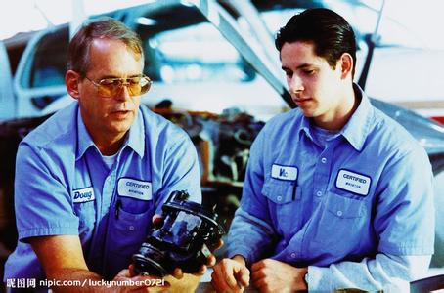
What can the men do?
They can make machines for people.

Slide 31
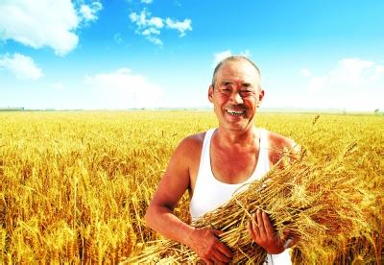
What can the man do?
He can grow food for people.

Slide 32
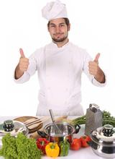
What can the man do?
He can cook nice food for people.

Slide 33
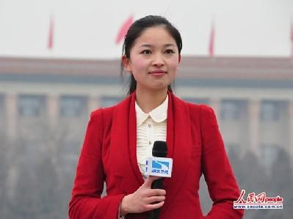
What can the lady do?
She can get news for people.

Slide 34
Practise
请同学们按照一下对话的形式进行小组活动：
A: What can you do?
B: I can....
A: You are a ....
B: Yes.

Slide 35
Goodbye!

