Slide 1
Unit 5 Wild animals
第1课时
WWW.PPT818.COM

Slide 2
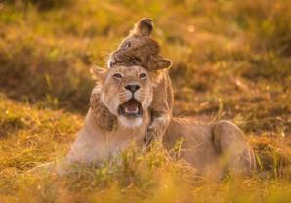
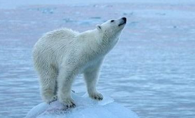
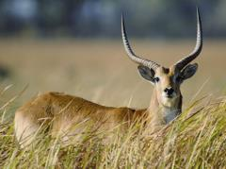
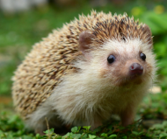
Do you know the names of these animals?

Slide 3
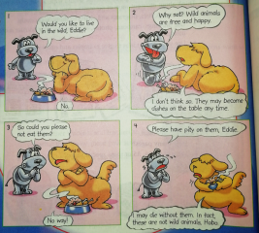
Comic strip
1 —Would you like to live in the wild， Eddie?
— No.
2 —Why not? Wild animals are free and happy.
—I don't think so. They may become dishes on
the table any time.
3 —So could you please not eat them?
—No way!
4 —Please have pity on them, Eddie.
—I may die without them. In fact, these are not wild animals, Hobo.

Slide 4
知识点
Would you like. . . ? 你想... ...吗？
1
交际用语Would you like. . . ? 征求对方意见，并期望对方给予肯定的回答的句型
肯定回答：Yes, I'd love/like to.
否定回答：I'd like to, but. . . / Sorry, I' m afraid not.

Slide 5
知识点
wild /waɪld/ adj.野生的 n．自然环境，野生状态
2
考向一
【重点】
wild 用作名词，意为“自然环境，野生状态”，in the wild意为“在野外；在自然环境下”。
eg: Can giant pandas live in the wild on their own?
大熊猫能独立在野外生存吗？

Slide 6
考向二
wild 用作形容词，意为“野生的”。
【重点】
eg: We should protect wild animals.
我们应该保护野生动物。
拓展
wild的副词形式为wildly, 意为“失控地”。

Slide 7
知识点
free/friː/ adj.自由的，不受束缚的
3
eg: You are free to come and go as you please.
你来去自由。
free还有“空闲的；免费的”的意思。作“空闲的”讲时，其反义词为busy“忙的”。
考向

Slide 8
eg：You don't have to pay; the exhibition is free.
你不用付钱，展览是免费的。
Will you be free this afternoon?
你今天下午有空吗？
拓展
其名词为freedom

Slide 9
知识点
pity /'pɪti/ n．同情
4
pity 用作不可数名词，表示“同情”。常用于feel pity for sb.或have / take pity on sb.“同情某人”等固定搭配。
考向一
【重点】
eg: The disabled don't need pity. They need help. 残疾人不需要同情，他们需要帮助。

Slide 10
考向二
pity 用作可数名词，指“遗憾的事，可惜的事”。常用于What a pity！“真可惜！”；It's a pity that...“令人遗憾的是……”等固定搭配。
【重点】
典例
—Let's go for a swim on Saturday, Jack.
—Oh, _______ I have to work on a science report.(泰安)
A. what a pity！ B．with pleasure.
C．go ahead. D．how come?
A

Slide 11
知识点
die /daɪ/ vi.死
5
eg: His grandpa died two weeks ago.
他祖父两周前去世了。
die的过去式、过去分词为died, died；现在分词为dying。
考向一
【重点】

Slide 12
考向二
die的形容词和名词形式
【易错点】
词条 | 词性 | 示例
dead | 形容词 | She thought of her dead dog and felt sad. 她想起她死去的狗感到很难过。
death | 名词 | His death made all of us sad. 他的去世使我们所有人都很难过。

Slide 13
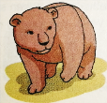
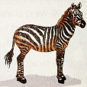
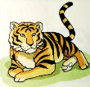
Welcome to the unit
A)The Wild Animals Club is doing a quiz on wild animals. Write the correct names under the pictures.
bear
dolphin
giant panda
squirrel
tiger
zebra
1 2 3
_________ _________ ________
4 5 6
_________ _________ ________
dolphin
squirrel
giant panda
bear
zebra
tiger

Slide 14
B)Millie and her classmates are talking about their favourite wild animals. Work in groups and talk about the wild animals you like best. Use the conversation below as a model.
Millie：What wild animal do you like best, Kitty?
Kitty：I like monkeys best. They're so clever and funny. What about you, Simon?
Simon：I like lions best. They're strong and they can run very fast.
Millie：They're the kings of the animal world.
Simon：Yes, they are. What wild animal do you like best, Peter?
Peter：I like pandas best. They look so cute.
Millie：Pandas are my favourite animals too.

Slide 15
知识点
6
like...best “最喜欢……”
like...best 可以与含favourite的句子进行转换。
常用结构：What＋名词＋do you like best?
＝ What＋ be＋ your favorite＋名词?
你最爱的……是……？

Slide 16
Which is your favourite subject？(改为同义句)
Which subject do you ________________?
典例
like best
【点拨】本题用代替法。favourite用like best替换。

Slide 17
一、根据句意及所给提示完成下列各题
1．There are many ________ (野生的) animals in the forest.
2．—Can I watch TV, Mum?
—You are ________ (自由的) to do anything today.
3．This ________ (一道菜) tastes delicious.
4．There are some _______ (斑马) in the zoo. Let's go and see.
5．________ (熊猫)are lovely animals.
wild
free
dish
zebras
Pandas

Slide 18
二、单项选择
6．—Could you please tell me how to get to the restroom?
—________. I'm not sure how to get there.(临沂)
A．Sorry B．OK
C．Of course D．No problem
A
【点拨】句意：—你可以告诉我如何到达洗手间？—________。我不确定怎么去那里。由回答可知表示抱歉。故选A。

Slide 19
7．—We should have pity ________ the wild animals.
—I agree with you.
A．at B．on C．in D．of
8．Sugar tastes sweet. But _______, it's bad to eat too much.
A. such as B. for example
C. in fact D. though
B
【点拨】固定短语have pity on“同情……”， 所以选择B。
C

Slide 20
9．—Could you please sweep the floor?
—________．I am busy doing my homework.
A．Sorry, you can't B．Yes, sure
C．Yes, I can D．No way
D
【点拨】本题用交际法。由答语后一句“我正忙着做我的家庭作业。”可知选D。

Slide 21
10．His father ________ five years ago.
A．die B．died C．dead D．Death
B
【点拨】本题用题眼法。句子缺少的是谓语动词，由five years ago可知用一般过去时。故选B。

Slide 22
本节课主要学习了以下知识点，请同学们及时巩固练习：
wild，free， pity ，die
Would you like. . . ?
like...best

