Slide 1
Unit 2 This is my sister.
Self Check
WWW.PPT818.COM

Slide 2
一、单项选择。
1．This ______ my son.
A．are B．is
C．am D．be
2．Here ______ my ______．
A．is，books B．are，book
C．are，books D．are，book's
3．—Is Jim a good boy?
—Yes，______ is.
A．he B．it
C．she D．they
B
C
A

Slide 3
4．______ are good friends.
A．Peter and I B．I and Peter
C．He D．She
5．—Are these your grandparents?
—No，______．
A．they are B．they aren't
C．he is D．she isn't
6．Dad，______ my friend，Tom.
A．he's B．it's
C．this is D．she's
A
B
C

Slide 4
7．I have ______ aunt and ______ cousin.
A．a，a B．a，an
C．an，a D．an，an
8．—Are ______ your photos?
—Yes，and in the first photo ______ my mother.
A．this，is B．these，are
C．these，is D．those，are
9．These are ______．
A．my two brothers B．two my brothers
C．his two brother D．two her sisters
C
C
A

Slide 5
10．Is ______ your daughter？What's ______ name?
A．he，his B．she，her
C．he，her D．she，his
11．Here is ______ my family.
A．a photo of B．photo of
C．a photo for D．photo for
12．______ is a boy.______ name is Nick.
A．He，Her B．She，Her
C．He，His D．She，His
B
A
C

Slide 6
13．—Have a good day!
—______．
A．Thanks B．OK
C．Not at all D．Thank
14．—Is he your cousin?
—Yes，______．
A．he is B．it is
C．it isn't D．he isn't
15．—Your picture is very good.
—______．
A．No，it isn't B．Thank you
C．Don't say that D．That's not right
A
A
B

Slide 7
二、根据句意及汉语提示拼写单词。
16．Is this your ________(叔叔)?
17．I have an _________(婶婶)．
18．Those _______(女孩) are her sisters.
19．In the ______(下一个) picture is my grandpa.
20． ________(那些) are apples.
uncle
aunt
girls
next
Those
21．These are my __________(朋友)．
22．Is this your __________(照片)?
23．Coco is ______(在……里面) my family.
24．My aunt has a son and a __________(女儿)．
25． ________(这儿) are my parents.
friends
photo
in
daughter
Here

Slide 8
三、按要求完成句子。
26．These are his sisters.(改为一般疑问句，并作肯定回答)
___________his sisters?
Yes，___________．
27．Those are my friends.(改为单数形式)
_______my __________．
28．This is my family photo.(改为同义句)
This is a ____________my family.
29．He is my_son．(对画线部分提问)
____________he?
30．is，photo，my，here，of，a，family(连词成句)
_______________________________．
Are these
they are
That's
friend
photo of
Who is
Here is a photo of my family

Slide 9
四、完形填空。
This is a photo 31. __ my family.32. __ are my grandparents.Those are my 33. __．This is my uncle 34. __ that is my aunt.This boy is my 35. __．He is my uncle's 36. __. 37. __ name is Eric.This girl 38. __ me.My name is Kate.I 39. __ twelve(十二)．I love 40. __ family.
B
C
C
A
C
B
B
B
A
C

Slide 10
31．A.for B．of C．on
32．A.This B．That C．These
33．A.parent B．mother C．parents
34．A.and B．but C．or
35．A.brother B．uncle C．cousin
36．A.daughter B．son C．brother
37．A.He's B．His C．He
38．A.am B．is C．are
39．A.am B．is C．are
40．A.I B．me C．my

Slide 11
五、阅读理解。
A
Alan：Mother，this is my friend，Bruce.
Bruce：Nice to meet you，Mrs.Green.
Mrs.Green：It's nice to meet you，Bruce.
Alan：And these are my grandparents，Charles and Nancy Green.That's my uncle，Dustin，and this is my sister，Emma.
Bruce：Hello！Hello！And is this your cousin?
Alan：Yes，this is Clark.

Slide 12
根据短文内容，判断句子正(T)误(F)。
( )41.Bruce is Alan's brother.
( )42.Charles and Nancy are Alan's grandparents.
( )43.Mrs.Green and Bruce are cousins.
( )44.Dustin and Clark are cousins.
( )45.Emma and Alan are sister and brother.
F
T
F
F
T

Slide 13
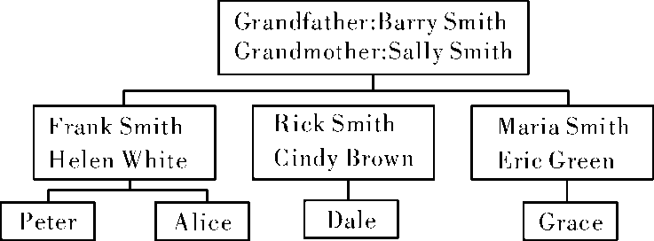
B

Slide 14
46．What's Peter's last name？____
A．Green. B．Smith. C．Brown.
47．Rick is Peter's ____．
A．father B．uncle C．aunt
48．Maria is Frank's ____．
A．sister B．mother C．daughter
49．Peter has ____ cousins.
A．one B．two C．three
50．Peter's sister is ____．
A．Cindy B．Grace C．Alice
B
B
A
B
C

