Slide 1

Module
My future life
8
Unit 2
I know that you will be better at maths.
WWW.PPT818.COM

Slide 2

Warming up
How soon will you leave school?

Slide 3
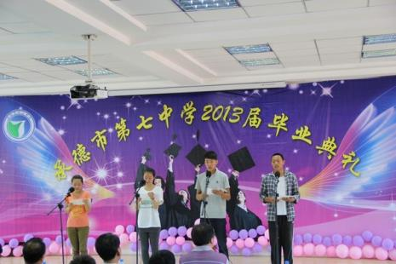
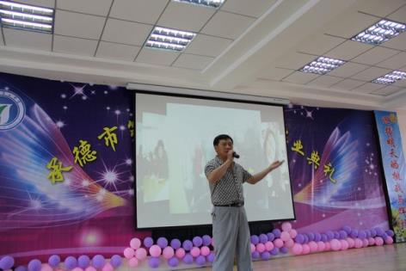
Will you have a school-leavers’ party?
Where will you hold the school-leavers’ party?

Slide 4
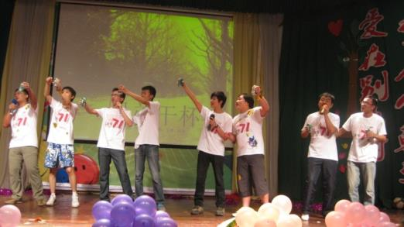
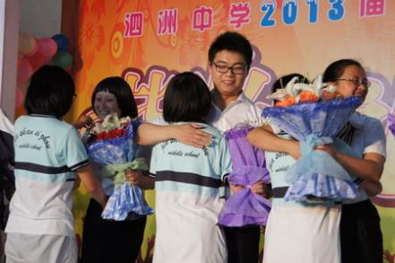
How will you decorate the place where you’ll hold the party?
Will you be happy or sad at that moment?

Slide 5
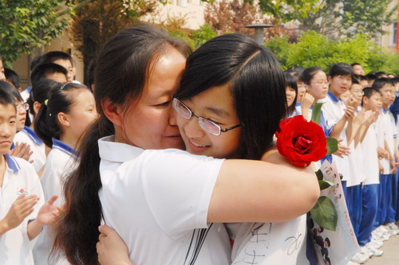
Who will you say thanks to at that time?

Slide 6

Words review
rose
laugh at
kindness
give up
try one's best
disappointed
n. 玫瑰；蔷薇
嘲笑；对......一笑置之
n. 善举；好意
放弃（努力）
尽某人最大的努力
adj. 失望的；沮丧的

Slide 7
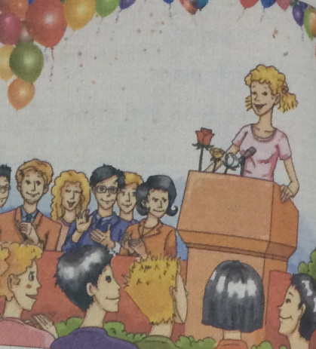
1. Look at the picture and
choose the answers to the questions.
There may be more than one answer.
1. Who will probably get thanks from the school-leavers?
a) Family
b) Friends
c) Teachers
√
√
√

Slide 8
2. What is the speaker probably going to say?
a) Thank you.
b) Good luck!
c) Cheers!
√
Now read the passage and check.

Slide 9

Listen to Part 3 and answer the questions.
1. How many roses does the speaker has?
2. Did the speaker’s father buy a violin?
Three.
Yes, he did.

Slide 10

Watch and read

Slide 11

Read the passage and answer the questions.
fellow students 同学 fellow 同伴;男子
be proud that 感到自豪
be proud of 自豪，高兴
Dear head teacher, teachers, parents and fellow
students, I'm very proud that you have chosen me
to speak to you today.
I have three roses here: a red one, a yellow one and a white one. These roses are to thank three groups of people for the three most important things that I have learnt. These three things are friendship, effort and trust.
I give the red rose to my friends. When I started school here, my Chinese was not good,
choose sb. to do sth. 选择某人做某事
one 在这里指代rose
be to do sth.表示按计划或安排要做的事
give sth. to sb. 给某人某物

Slide 12
and some of my mistakes were very funny. I once tried to say"xiexie", but I said"xiaxia" instead. Of course some people laughed, and I felt quite silly. But they were not laughing at me. They taught me to say many things in Chinese and kindly invited me to join them. Today, thanks to their kindness, my Chinese is much better, and we have become friends. So, let me say" xiexie" again to all of you for your help.
I give the white rose to my teachers, who have taught me that there is no success without effort. When I started running in the 800 meters, I always finished last and I just wanted to give up.
try to do sth. 试图做某事
silly[sɪli]adj 愚蠢的
teach sb. to do sth.叫某人做某事
teach sb.sth.=teach sth. to sb. 叫某人某物

Slide 13
But the PE teacher, Ms Huang, helped me. She ran along with me, and she said," You only really lose if you give up!" I still can't run fast enough, but I've learnt to try my best, not only with running but with whatever else I do.
I give the yellow rose to my parents for teaching me that love is about trust. When I wanted to learn the violin, my father told me that I should work harder at maths. I was disappointed. Then, on the morning of my birthday, I woke up to find a beautiful violin at my bedside. There was a note from my father:"I'am sure you will be good at music. I
ran along with me 和我一起跑
wake up 醒来
be sure 确信
be good at 擅长

Slide 14
know that you will be better at maths."
I'm sure that you all have your own memories about the happiness of the last three years, and the people whom you want to thanks for it, so let's all stand up and say, " Thank you, friends, teachers, and parents! We love you!"
stand up 起立

Slide 15
2. Find sentences which show:
1. the three things the speaker has learnt
These three things are friendship, effort and trust.
2. the three groups of people the speaker wants to thank
I give the red rose to my friends.
I give the white rose to my teachers.
I give the yellow rose to myparents.

Slide 16
3. what the speaker has learnt from each group of people
But they were not laughing at me. They taught me to say many things in Chinese and kindly invited me to join them.
I give the white rose to my teachers, who have taught me that there is no success without effort.
I give the yellow rose to my parents for teaching me that love is about trust.

Slide 17
3. Answer the questions.
1. Which sentence in Paragraph 4 means “You have to work hard to succeed”?
“You only really lose if you give up!”
2. “You only really lose if you give up!” What does the sentence mean?
只要你坚持下去，跑完全程，那么即使你最后一个到达终点，你也不是一个失败者。

Slide 18
3. “I’m sure you will be good at music. I know that you will be better at maths.” What did Betty’s father want her to do?
He wanted her to study maths harder.
4. How do you think Betty would write to her father in reply?
Thanks for your gift, and I’ll do better in maths as well as music.

Slide 19
5. “I’m sure that you all have your own memories about the happiness of the last three years, and the people whom you want to thank for it…” What does it mean?
Let all the students say thanks to their friends, teachers and parents.

Slide 20
4. Check (√) the answers to the questions.
There may be more than one answer.
1. Which words can you use to describe the speech in Activity 1?
careful excited moving
polite silly troubled
warm worried
√
√
√

Slide 21
2. Which sentence(s) will you probably find in speeches at a school-leavers’ party?
a) Thank you, friends, teachers and
parents!
b) We’ll always stay in touch.
c) I’m proud to be chosen to speak to
you.
d) Let’s all stand up and say …
√
√
√
√

Slide 22
Learning to learn
You may have to make speeches on the first day at your senior high. Try to plan ahead what you are going to say, but do not write the speech in full—just make notes. When you make your speech using the notes, you will sound much more natural.

Slide 23
Language points
1. But they were not laughing at me.
laugh at sb. 嘲笑，对……一笑置之
e.g. We shouldn’t laugh at the person
who is disabled.
我们不应该嘲笑残疾人。

Slide 24
2. Today, thanks to their kindness, my Chinese is much better, and we become friends. 今天，因为他们的善良，我的汉语比前更好，而且我们成为了朋友。
thanks to +名词/v-ing 多亏，由于
表示原因，在句中作状语，可以置于句首或句末。
e.g. Thanks to his help, we found the
hospital.
kindness n. 善举，好意 是不可数名词

Slide 25
3. I always finished last and I just wanted to give up.
give up 放弃
e.g. Smoking is bad for you, so give
up smoking right now.
吸烟对你有害，所以马上戒烟
吧。

Slide 26
常见的含give的短语有：
give back ①还给，归还；②恢复（健康
等）。
give in ① 交进来；②认输，投降；③
让步，勉强同意。
give out ①散发；②停止运转；③被用
完，耗尽；④发出，散发出。
give away ①送给人，分发；②背弃，出
卖；③泄露。

Slide 27
4. I give the white rose to my teachers, who have taught me that there is no success without effort.
我将白，玫瑰献给我的老师们，他们教会了我不努力就不会成功的道理。
who have taught me that there is no success without effort是一个非限制性定语从句，对前面的先行词teachers进行信息的补充，而不是限定性描述。与限定性定语从句不同，非限定性定语从句前面通常加逗号，从句部分即使被省略也不会造成主句意义上的不完整。

Slide 28
非限定性定语从句中的关系代词不能省略。此句中还包含有一个宾语从句that there is no success without effort, 作have taught的宾语。
no/not … without …表示“没有…就不…”。
e.g. We can’t achieve anything without you.
没有你（们）我们将一事无成。

Slide 29
5. I still can’t run fast enough, but I’ve learnt to try my best, not only with running but with whatever else I do.
我还是跑不快，但是我学会了无论做什么事都要尽最大的努力，不仅在跑步上。
try one’s best 尽某人最大努力
其后常接带to的动词不定式，即try one’s best to do sth.，表示“尽力做某事”。
e.g. Try your best to do whatever you
do.
无论你做什么事都要尽力去做。

Slide 30
not only … but .... 不但……而且……
e.g. The girl is not only clever but
hardworking.
这个姑娘不仅聪明而且还很努力。
6. I was disappointed.
disappointed adj. 失望的
e.g. I felt disappointed when he gave up
studying.

Slide 31
拓展
1. be disappointed with/in sb. 对某人失望。
2.be disappointed at/about sth. 对某事失望。
3. be disappointed to do sth. 失望做某事。
The teacher was disappointed with/in us!
老师对我们很失望。
We are disappointed at/ about the test result.
我们对测试结果很失望。
He is disappointed to hear the news.
听到这个消息他很失望。

Slide 32
7. …I woke up to find a beautiful violin at my bedside.
我醒来发现床边放着一把漂亮的小提琴。
bedside表示“床边，床头”。
句中的to find a beautiful violin at my bedside是一个不定式结构，表示行为的结果。
e.g. He arrived at the station to find the
train gone.
他到车站时发现火车已经开走了。

Slide 33
5. Write a speech you might
give at your school-leavers' party.
Start your speech by saying what your speech is going to be about.
Dear head teacher, teachers and parents, I’d like to thank you for …
Decide who you want to say thank you to.
There are many people who I’d like to thank. First, I want to thank …

Slide 34
Decide what you want to thank them for with examples.
They have always given me great help …
Finish your speech by giving best wishes for the future.
Thank you and good luck for the future.

Slide 35
练一练
C
1. It’s not right to laugh ___ others when they make mistakes.
A. for B. to C. at D. with
2. I’ll try ____ best to finish the work before Friday.
A. I B. me C. my D. mine
C

Slide 36
B
3. I can’t get high marks ________ your help.
A. with B. without
C. at D. under
4. His father didn’t buy the toy bear, so he felt _______.
A. happy B. disappointed C. kind D. wonderful
B

Slide 37


Homework：
毕业在即，请在毕业纪念簿上留下你对同学一直要说的话。60词左右。

