Slide 1
Unit 8 Topic 3
He said the fashion show was wonderful.
Section A
WWW.PPT818.COM

Slide 2
Listen to 1a and answer the questions.
1. Who watched the fashion show last month?
Kangkang.
2. How was the fashion show?
It was wonderful.
3. When will another fashion show start?
It will start at 7:30 p.m. tomorrow.

Slide 3
Underline the object clauses. Pay attention to the tense.
Kangkang said he watched it.
And he said the fashion show was wonderful.
Do you know when it’ll start?
The poster says it starts at 7:30 p.m.
I know Michael likes fashion shows very much.

Slide 4
Key points of 1a
1. And he said the fashion show was wonderful.
并且他说时装表演很精彩。
此句结构：主句为he said,宾语从句为the fashion show was wonderful,中间省略了引导词that。在这个句子中，我们重点注意宾语从句的时态必须与主句呼应。
(1) 当主句中谓语动词是一般现在时或一般将来时，从句中的谓语动词不受主句谓语时态的影响，可以按需要使用任何时态。如：
她说她要在他的桌子上留个便条。
She says (that) she will leave a message on his desk.
(2) 若主句是过去时，从句的谓语动词的时态要变成相应的过去时态，即一般现在时变为一般过去时；一般将来时变为过去将来时；现在进行时变为过去进行时等。如：
①吉姆说他喜欢听音乐。
Jim said (that) he liked listening to music.
②玛丽告诉我她正在努力学习汉语。
Maria told me (that) she was working hard on her Chinese.
③他问他们什么时候去参观农场。
He asked when they would visit the farm.
2. There will be another one there tomorrow.
明天那儿将举行另一场时装表演。
There will be...=There is/are going to be... 是there be句型的一般将来时结构

Slide 5
1b
Listen to 1a and complete the sentences. Pay attention to the tense.
1. Kangkang said he _________ a fashion show in Xidan Shopping Center last month.
2. Jane told Sarah there __________ another one in Xidan Shopping Center.
3. The poster said it ____________ at 7:30 p.m. on June 8th.
4. Sarah said they ___________ Michael to watch the show.
watched
would be
would start
would invite
宾语从句的时态必须与主句呼应。

Slide 6
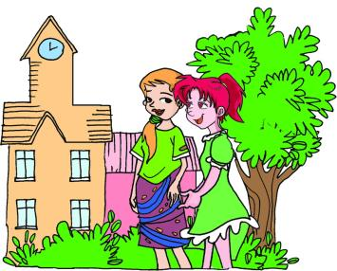
Listen and follow.
(Jane and Sarah are talking about the fashion show.)
Jane: Hi, Sarah! Did you watch the fashion show in Xidan Shopping Center
last month?
Sarah: No, but Kangkang said he watched it. And he said
the fashion show was wonderful.
Jane: There will be another one there tomorrow. Many
famous models will be there to model the clothes.
Would you like to go with me?
Sarah: Sure. Do you know when it’ll start?
Jane: The poster says it starts at 7:30 p.m.
Sarah: Oh, I know Michael likes fashion shows
very much. Shall we invite him?
Jane: Good idea!
Fashion Show
Charming Modes
Beautiful Clothes
Amazing Show
Don't miss it!
Date:June 8th
Time:7:30p.m
Place:Xidan Shopping Center

Slide 7
Retell the dialog with your partner.The following information may help you.
(Jane and Sarah are talking about the fashion show.)
Jane: Hi, Sarah! Did you ____________________________________________?
Sarah: No, but Kangkang said ___________. And he said
_____________________________.
Jane: There _____________________tomorrow. Many
famous models ___________________________.
______________________________?
Sarah: Sure. _____________________start?
Jane: The poster says _________________.
Sarah: Oh, I know_____________________.
Shall we ____________ him?
Jane: Good idea!
Fashion Show
Charming Modes
Beautiful Clothes
Amazing Show
Don't miss it!
Date:June 8th
Time:7:30p.m
Place:Xidan Shopping Center

Slide 8
1c
Read and number the sentences to make a conversation. Then practice in pairs.
Sure. It will start at 7:30 p.m.tomorrow in Xidan Shopping Center.
Hi, Michael! We are going to watch a fashion show tomorrow. Would you like to go with us?
How do you know that?
I read the poster. It also says many famous models will be there to model the clothes.
A fashion show? Sounds interesting. Could you tell me when and where?
Great! I'll go with you.
3
1
4
5
2
6

Slide 9
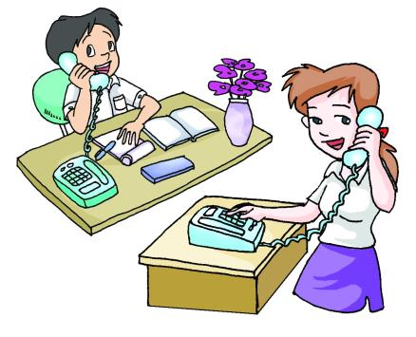
2
Look at the pictures. Ask and answer in pairs by following the example.
I'm designing our
school uniforms.
What are you doing?
Example:
A:What did Kangkang's mother ask?
B:She asked Kangkang what he was doing.
A:What did Kangkang say?
B:He said he was designing their school uniforms.

Slide 10
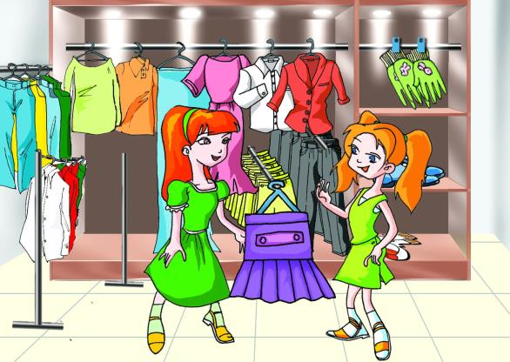
How do you like the dress?
I don't like it at all.
1
A:What did Sally ask?
B:She asked Helen how she liked the dress.
A:What did Helen say?
B:She said (that) she didn't like it at all.

Slide 11
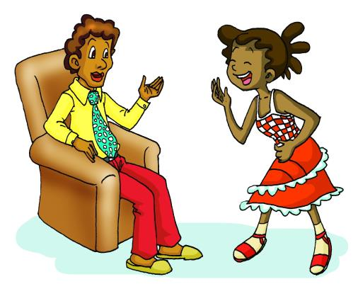
Can I watch TV ?
You should wash your
clothes first.
2
A:What did Maria ask?
B:She asked her father if/whether she could watch TV.
A:What did her father say?
B:He said (that) she should wash her clothes first.

Slide 12
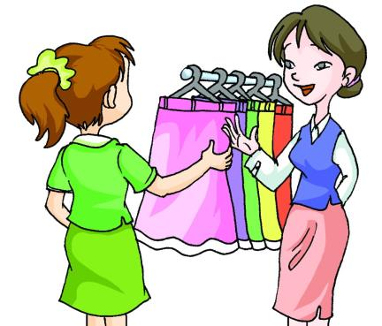
Where can I find sportswear?
You can find it on the
second floor.
3
A:What did the girl ask?
B:She asked the saleswoman where she could find sportswear.
A:What did the saleswoman say?
B:She said (that) she could find it on the second floor.

Slide 13
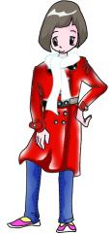
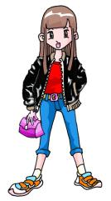
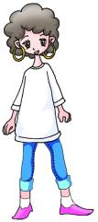
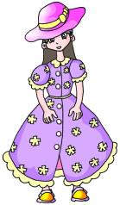
Project
3
A. Listen to the description of the fashion show and match the models with their names.
Susan Lisa Ann Amy Sally
A
B
C
D
E

Slide 14
B.Listen again and fill in the blanks.
1. Ann was wearing a silk _____ and a _______ dress.
2. Amy was wearing a ______ ______ , blue jeans and white ________.
3. Lisa was wearing a _______ blouse and ________ pants.
4. Sally was wearing a leather __________ and a white _________.
5. Susan was wearing a black ________ with a _______ ________ in her hand.
hat
woolen
white
T-shirt
socks
cotton
brown
overcoat
scarf
jacket
pink handbag
A
B
C
D
E

Slide 15
Exercises in class
单项选择
( )1. — What did Li Xiang say just now?
— He said he ____ his homework in the classroom at that time.
A. did B. is doing C. was doing D. does
( ) 2. There ____ a talk show on CCTV-4 at nine this evening.
A. will have B. is going to be C. is going to have D. is having
( ) 3. — Could you let me know ____ yesterday?
— Because the traffic was heavy.
A. why did you come late B. why you came late
C. why do you come late D. why do come late
( ) 4. “ Have ____ try, you are so close to the answer.” the teacher said to Amy.
A. the other B. one another C. other D. another
C
B
B
D

Slide 16
Exercises in class
句型转换
1. There will be a flower show in the park.(同义句转换)
There _____ ________ ______ ______ a flower show in the park.
2. Chinese fashion is different from that in the West.(用He said 连成一句)
He said that _____________________________________________.
3. Can I play basketball after school? Michael asked his teacher.(合并成一句)
Michael asked his teacher____________ ______ ________ play basketball after school.
4. He says there will be a football match in the afternoon.(改成主句谓语动词为一般过去时的宾语从句)
____________________________________________________.
is
going
to
be
Chinese fashion was different from that in the west
if/whether
he
could
He said there would be a football match in the afternoon

Slide 17
Summary
We learn:
Object clauses:
Kangkang said he watched it.
He said the fashion show was wonderful.
Do you know when it’ll start?
The poster says it starts at 7:30 p.m.
I know Michael likes fashion shows very much.
She asked Kangkang what he was doing.
He said he was designing their school uniforms.
We can:
◆Talk about fashion show:
There will be another fashion show there tomorrow.
Many famous models will be there to model the clothes.
The poster says it starts at 7:30 p.m.
Could you tell me when and where?

Slide 18
Homework
1.Read 1a aloud and try to repeat.
2.Finish Section A in your workbook.
3.Preview Section B.

Slide 19
Thank you

