Slide 1
Unit 6 Be a Champion!
Classroom Olympics
WWW.PPT818.COM

Slide 2
Objectives
To understand the letter.
2. To learn some useful words and expressions about classroom Olympics.
3.Learn how to write an E-mail.

Slide 3
Words & expressions
rope
sit-up
push-up
race
result
none
twentieth
n. 绳
n. 仰卧起坐
n. 俯卧撑
n. 赛跑；速度竞赛
n. 结果；成绩
pron. 一个也没有；毫无
num. & adj. 第二十(的)

Slide 4
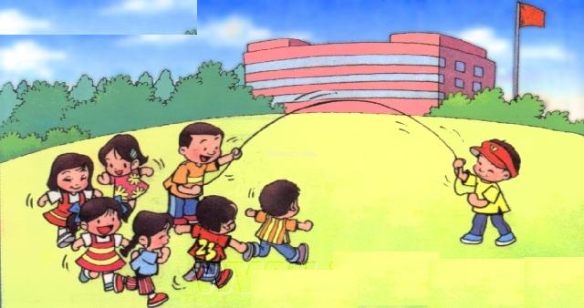
jump rope

Slide 5
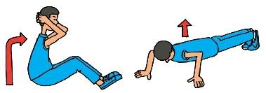
sit-ups
push-ups

Slide 6
Listening

Slide 7
1. How many events did Jenny’s classmates invent for the classroom Olympics? ( ) A five B six C four D seven
Reading
Read the lesson and finish the exercises.
A
Dear Li Ming,
This week in school, we had our own classroom Olympics! Our class had five different events--- jumps rope, long jump, sit-ups, push- ups and “Jump over the Dinosaur”. Everyone competed in each event, one by one.

Slide 8
2. Who won first place in the long jump?( ) A Sandra B Lisa C Kim D Jenny
C
The events were fun! Sandra won first place in the rope event. She jumped 180 times in one minute without stopping. Lisa won second place in the long jump. She jumped very far, but Kim jumped farther.

Slide 9
3. What things did they need to prepare for Danny’s event?
Some paper pizzas, a cardboard donut and a toy dinosaur.
But my favourite event was Danny’s. He called it “Jump over the Dinosaur”. It was a race. Each person walked on some paper pizzas, climbed through a cardboard donut and then jumped over a toy dinosaur. We used a watch to see who was the fastest.

Slide 10
4.Who was the second of the race?
Jenny.
What was the result? Danny won the race! None of us could catch him! But I was close. I was only two seconds slower than Danny.
5. How did Brian feel? Why?
Brain was sad because he lost.
Brain was sad because he lost. He came in twentieth. He did his best, but he kept falling off the pizzas!
Notes:
10

Slide 11
Practice
Fill in the blanks with the words in the box.
none result rope event
A/An ________is a race or a competition.
A/An _______ is a very thick strong string.
The accident was a/an _______of bad driving.
He went to many bookstores, but _______ of them had the book he wanted.
event
rope
result
none

Slide 12
Summary
1.jump rope 跳绳
long jump 跳远
high jump 跳高
sit-ups 仰卧起坐
push-ups 俯卧撑
2. jump over 跳过（越）； 忽略
3. one by one 一个接一个
4. win first place in在（某个比赛、项目）中赢得第一名

Slide 13
5. the result of ……的结果
6. win the race 赢得赛跑
7. none ( ≥3个)没有一个(人/物)
none of +n(不可数）+v（单数）
none of +n(可数复数)+ v（单数/复数)
eg1:None of the money belongs to me. eg2:None of your books is/are on the desk.

Slide 14
8. come/be in twentieth ……第20名
我在这次数学考试中得了第15名。
I came/was in fifteenth in this maths test.
9. do/try one’s best to do sth.
尽某人最大的努力做某事
Eg. We should ______________ to work hard .
try our best

Slide 15
10. ① keep doing 继续做某事(不间断)
② keep on doing 重复做某事（反复性）
③ keep /stop/prevent sb. from doing sth.
阻止某人做某事

Slide 16
HOMEWORK
1. Imagine you have a pen pal in Canada. Send an e-mail to him or her telling about your classroom Olympics or a school meeting.
2.Learn the words and expressions in Lesson 37.

Slide 17
Thank you

