Slide 1
Module 8 My future life
Unit 1
Here’s to our friendship!
WWW.PPT818.COM

Slide 2
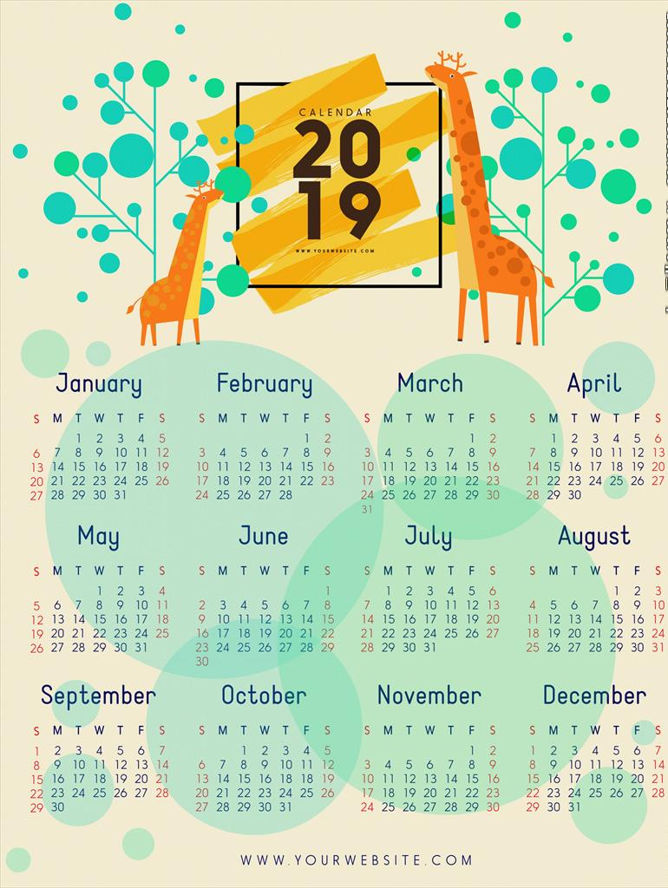

Slide 3
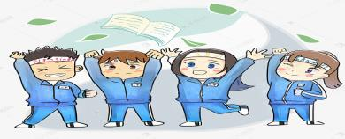
Examination countdown
20 days

Slide 4
Three years ago, we met at Tashui Middle School. We were young at that time.

Slide 5
Every day, we studied in the classroom, played together. We laughed, even cried…

Slide 6
There are many friendly teachers, they have been around us all the time!

Slide 7
There are many cute classmates, we are growing together!

Slide 8
We are “Class Three”! We will leave our school, teachers, friends…

Slide 9
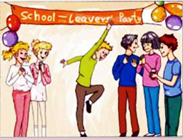
school-leavers’ party
Let’s prepare for our party!

Slide 10
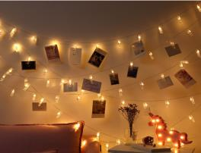
Decorate our party
Make sth look beautiful!
balloons
flags
pictures and lights
---How can we decorate our party?
---We can put up/hang some…

Slide 11
Choose the music
Pardon?
I’m sorry!
Please say it again?
---What do you think of the music?
---It’s got a great beat!
---It’s a bit noisy!
n.节拍;拍子

Slide 12
Food and drink:
School-leavers’ Party
Menu
Apple juice
Hot dog
Pancake n.薄煎饼
…
we can fetch anything to eat!
---What’s on the menu?
---There is/are …on the menu.
go and bring sth back.

Slide 13
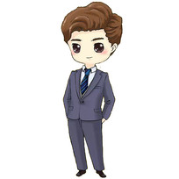
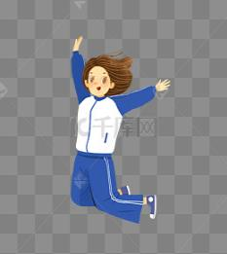
What will you wear at the party?
dress
handbag
suit
school uniform
n.小提包
beautiful dresses with handbags.
Girls can wear
suits.
Boys can wear

Slide 14
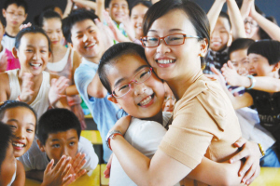
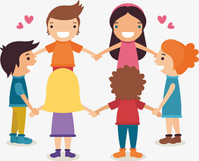
What can you do at the party?
---We can…
sing and dance
take photos
play games
hug our teachers and classmates
talk about your future!

Slide 15
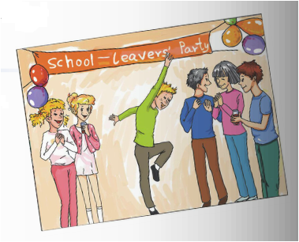
Listen and answer the questions
1 Where is Betty going tonight?
Betty is going to the school-leavers’ party.
2 What are Betty and Tony going to do?
She is going to help Tony put up the pictures balloons and flags.
3 Why does Betty refuse to eat before she leaves?
Betty refuses to eat because she is going to eat at the party.

Slide 17
Listen and check(√)
What are they talking about at the party?
Their feelings
The hall
The music
Their teachers
Their plans
Their family
The food and drink
√
√
√
√
√

Slide 18
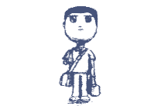
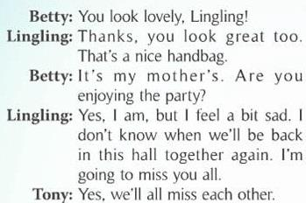
Their feelings:
How do they feel?
They enjoyed the party, but feel a bit sad.
Why is Lingling sad?
Lingling is sad because she’s going to miss her friends.

Slide 19
The hall
What makes the hall look wonderful?
The international flags make the hall look wonderful.

Slide 20
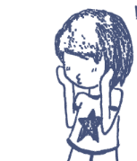
The music
What do they think of the music?
They think the music has got a good beat, but it’s a bit noisy.

Slide 21
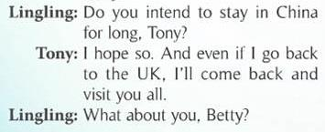
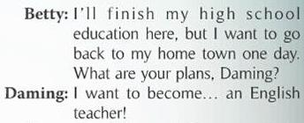
Their plans
Plan to do sth.
What are their future plans?
Tony
Betty
Daming
stay in China ,or come back and visit.
finish high school, but go back to home town.
替换入自己学校的照片
become an English teacher.

Slide 22
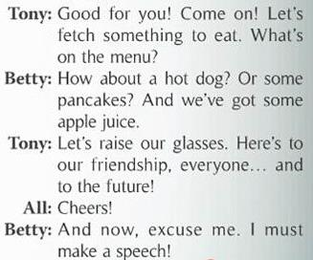
The food and drink
What is on the menu?
A
B
School-leavers’ Party
Menu
hot dogs;
Jiaozi;
cakes;
apple juice
School-leavers’ Party
Menu
hot dogs;
pancakes;
apple juice
为…干杯
替换入自己学校的照片
What do they wish for when they raise their glasses?
They wish for their friendship and future.

Slide 23
Watch and role-play

Slide 24
Summary and retelling:
Their feelings:
enjoy, but a bit sad
Because…
the hall:
wonderful
flags and balloons
The music:
a great beat; a bit noisy
school-leavers' party
hot dogs, pancakes, apple juice
The food & drink:
raise glasses for…
Tony: intend to…
Their plans:
Betty: finish…
Daming: want to…

Slide 25
What are your plans and hopes for the future?
I intend to…
I want to…
I hope to…
…
xxx
2019.5

Slide 26
Will you miss your friends and classmates?
I did not meet you at the best time, but when I met you, I had the best time.
我不是在最好的时光遇见了你们，而是遇见了你们，我才有了最好的时光。

Slide 27
homework
Suppose you were going to make a speech
at the school-leavers’ party, what would
you say?
Please think about how to give a speech
and write your own speech.

Slide 28
Thank you！

