Slide 1
Sports and Fitness
Section D Reading for Writing & Assessing Your Progress
WWW.PPT818.COM

Slide 2
Ⅰ
Ⅱ
Ⅲ
Ⅰ.知识体系图解
positive
slim
rather
jog
stress
error

Slide 3
Ⅰ
Ⅱ
Ⅲ
有作用或影响
而不是
停止做(或使用、食用);剪下
有时;偶尔
与……相比
与……相似
与……有共同之处
最终

Slide 4
Ⅰ
Ⅱ
Ⅲ
Ⅱ.介词填空
1.Compared her achievements,her shortcomings are,after all,only secondary.
2.Let us suppose another planet with conditions similar
those on the earth.
3.In common you,I think the venture will be a success.
4.It is known to all that London was different most European capitals.
5.It’s hard work but if you hang on you’ll succeed the end.
with
to
with
from
in

Slide 5
Ⅰ
Ⅱ
Ⅲ
Ⅲ.朗读并熟记下列句子
1.体育运动可能是几乎所有人都可享受的最大众化的放松形式。
Sports are perhaps the most popular form of relaxation that almost all can enjoy.
2.我每天都设计具体的计划来锻炼我的大脑和身体。
I have a detailed routine that is designed to strengthen both my mind and my body.
3.只有那些达到标准的运动员才能够参加。
Only those athletes who have reached the required standard are allowed to take part.
4.很显然每天锻炼非常有益于你的健康。
It’s obvious that daily exercise is very beneficial to your health.
5.他每周锻炼四次来增强体质。
He works out four times a week to build up his health.

Slide 6
重点词汇
重点句式
高分写作
随堂练习
1.make a difference有作用或影响
【课文原句】I had no idea a letter could make such a difference!
我不知道一封信能有如此大的作用!
【词汇精讲】make a difference有作用或影响
The researchers found that cultural and environmental factors made a difference.
研究人员发现,文化和环境因素起着重要的作用。
【词汇拓展】
It makes no difference whether...是否……没有关系
Does it make any difference...?……有区别吗?
make a difference有区别

Slide 7
重点词汇
重点句式
高分写作
随堂练习
It makes no difference whether you will take part in our activity.
你是否参加我们的活动已无关紧要了。
Does it make any difference whether she will come to our party?
她来不来参加我们的聚会有什么关系吗?
Nothing I say is going to make a difference with you.
我说的话对你来说没有什么区别。

Slide 8
重点词汇
重点句式
高分写作
随堂练习

Slide 9
重点词汇
重点句式
高分写作
随堂练习
2.cut...out停止做(或使用、食用);剪下;删除
【课文原句】Rather than cutting out the foods I enjoyed,I added healthy foods to my meals.
我在我的饮食中添加了健康的食物,而不是停止吃我喜欢的食物。
【词汇精讲】句中的cut out意为“停止食用……”,是“动词+副词”构成的短语。cut out还可表示“剪下;删除”等。
He cut this article out of the magazine.
他从杂志上剪下了这篇文章。
The teacher cut out a paragraph of his article.
老师删掉了他文章中的一个段落。

Slide 10
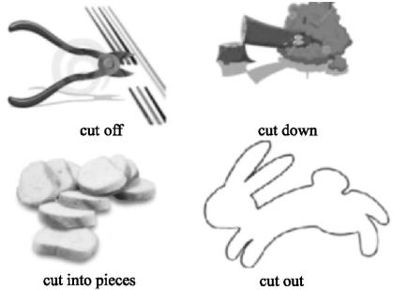
重点词汇
重点句式
高分写作
随堂练习
【词汇拓展】

Slide 11
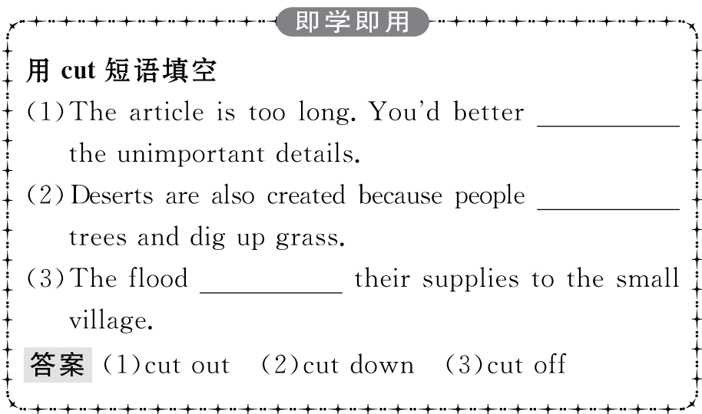
重点词汇
重点句式
高分写作
随堂练习

Slide 12
重点词汇
重点句式
高分写作
随堂练习
3.compare...with/to与……比较
【课文原句】Finally,I stopped comparing myself with actresses and models and looking for things that were wrong with my face or body.
最后,我不再拿自己与女演员和模特做比较,寻找我的脸和身体有问题的地方。
【词汇精讲】句中的compare...with...意为“与……相比”,在句中是动词-ing形式做动词stopped的宾语。
The teacher compared my handwriting with that of Tom’s.
老师把我的书法和汤姆的做了比较。
Compared to our small house,Bill’s house seemed like a palace.
与我们的小房子相比,比尔的房子就像一座宫殿。

Slide 13
重点词汇
重点句式
高分写作
随堂练习
compare...to...还可以表示“把……比作……”,指出两个事物之间的关系或相似。
Young people are compared to the sun at eight or nine in the morning.
年轻人常常被比作早晨八、九点钟的太阳。

Slide 14
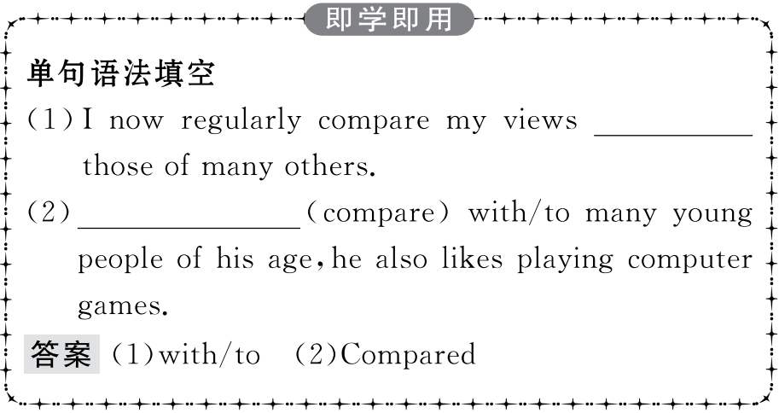
重点词汇
重点句式
高分写作
随堂练习

Slide 15
重点词汇
重点句式
高分写作
随堂练习
4.positive adj.积极的;正面的;乐观的;肯定的
【课文原句】By being positive about myself and my body,I became both happier and healthier.
通过积极地对待自己和我的身体,我变得更加快乐和健康。
【词汇精讲】句中的positive意为“积极的”,做being的表语。
He has made a very positive contribution to the organisation.
他对这个组织做出了积极的贡献。
Good TV programmes have a positive influence on kids.
好的电视节目对孩子有积极的影响。
She’s got a really positive attitude to life.
她对生活的态度很乐观。

Slide 16
重点词汇
重点句式
高分写作
随堂练习
【词汇拓展】
She was quite positive about the amount of money needed.
她对所需要的钱的数目非常肯定。

Slide 17
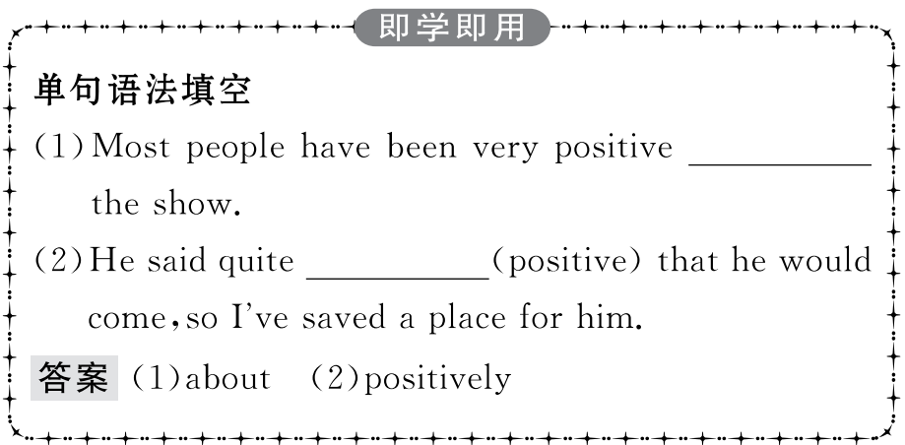
重点词汇
重点句式
高分写作
随堂练习

Slide 18
重点词汇
重点句式
高分写作
随堂练习
Once I started thinking about fitness rather than weight,things began to change.
一旦我开始考虑健康而不是体重,事情就开始变了。
【句式剖析】本句是一个复合句。主句是things began to change,once是连词,意为“一旦……,就……”,引导条件状语从句。
Once you make a promise,you should keep it.
你一旦做出承诺,就要遵守诺言。
Once you get into a bad habit,you’ll find it hard to get out of it.
你一旦染上坏习惯,你就会发现很难戒掉。

Slide 19
重点词汇
重点句式
高分写作
随堂练习
在once引导的条件状语从句中,如果主句和从句都表示将来的动作,从句要用一般现在时来表示将来时。
You will be successful in the interview once you have confidence.
在面试时你一旦有了自信心,就将会成功。

Slide 20
重点词汇
重点句式
高分写作
随堂练习
有关锻炼与健康的短文
一、审题定调
1.确定体裁:本单元的写作为一篇关于锻炼与健康的短文。根据写作材料来看,该类短文可使用记叙文的形式,写作时可根据材料内容使用对比的方法,主要描述自己的变化过程。
2.确定人称:本文的主要人称为第一人称。
3.确定时态:由于短文主要讲述的是过去发生的事情,所以主要用一般过去时。

Slide 21
重点词汇
重点句式
高分写作
随堂练习
二、谋篇布局
该写作可以按照时间顺序来写,分为三个段落。
第一段:介绍短文的主题:健康的饮食和规律的运动可能有助于防止儿童肥胖。(写作要求中已给出,然后使用过渡句引出下文)。
第二段:介绍自己一年前的饮食习惯以及健康状况。
第三段:介绍自己的改变以及未来的打算。

Slide 22
重点词汇
重点句式
高分写作
随堂练习
三、短文模板

Slide 23
重点词汇
重点句式
高分写作
随堂练习
四、组织语言
1.常用语块

Slide 24
重点词汇
重点句式
高分写作
随堂练习
2.遣词造句

Slide 25
重点词汇
重点句式
高分写作
随堂练习

Slide 26
重点词汇
重点句式
高分写作
随堂练习
某英文报“健康生活”栏目正在讨论有关健康食品、体育锻炼与少年儿童肥胖的问题。假如你是某校高一学生李华,请根据以下要点写一篇短文。
1.一年前,吃垃圾食品,不参加锻炼,上楼困难;
2.改变:平衡膳食,参加锻炼,身体健康。
注意:
1.词数不少于100;
2.短文的开头已给出。
提示词语:junk food好吃但不利于健康的食品
snacks各种零食
A healthy diet and regular exercise may help to prevent obesity among children.

Slide 27
重点词汇
重点句式
高分写作
随堂练习
参考范文
A healthy diet and regular exercise may help to prevent obesity among children.Take myself for example.
I used to be a healthy boy,but over a year ago,I got into the habit of eating a lot of junk food and snacks.Besides,I spent a lot of time lying on the sofa,watching TV,and did little exercise.As a result,I put on so much weight that I found it difficult to climb the stairs.
So I made up my mind to change the unhealthy lifestyle.Not only did I begin to have a balanced diet,but I also took an active part in various sports activities such as swimming,skating,running and playing basketball.Months later,I became as fit as before.I will keep on exercising and have a healthy lifestyle.

Slide 28
重点词汇
重点句式
高分写作
随堂练习
Ⅰ.单词拼写
1.Be (乐观的) and joyful,for your mental health is equal to your physical health.
答案:positive
2.There are some cultural d (差别) between the West and the East.
答案:differences
3.As is well known,cycling,along with (慢跑) is regarded as one of the best forms of exercise.
答案:jogging

Slide 29
重点词汇
重点句式
高分写作
随堂练习
4.Dickens is compared with the Mona Lisa in the text to (强调) his importance in literature.(2018·浙江卷)
答案:stress
5.C with previous studies,she finds the speed of breaking down in this one exciting.(2018·北京卷)
答案:Compared

Slide 30
重点词汇
重点句式
高分写作
随堂练习
Ⅱ.课文语篇填空
Though I knew that it was impossible for me to look like the slim girls on TV,I tried my best (lose) weight and tried every new diet I read online.One day,I read an article which made a great __________(different) to my life.I began to consider my fitness rather
weight.I started to work out and added (health) foods to my meals instead of cutting the foods I enjoyed.I didn’t compare myself with the actresses or models any more and was positive about myself and my
body. a result,I became both happier and healthier.
to lose
difference
than
healthy
out
As

