Slide 1
Unit4 I live in a big house
WWW.PPT818.COM

Slide 2
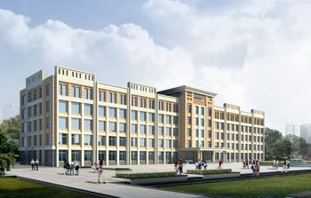
building

Slide 3
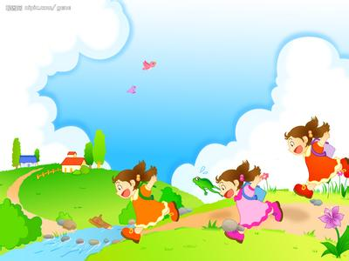
after school

Slide 4
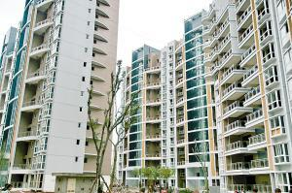
flat

Slide 5
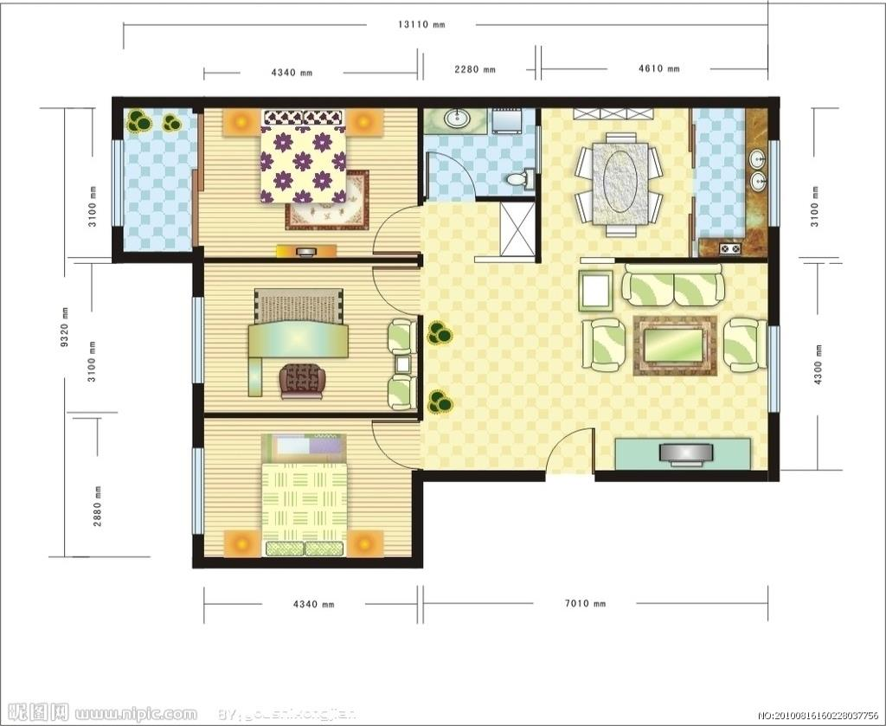
bathroom
garden
bedroom
kitchen
study
living room
bedroom
flat

Slide 6
bathroom
garden
bedroom
kitchen
study
living room
bedroom
It has two bedrooms, a bathroom,
a study, a kitchen, a living-room and a
garden.

Slide 7
bathroom
garden
bedroom
kitchen
study
living room
bedroom
I live in the flat.

Slide 8
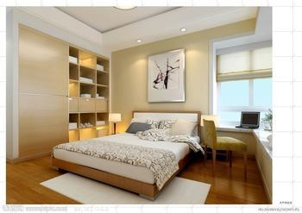
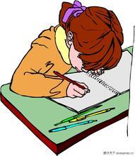
bedroom
read books
do my homework
I like to…

Slide 9
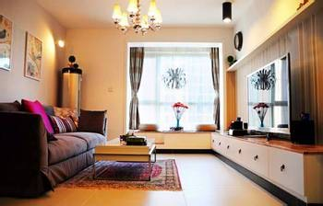
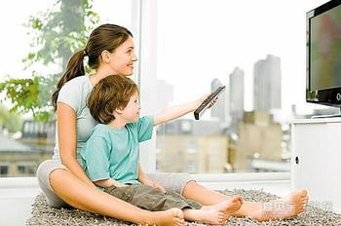
living room
watch TV
I like to…

Slide 10
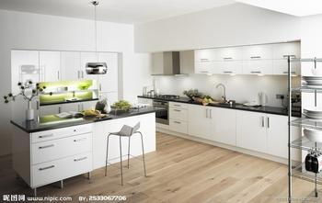
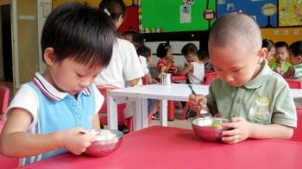
kitchen
have meals
I like to…

Slide 11
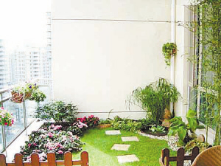
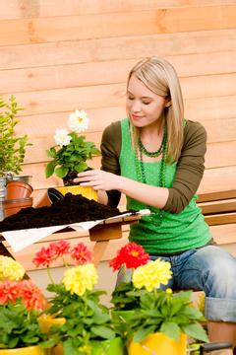
garden
grow flowers
I like to…

Slide 12
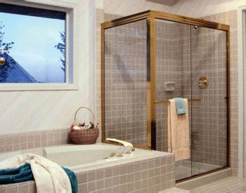
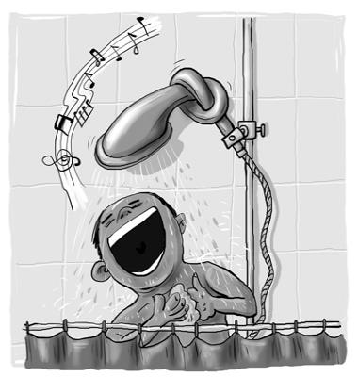
bathroom
I like to…
take a shower

Slide 13
What do you like to do in the …(bedroom)?
I like to…

Slide 14
Watch and Answer：
1.Does Janet live in a flat？
2.Does Ben live in a flat？
3.What does Ben like to do in the study?
Yes，she does.
No，he doesn’t.
Play computer games there.

Slide 15
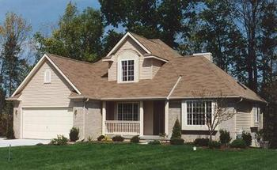
flat
house

Slide 16
Take your picture of your flat or house and talk
I live in a …
It’s…
It has… and…
I like to…in the…

