Slide 1
河北教育出版社 五年级 | 下册
Unit 1 Lesson2
What Are You Doing?
WWW.PPT818.COM

Slide 2
河北教育出版社 五年级 | 下册
Let's review
Look and say

Slide 3
河北教育出版社 五年级 | 下册
Warm-up

Slide 4
河北教育出版社 五年级 | 下册
Lead-in
Answer these questions
What does Jenny see on the train?
Jenny sees many tall trees …
What is Danny looking at?
Danny is looking at a banana and some dumplings.

Slide 5
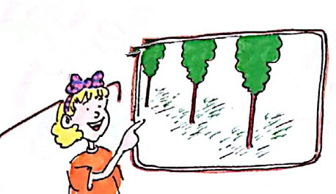
河北教育出版社 五年级 | 下册
Presentation
Jenny is looking out of the window on the train.
Look! I see many tall trees!

Slide 6
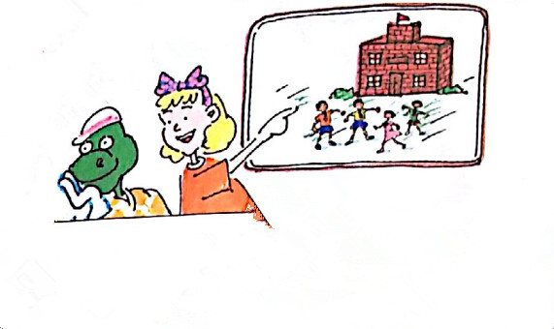
河北教育出版社 五年级 | 下册
There’s a red school! Some boys and girls are playing there.

Slide 7
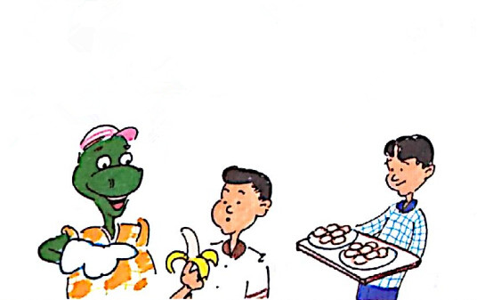
河北教育出版社 五年级 | 下册
Danny is not looking out of the window.
What is Danny looking at?
Look! I see a banana!
I see dumplings!

Slide 8
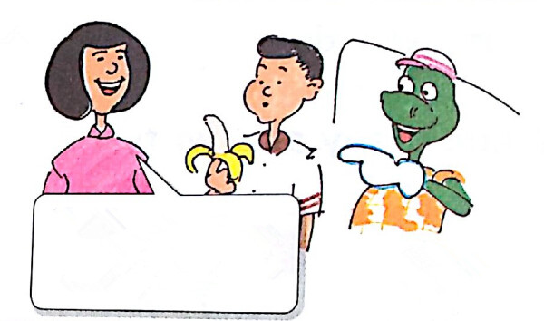
河北教育出版社 五年级 | 下册
Danny, please don’t point.
Sorry.

Slide 9
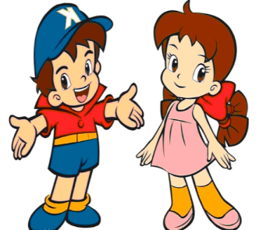
河北教育出版社 五年级 | 下册
Practice
Role play
The two people practice the dialogue and then act out.
两人一组练习对话，然后表演出来。

Slide 10
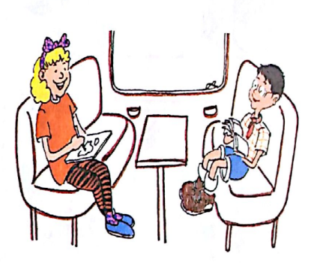
河北教育出版社 五年级 | 下册
Presentation
Li Ming: Jenny, what are you doing now?
Jenny: I am drawing a picture. What are you doing?
Li Ming: I’m reading a book.

Slide 11
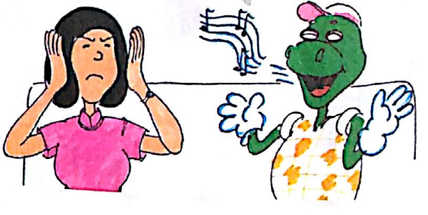
河北教育出版社 五年级 | 下册
Jenny: Danny is singing a song to your mother.
Li Ming: Danny, please don’t sing!

Slide 12
河北教育出版社 五年级 | 下册
Practice
Read Part1 and Part2. Tick or cross.
a. Jenny sees many trees.
b. Danny is pointing at the food.
c. Jenny is drawing a picture on the train.
d. Li Ming is reading the newspaper.
e. Mrs. Li likes Danny’s song.
√
√
√
×
×

Slide 13
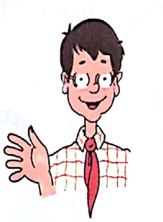
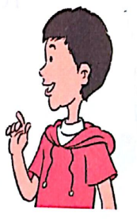
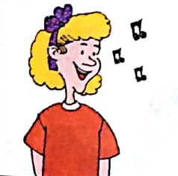
河北教育出版社 五年级 | 下册
What’s Jenny doing?
She’s singing a song.

Slide 14
河北教育出版社 五年级 | 下册
Summary
重点词汇
see look look out of look at
boy girl now draw picture
如何用现在进行时询问并回答
---What … doing?
---She’s/He’s/I am …

Slide 15
河北教育出版社 五年级 | 下册
Homework
1. watch the flash and repeat, in accordance with the correct pronunciation and intonation, read and act the dialogue.
观看课文动画并跟读，按照正确的语音、语调朗读并表演课文对话。
2. correctly write the words that are learned in this lesson.
正确书写本节课所学的单词。

