Slide 1
Module 10 On the radio
Unit 2 It seemed that they were speaking to me in person.
WWW.PPT818.COM

Slide 2
Warming-up
Chant or read aloud.
the red light
the interview
the programme
the football match
the end
the reports
the sports news

Slide 3
Pre-reading
New words
seem
v. 看来；似乎
listener
n. 听众；听者
part-time
adj. 兼职的
article
n. 文章；报道
studio
n. 录制室；录音室
purpose
n. 意图；目的

Slide 4
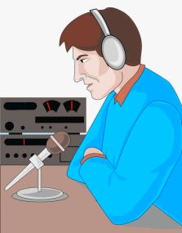
Pre-reading
Look at the photo and say what it shows.
earphone
a presenter
a microphone
in a radio studio/station
It probably shows that a newsreader or a presenter is on air.

Slide 5
While-reading
Read the passage and decide where you are likely to see the photo.
a) In a book about the history of radio.
b) In the life story of a famous radio presenter.
c) In a book on how radio works.


Slide 6
While-reading
Complete the sentences.
1. The writer met ______________ in a radio station.
2. The manager asked why he wanted a job _______.
3. At the age of four, the writer _________________________________
listening to his favourite programmes.
4. At the age of nine, he asked for part-time jobs in ________________.
5. As he grew older, he learnt about ____________.
6. This was how the writer’s _________________ began.
a radio manager
in radio
sat close to the radio in the living room
small radio stations
Internet radio
first real job in radio

Slide 7
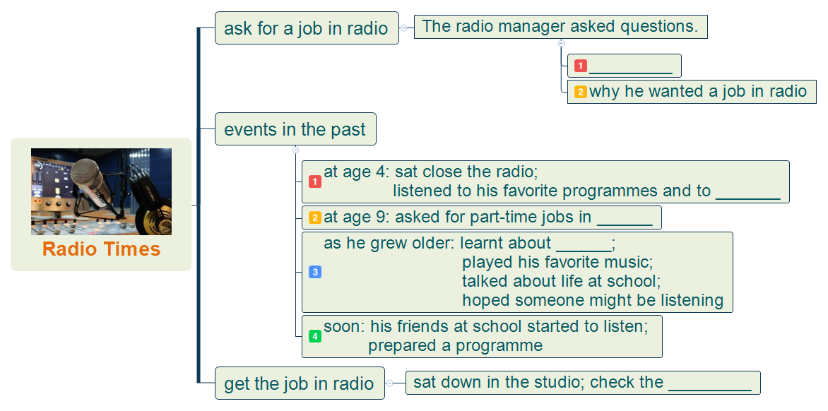
Post-reading
Fill in the blanks and retell the passage.
how old
to the voice of his favorite presenters
a small radio station
Internet radio
sound level

Slide 8
Post-reading
Language points
1. The radio manager looked down at me. 电台经理低头看着我。
look down 向下看
look down at sb./sth. 向下看着某人或某物
e.g. I was looking down at my watch when he called me.
2. And you want a job in radio? 你想在电台找份工作？
陈述句尾加问号变成陈述疑问句，朗读时句尾读升调。

Slide 9
Post-reading
Language points
3. Shouldn’t you be at school? 难道你不用上学吗？
否定疑问句，表示惊讶、赞赏或责难。
e.g. Aren’t these pictures lovely? （表示赞赏）
Why are you driving so fast? Don’t you know
the traffic regulations? （表示责难）

Slide 10
Post-reading
Language points
4. I still remember, when I was four years old, I sat close to the radio
in the living room, listening to my favourite programmes and to the
voices of my favourite presenters.
我仍然记得在我四岁的时候，我紧挨着客厅里的收音机坐着，听我最喜欢的节目
和最喜欢的主持人的声音。
close to 临近，靠近
sit close to sth. 坐在……的旁边
close adj. 离得近，距离短
v. 关上

Slide 11
Post-reading
Language points
5. It seemed that they were speaking not to lots of listeners
but to me in person. 我感觉他们好像不是在和广大听
众说话，而是在亲自和我说话。
It seems that+从句 看起来似乎……
seem+adj./to v./从句
e.g. You seem happy.
They seem to know what they should do.
It seems that they know what they should do.
in person 亲自，当面
e.g. I think you’d better give the money to him in person.

Slide 12
Post-reading
Language points
6. At the age of nine, I asked for part-time jobs in small radio stations.
九岁的时候，我去小电台找过兼职工作。
at the age of 在……岁的时候
ask for jobs 求职
ask sb. for sth. 向某人要求某物

Slide 13
Post-reading
Language points
7. One day I learnt about Internet radio.
有一天我听说了网络电台。
learn about 听说，了解
e.g. I didn’t learn about the importance of it.
8. I did this by looking out of the window.
我是根据观察窗外的情况做到的。
look out of the window 向窗外看
by doing sth. 通过做某事

Slide 14
Post-reading
Language points
9. The purpose is to check the sound level.
目的是检查音质水平。
purpose n. 目的；意图
the purpose is to do sth. 目的是做某事
for the purpose of 为了……
on purpose 故意，有意地

Slide 15
Post-reading
Complete the passage with the correct form of the words and expressions in the box.
article at the age of listener purpose seem studio
seems
Peter (1) __________ to be very happy with his new job. He works in the
(2) ________ of a local radio station. He is lucky that (3) ____________ only twenty he is doing something he loves and has a real (4) __________. Every morning when he starts work, he does a sound check and then he looks for interesting newspaper (5) __________ to talk about on the show. The (6) __________ can phone in to talk to Peter or they can send emails to ask him to play their favourite songs. At the end of the show, he closes down all the equipment and goes home.
studio
at the age of
purpose
articles
listeners

Slide 16
Post-reading
Look at the sentences from the passage.
“How old are you?” The radio manager looked down at me. “Fifteen,’’ I said. “And you want a job in radio? Shouldn’t you be at school?” he asked. | describing an important event in the past
I’ve always loved the radio. I still remember, when I was four years old, I sat close to the radio in the living room, listening to my favourite programmes and to the voices of my favourite presenters. | giving background information

Slide 17
Post-reading
Now find sentences in the passage in Activity 2 which show:
important events in the past
background information

Slide 18
Post-reading
Possible answers:
Important events in the past:
—One day I learnt about Internet radio.
—Soon my friends at school started to listen, and then they wanted to help.
Background information:
—Once a week. I played my favourite music from my father’s computer,
talked about life at school, and hoped someone might be listening.
—We prepared a programme once a week, doing research by reading
articles about music and sports news. We also did research for jokes and
the weather report. (I did this by looking out of the window).

Slide 19
Post-reading
Write a passage describing an important event in the past and giving background information.

Slide 20
Post-reading
Fill in the blanks according to Chinese.


prepared
1. We ___________ (准备) a programme everyday.
2. I want you to ___________ (解释) why you didn’t go there.
3. He ___________ (看起来) to be very strange.
4. She has written an __________ (文章) for the newspaper.
5. ___________ (国际的) calls are very expensive.
6. The ___________ (目的) of this project is to make money.
7. At the ___________ (年龄) of twenty, he found a job in radio.
8. When the red light is on, we’re on ___________ (广播).
explain
seems
article
International
purpose
age
air
Notes:
20
中国英语教师网

Slide 21
Summary
seem, listener, article, studio, part-time, purpose
in person
1. It seemed that they were speaking not to lots of listeners but
to me in person.
2. … and hoped someone might be listening.
3. Just tell me what you had for breakfast.
4. The purpose is to check the sound level.

Slide 22
Homework
1. Rewrite the passage in Activity 2 according to the order
in which the events happened.
2. Preview Unit 3.

