Slide 1
Unit 3 Topic 3
Could you give us some advice on how to learn English well?
Section B
WWW.PPT818.COM

Slide 2
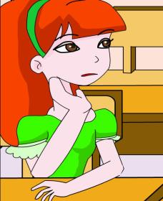
What’s her difficulty in learning English?
She doesn’t know how to pronounce the words.
Can you give her some advice on how to learn English well?

Slide 3
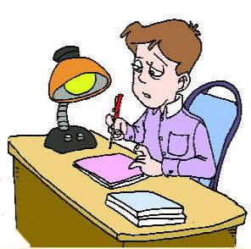
What’s his difficulty in learning English?
how to write a composition
Can you give them some advice on how to learn English well?
feel sleepy

Slide 4
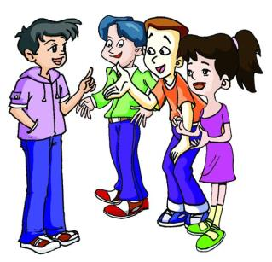
Listen to the 1a and complete the table.
Name | Difficulties in learning English
Wang Junfeng
Li Hong
Li Ming
can’t remember new words.
how to improve reading ability.
be afraid of making mistakes

Slide 5
1b Listen to 1a and fill in the blanks. Then check the
sentences which use wh-/how+ to do.
Could you give us some advice on ______ to learn English well?
How to _________ it was my biggest problem.
How do you __________ new words?
Could you please tell me how to ________ my reading ability?
Try to ________ the meaning of new words, and get the _______ idea of the article.
how
√
( )
( )
( )
( )
( )
√
improve
remember
√
improve
guess
main

Slide 6
let me
help you!
Read 1a and find the advice on how to learn English well.
Difficulty in remembering new words
Copy new words on pieces of paper, stick them on the walls and read the words aloud when I see them. Change them often and read the English words on the objects I see.
n.物品，物体

Slide 7
let me
help you!
How to improve reading ability
Do more reading. Try to guess the meaning of new
words, and get the main idea of the article.
Be afraid of making mistakes
Don’t be shy. Think about your answer, take a deep
breath and smile, and then answer the question.
Smiling is always helpful.

Slide 8
1c Read 1a and complete the passage.
Kangkang gives his friends some ______ on how to learn English well. Wang Junfeng thinks it is difficult to _________ new words, so Kangkang advises him to ______ new words on pieces of _______ and _______ them on the wall.
Li Hong says she always reads the English textbook but some texts are___________, so she wants to ask about how to _______ her reading ability. Kangkang’s suggestion is to read more, _______ the meanings of new words, and get the ________ _______ of the article.
Li Ming dare not answer questions in class because he is afraid of making __________. “Think about your answer, take a deep _______ and _______” is Kangkang’s answer.
advice
remember
copy
paper
stick
difficult
improve
guess
main
idea
mistakes
breath
smile

Slide 9
Language Points
1. Could you give us some advice on how to English well?你能在如何学好英语方面给我们些建议吗？
on 关于
a book on South Africa
2. Two years ago, I was also weak in English.两年前，我在英语方面也很弱。
不善于，不擅长
be weak in/at
= be not good at
do well in/ be good at
opposite
e.g. He is weak in playing basketball, but he is good
at soccer.

Slide 10
3. So I turned to Mr. Brown and I have learned a lot
from him.因此我向布朗先生求助，我从他那里学到了很多。
turn to sb. 向某人求助
e.g. I’m a stranger in the city, and I have to
_______________.(向警察求助）
turn to the police
4. Think about your answer, take a deep breath and
smile, and then answer the question.思考一下你的问题，深
吸一口气，然后微笑，再回答问题。
take a deep breath
have a deep breath
Take a deep breath
e.g. _________________, （深呼吸）and then you will
feel relaxed.

Slide 11
Pair work
Work in pairs and make up a conversation. One of you talks about your difficulties in learning English and the other gives some suggestions.

Slide 12
Study the sentences with how to in 1a and complete the sentences with the phrases in the box. Then read them and pay attention to the stress and liaison.
when, what, which，who, how, whether 等疑问词
Could you give us some advice on how to learn English
well?
How to improve it was my biggest problem.
Could you please tell me how to improve my reading
ability?
+ to do(不定式)
（在句子中作）主语、宾语、表语等
e.g. She doesn’t know how to deal with the problem.
e.g. The teacher wants to know who to answer the
question.

Slide 13
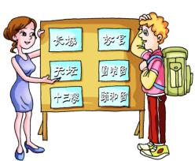
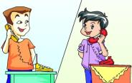
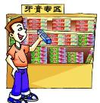
what time to meet them
where to go
whether to go the party
what to do
which one to buy
Example:
He `wants to `go on a `trip.
He is `thinking about
_____________.
`where to `go
He has `difficulty in `learning `English.
He `asks Kangkang __________ .
what to do
what time
2. He is `going to `meet his `friends.
But he `forget ____________________ .
what time to meet them
3. There are `many` kinds of `toothpaste.
He can’t `decide _________________.
which one to buy
4. He `has a lot of` work to do.
He is `wondering _____________________.
whether to go to the party

Slide 14
Exercises
Choose the correct word to fill in the blanks.
1. ----Please tell me ________ to get to the TV station.
----Follow me, please. I’ll go there soon.
2. There are so many beautiful flowers. I can’t decide ______one to buy.
3. I don’t know _______ to find my book. The room is so large.
4. ----Could you tell me ______ to leave for Shanghai?
----Tomorrow evening.
5. ----I can’t decide _______ to go to the party or not.
----I wish you could go there.
when, which, how, whether, where
how
which
where
when
whether

Slide 15
Exercises
Choose the best answer.
( ) 6.—I don’t know _____ remember the new English words.
—Don’t worry! Try to think about their pronunciations.
A. what to B. how to C. where to D. when to
B
( )7.—This physics problem is too difficult. Can you show me
_____,Wang Li?
—Sure.
A. what to work it out B. what to work out it
C. how to work it out D. how to work out it
C
( ) 8.There are many kinds of bikes here. She can’t decide _____.
A. where to buy B. which one to buy
C. how to go there D. when to go there
B

Slide 16
summary
1. Some words: aloud, object, textbook, ability,
toothpaste
2. Some phrases: be weak in, turn to sb.
take a deep breath, give it a try
3. Some sentences:
(1)How to improve it was my biggest problem.
(2)Could you please tell me how to improve my reading ability?
We learn:
We can:
Use the structure of wh- /how + to do.
(1)There are many kinds of toothpaste. He can’t decide which one to buy.
(2)He has a lot of work to do. He is wondering whether to go to the party.

Slide 17
Assignment
Read 1a.
Memorize the useful expressions and key sentences which we learn today.
Finish Section B in your workbook.
Preview Section C.

