Slide 1
Unit 9
I like music that I can dance to.
Section B Period 3 1a-2e
WWW.PPT818.COM
Notes:
1
1

Slide 2
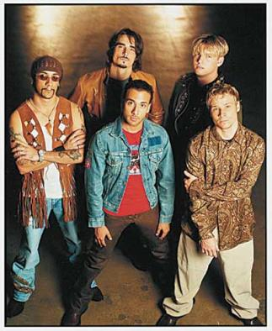
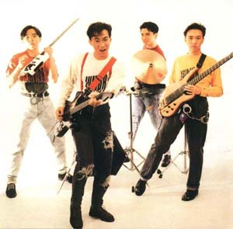
Bands:
Back Street Boy
Beyond

Slide 3
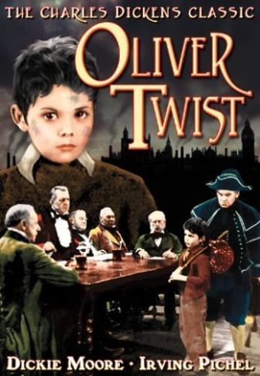
Books:
Oliver Twist
Harry Potter

Slide 4
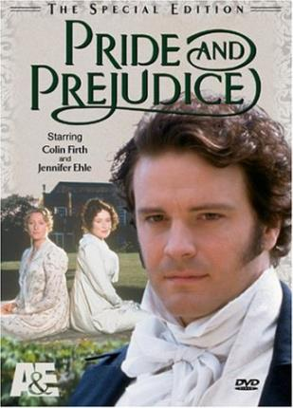
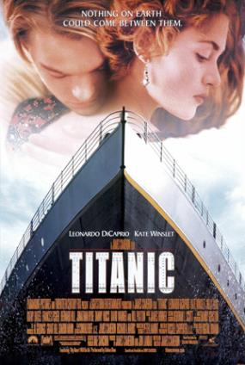
Movies
Pride and Prejudice
Titanic

Slide 5
1a
Fill in the chart. Write names of your favorite band, book, and movie.
Movie | Pride and Prejudice Titanic
Book | Oliver Twist, Harry Potter
Band | Back Street Boy, Beyond

Slide 6
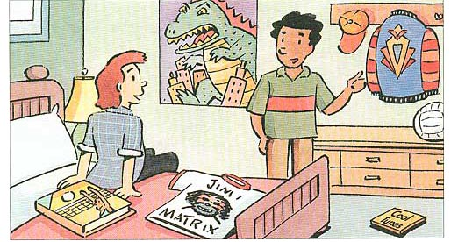
Listen and write down the three things in the picture that Michael and Ali talk about.
1b
1.
2.
3.
jacket
book
movie poster

Slide 7
2b Listen again. Write what Michael likes and
why he likes each thing.
What Michael likes | Why he likes it
jacket | He likes clothes ________________
 | He likes writers ____________________
 | He likes movies ____________________
that are unusual.
book
who explain things well.
movie poster
that are about monsters.

Slide 8
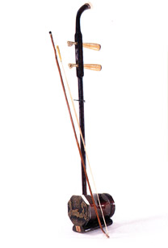
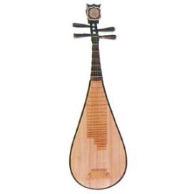
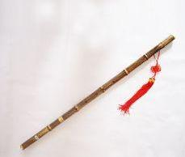
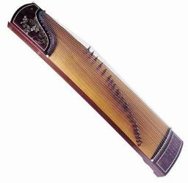
2a
H How many Chinese musical instruments do you know about? Do you know any famous pieces of music that are played on these instruments? Make a list with your partner.

Slide 9
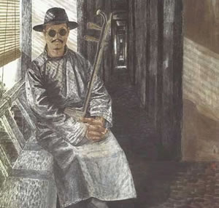
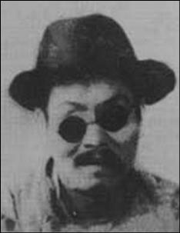
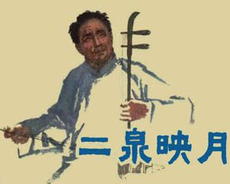
Warming up
Which piece of his music is the most famous?
The man is Abing. He was a folk musician. He wrote many pieces of beautiful music. He was born in Wuxi in 1893.

Slide 10
Fast Reading
2b Read the passage and answer the questions.
1) Which musician does the passage mainly talk about?
2) What is the name of his most famous piece of music?
Abing.
Erquan Yingyue.

Slide 11
3) How does the writer feel about this piece of music?
He feels that it is sad but beautiful, and it not only paints a picture of Abing’s own life but also makes people recall their deepest wounds from their own sad or painful experiences.

Slide 12
1. The piece which was played on the erhu especially moved me.
那首用二胡演奏的乐曲特别使我感动。
2.It was one of the most moving pieces of music that I've ever heard. The erhu sounded so sad that I almost cried along with it as I listened.这是我听过的曲子中最令人感动的曲子之一。 二胡曲听起来太悲伤了以至于我听的时候几乎随之哭起来。

Slide 13
3. look up查阅; 抬头看
【语境领悟】
*Later I looked up the history of Erquan Yingyue, and I began to understand the sadness in the music. 后来我查阅了《二泉映月》的历史, 才开始理解了音乐中的悲伤。

Slide 14
4. marry v. 嫁，娶，
1）marry sb. 表示嫁给某人；与......结婚
eg:John married Mary last week.
2）be /get married to sb. 表示与某人结婚
eg:Jane was married to a doctor last month.
【注意】
①marry 一般不与介词with 连用；
②get married 表示短暂性动作，不能和表示一段时间的状语连用。
be married 表示状态，可以和表示一段时间的状语连用。
Tom has been married to Lucy for three years.

Slide 15
5. perform v. 表演; 执行
名词形式为performance
【语境领悟】
*He performed in this way for many years. 他以这种方式演出了多年。
*Our football team’s performance has been excellent this year.
今年我们的足球队表现出色。

Slide 16
6.It is a pity that only six pieces of music in total were recorded for the future world to hear, but his popularity continues to this day.
遗憾的是, 可供将来的人们听到的曲子总共只记录了六首。但时至今日，他依旧颇受欢迎。

Slide 17
in total 总共 【自主归纳】
(1)total作形容词, 意为“总计的, 总括的, 全体的”。
(2)total作名词, 常与in构成短语in total(总共, 合计)
*What is the total population of Japan?
日本的总人口为多少?

Slide 18
7. Its sad beauty not only paints a picture of Abing’s own life but also makes people recall their deepest wounds from their own sad or painful experiences.
那种凄美不但描绘了一幅阿炳自己的生活图画, 而且也让人们从自己的悲伤或痛苦的经历中回忆起自己深深的创伤。

Slide 19
【句型剖析】not only. . . but also. . . 句型
(1)not only. . . but also. . . 意为“不但……而且……”,
She is famous not only in the USA, but also in other parts of the world.
她不仅在美国出名, 而且在世界其他地方也出名。

Slide 20
(2)not only. . . but also. . . 连接并列主语时, 由于强调but also后边的成分, 因此句中谓语动词在人称和数上要与but also后边的部分保持一致, 即遵循“就近原则”。

Slide 21
8. praise v.&n. 表扬，赞扬
【典例】
This is a move that__________ (praise)by many people.
短语 praise...for... 因......而表扬......
eg. Tom was highly praised by the teacher for helping Wang Hong learn Emglish.
is praised

Slide 22
Careful Reading
2c Read the passage again and use suitable words to complete the main idea of each paragraph. Then list the supporting details in each paragraph.

Slide 23
Paragraph | Main idea
1 | I was _______ by a piece of music named Erquan Yingyue.
2 | Abing lived a very ______ life.
3 | Abing’s musical skills made him very __________.
moved
hard
popular

Slide 24
Paragraph | Supporting details
1
◆ The music was strangely beautiful but under the beauty I sensed a strong sadness and pain.
◆ It was one of the most moving pieces of music that I’ve ever heard.
◆ I almost cried along with it as I listened.

Slide 25
Paragraph | Supporting details
2
◆ His mother died when he
was very young.
◆ His father died when he was a teenager.
He was poor and homeless.
◆ He developed an illness and became blind.
◆ He lived on the streets and played music to make money.

Slide 26
Paragraph | Supporting details
3
◆ He could play over 600 pieces, and he wrote many of them himself.
◆ His most famous piece is still played and praised by erhu master today.
◆ Erquan Yingyue has become one of China’s national treasures.

Slide 27
Post Reading
2d Circle that or who and fill in the blanks with the words in the box.
pain wounds sense
pity praise

Slide 28
Abing played music (that/who) could touch the hearts of people. When we listen to his music, we can ______ both the beauty and the sadness in it. It makes us think about the _____ and _______(that/who) we have experienced in the past. For this reason, many people _____ him as the musician (that/who) has greatly influenced erhu music. So it is really a ______ that not many pieces of his music were recorded.
sense
pain
wounds
praise
pity

Slide 29
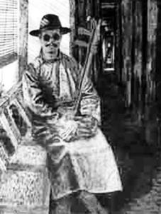
2e Student A is foreign visitor who is interested in Abing and his music. Student B is a Chinese student who knows about Abing. Use the information in the passage to make a conversation.

Slide 30
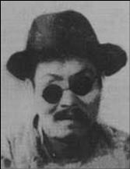
A: What kind of musical instruments did Abing play?
B:He could play many instruments, but he is best known for playing the erhu.

Slide 31
Homework
1. 课后阅读短文，试着复述这个故事。
2. Write a passage about Abing and Erquan Yingyue.

