Slide 1
Section Ⅱ Integrating skills & Developing ideas
WWW.PPT818.COM

Slide 3
function
tip
custom
attack
within

Slide 4
related
addict
differ
slightly
recommend
construction

Slide 5
satisfying
convenient
originally
official
resist
adapt

Slide 6
in case
put...to the test
belong to
end up
catch up
bring up
more or less
adapt to
pick up

Slide 7
too tired to eat
Cooking together

Slide 8
no family meal is complete without
some form of meat
I still don’t think that anything can beat

Slide 13
playing
addict
addicted
addictive

Slide 14
Addicted to computer games, the boy didn’t
want to study.
Addicting himself to computer games, the boy
didn’t want to study.

Slide 16
in case of

Slide 17
In this case
In that case
In any case
In no case

Slide 19
to

Slide 20
to take
visiting
(should) be checked

Slide 22
under
on/upon

Slide 23
died of a heart attack

Slide 24
belonging

Slide 25
As is known to us
belonging to
It is known to us that
belongs to

Slide 27
as
with

Slide 28
dead
getting

Slide 30
up

Slide 31
about
down

Slide 33
to satisfy
to my satisfaction

Slide 34
satisfied
satisfied
satisfying

Slide 36
to/for
for

Slide 37
to pick
convenience

Slide 40
buying

Slide 41
resistance
to
couldn’t resist showing off his being praised

Slide 43
to
to

Slide 45
adopted
adopted
adapt
adapted

Slide 46
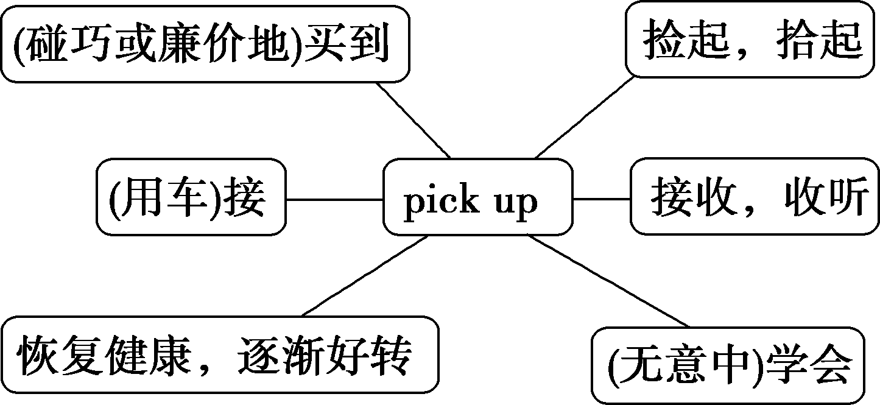

Slide 47
picks up

Slide 48
(无意中)学会
开车接(人)
接收(信号)
恢复；好转

Slide 51
to know
to cross

Slide 52
too difficult for me to work out
too narrow for a car to get through

Slide 53
本部分内容讲解结束
按ESC键退出全屏播放

