Slide 1
陕旅版英语六年级上册
Unit8 New Year’s Party
第2课时
WWW.PPT818.COM

Slide 2
教学目标：
1. 能熟练运用功能结构What do you think of...? It is / was…询问并描述事物、表达感受，并能在日常交流中自如使用。
2. 能听懂并理解句子They acted it well. 和I think everyone had a good time.并在实际生活中熟练运用。
3. 能听懂、理解对话的意义，并能正确朗读、模仿对话，语音语调自然流畅。

Slide 3
Let’s sing

Slide 4
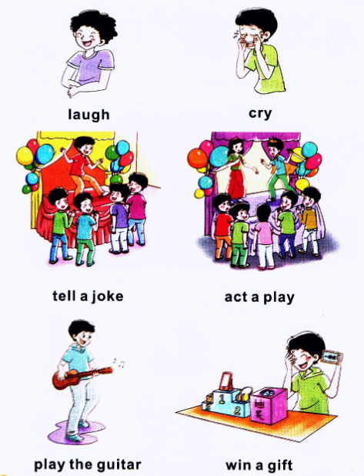
Review

Slide 5
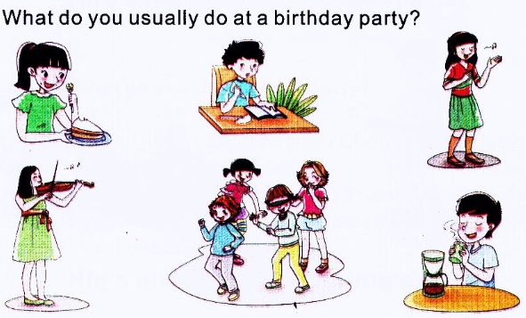
Warming-up: Look and tick

Slide 7
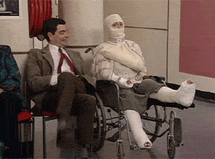
What do you think of the man?
He’s very funny.

Slide 8
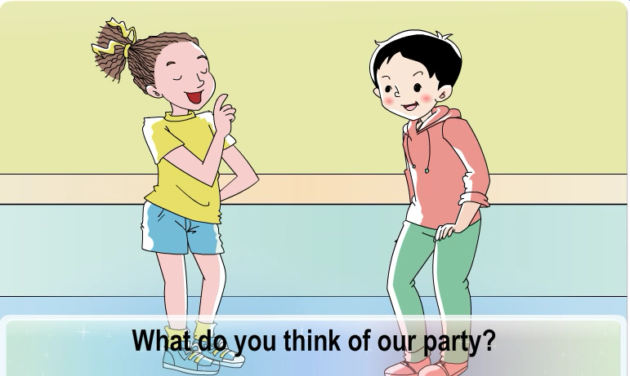
Part A Let’s talk

Slide 9
活动规则详见第2课时教案
Spelling race

Slide 10
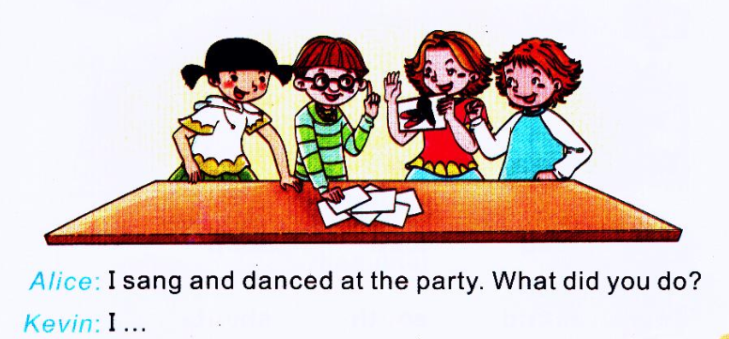
Let’s play

Slide 11
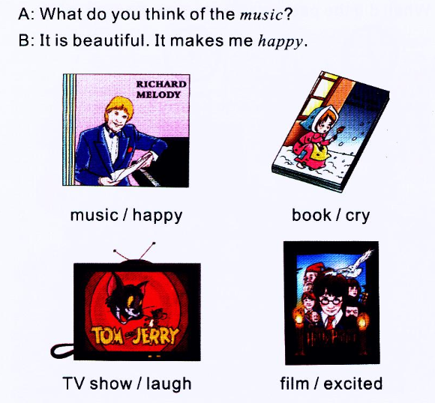
Part B Ask and answer

