Slide 1
人教版八年级上册
Unit4
What’s the best movie theater?
Section B（第2课时）
WWW.PPT818.COM
0

Slide 2
学习目标
一、语言知识目标：
熟练使用以下词汇、短语和句型：
talent, have … in common, magician, all kinds of, beautifully, be up to, role, play a role, winner, prize, everybody, make up；
the most talented dancer: …
the most exciting magician: …等
二、学习策略：
2. 通过限时阅读，整体阅读训练，能够抓住篇章主旨并对文章细节进行理解。
3. 优生能快速阅读并掌握文章大意并能复述此文，中等生能理解文章意思，并能阅读。
4. 能正确的运用相关短语表达，通过跟读，仿说，能够评价并介绍同学和朋友的才艺。
三、情感态度价值观目标：
鼓励学生客观评价自己身边的人并认识到培养良好爱好的重要性，提升学生综合素质。
四、文化意识：
初步了解中外“达人秀”现象，并能正确认识这种流行文化。

Slide 3
自学互研
新词自查
根据句意及汉语提示完成句子
1. He had a talent (天赋) for music.
2. They have one thing in common (与······相同).
3. Although they are poor (贫穷的), they are happy.
4. I think Lucy sang the most beautifully (漂亮地) yesterday.
5. I won the first prize (奖). I was a winner.
6. He often makes up (编造) interesting stories.
7. Doing homework is up to (是······的职责) ourselves.
8. We should take our study seriously . (认真对待······)

Slide 4
Review
Read and answer the questions.
A: Who was the best performer?
B: Eliza was the best performer.
A: Who was the funniest performer?
B: Steve was the funniest performer.
A: Who was the most creative performer?
B: Vera was the most creative performer.
A: Who was the worst performer?
B: Dennis was the worst performer.
A: Who was the loudest performer?
B: The math teachers were the loudest performer.

Slide 5
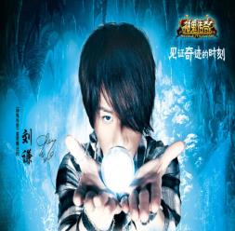
情景导入
Liu Qian is one of the most creative_________(魔术师) I know. He’s truly talented in _____(魔术). His _______ _____ (魔术表演) bring people into a _________(魔术的) world.
magicians
magic
magic
shows
magical
He is serious about his shows as a magician.
be serious about sth.
认真对待......
take ... seriously

Slide 6
beautifully
adv. 美好地；漂亮地
adv. 严重地；严肃地；认真地
seriously
e.g. Mary sings most beautifully in our class.
在我们班，玛丽唱得最优美。
He was seriously injured in the
traffic accident.
他在车祸中受了重伤。

Slide 7
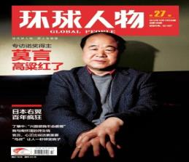
Mo Yan is one of the most _______ (有创意的) _________(作家) I know. He’s got _______ (有才华的) in writing. He ______(创作) lots of great works. He takes his job ________(认真地).He was the ______(获胜者) of The Nobel Prize in Literature(诺贝尔文学奖) in 2012.His books are ______(变得)_____________(越来越) popular.
creative
writers
talent
creates
seriously
winner
getting
more and more
get more and more popular
In his books, he made up a lot of stories we like .
make up a story/ lie
be made up

Slide 8
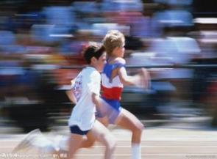
导学达标
winner
n. 获胜者；优胜者
托尼是赛跑的获胜者。
e.g. Tony was the winner of the race.

Slide 9
prize
n. 奖；奖品；奖金
琳达在英语比赛中获奖。
e.g. Linda got the prize at the English
competition.
everybody pron. 每人；人人；所有人
每个人都有一个梦想。
e.g. Everybody has a dream.

Slide 10
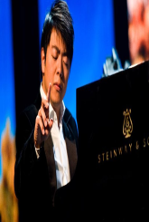
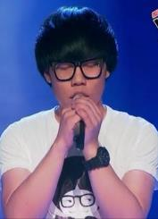
famous people (名人)
be truly talented
be the most creative
have... in common
take one’s job seriously
work hard
a talent show called …

Slide 11
有相同特征;（想法、兴趣等方）相同
have … in common
e.g. The two cultures have a lot in common.
这两种文化具有许多的共同之处。

Slide 12
n. 天资；天赋
talent
拓展：talent (n.) → talented (adj.)有才能的；有才干的
e.g. Do you like this talent show?
你喜欢这个才艺表演吗?
Miss Li has a talent for drawing.
李小姐有绘画的天赋。

Slide 13
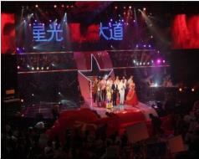
Its name is Britain’s Got Talent.
some talent shows around the world
What do you think of the show?
America’s Got Talent
All kinds of people can join these shows.
All the shows have one thing in common.
China’s Got Talent

Slide 14
more and more popular
The shows try to look for the best singers, the most talented dancers, the most exiting magicians, the funniest actors and so on.
Then, how to decide the winner?
I like singing and take the show
seriously.
I think Wan sings the most beautifully in the show.

Slide 15
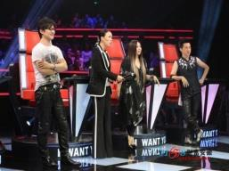
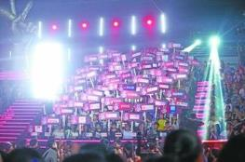
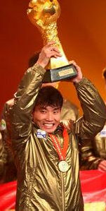
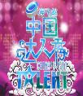
How to decide the winner?
1. VIP guests
2. people watch the game
…
That’s up to you to decide.
They play a role in deciding the winner.
The winner always gets a very good prize.
You can be a star overnight!
These shows give people a way to make their dreams come true.

Slide 16
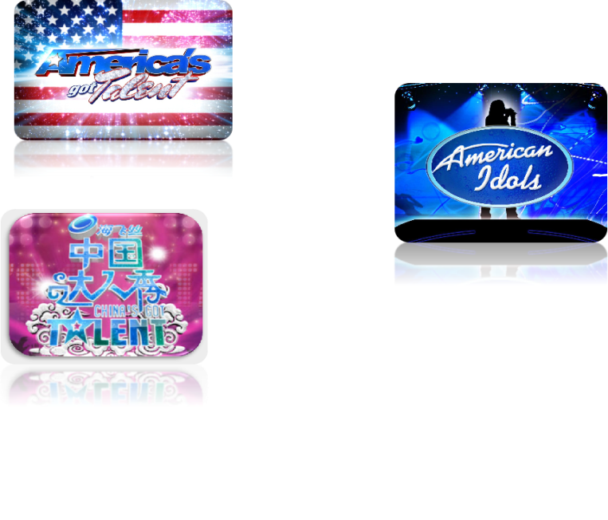
What talent shows are mentioned in the passage?
American Idol (美国偶像)
America’s Got Talent (美国达人秀)
China’s Got Talent
(中国达人秀)

Slide 17
What is the main idea of each paragraph?
Paragraph 1
A. Different people have different opinions(观点) about talent shows.
B. All the talent shows try to look for the most talented people.
C. Talent shows are getting more and more popular.
Paragraph 2
Paragraph 3

Slide 18
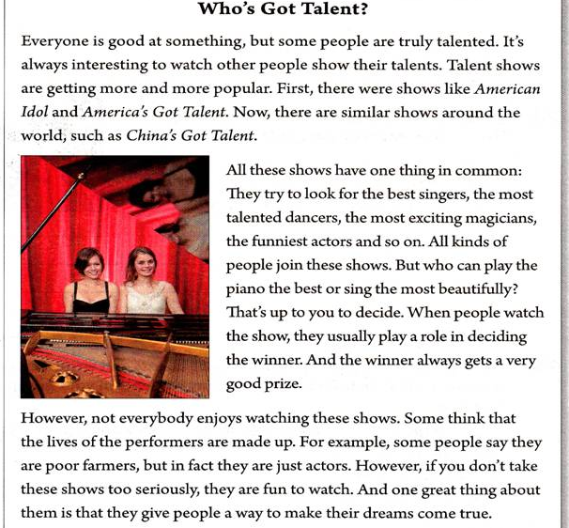
谁是达人？
play a role in doing sth

Slide 19
Who’s Got Talent?
true- truly
Everyone is good at something, but some people are truly
talented. It’s always interesting to watch people show their
talents. Talent shows are getting more and more popular.
First, there were shows like American Idol and American’s
Got Talent. Now, there are similar shows around the world,Such as China’s Got Talent.
Question: What three talent shows are mentioned?
American Idol, American’s Got Talent and
China’s Got Talent.
Question: How are these talent shows getting now?
Talent shows are getting more and more popular now.

Slide 20
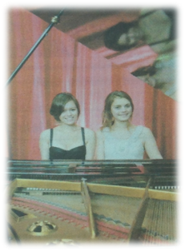
Question: What do talent shows have in common?
They try to look for the best singers, the most talented dancers, the magicians, the funniest actors and so on.
Question: Who decides the winners?
The people who watch the show decide the winners.
All these shows have one thing in common: they try to
look for the best singers, the most talented
dancers, the most exciting magicians, the
funniest actors and so on. All kinds of people
join these shows. But who can play the piano
the best or sing the most beautifully? That’s
up to you to decide. When people watch the
show, they usually play a role in deciding the winner. And
the winner always gets a very good prize.

Slide 21
Question: Why do some people not like these shows?
They think that the lives of the performers are made up.
Question: Why do some people like these shows?
The shows are fun to watch, and they give people a way to make their dreams come true.
However, not everybody enjoys watching these shows.
Some think that the lives of the performers are made up.
For example, some people say they are poor farmers, but
in fact they are just actors. However, if you don’t take
these shows too seriously, they are fun to watch. And one
great thing about them is that they give people a way to
make their dreams come true.
make up 编造… are made up …被编造
make sb/sth. do 使/让….做…
make their dreams come true 让他们的梦想成真

Slide 22
Judge the statements T or F according to the passage.
It’s always boring to watch people show
their talents.
2. Only the actors can join these talent shows.
3. The winner always gets a very good prize.
All the performers like to say they are
poor farmers.
5. These talent shows can help people make
their dreams come true.

Slide 23
Read Para 2 and answer the questions.
1. What do talent shows have in common?
2. Who decides the winner?
They try to look for the best singers, the most talented dancers, the most exciting magicians, the funniest actors and so on.
People who watch the show decide the winners.
be up to sb.
由某人决定
play a role in deciding the winner

Slide 24
Read Para 3 and tell True or False.
1. Everyone enjoys watching these talent shows.
2. Some people like the lives of the performers in the show because they are true.
3. In fact some people are poor farmers in the show.
4. It’s always fun to watch these shows if you don’t take them too seriously.
F
F
F
T
The writer’s opinion(观点)
These talent shows give people a way to make their dreams come true.

Slide 25
Translate the phrases and the sentences.
达人
有相同特征
动听地唱歌
发挥…作用
认真对待…
got talent
have … in common
sing beautifully
play a role
take … seriously
你正变得越来越漂亮。
You are getting more and more beautiful.

Slide 26
Fill in the blanks.
Everyone is good at something, but some people are _______ talented. It’s always ___________ to watch people show their ______. Talent shows are getting ______ _____ ______popular.
truly
interesting
talents
more and more
in common
All these shows have one thing ____ _________: they _____ to look for the ______ singers, the most talented dancers, the most exciting ___________, the ________ actors and so on. All _____ of people join these shows. But who can play the piano the _______ or sing the _____ ___________? That’s ___ to you . People who watch the show usually play a _____ in deciding the ________. And the winner always gets a very good ________.
try
best
magicians
funniest
kinds
best
most beautifully
up
role
winner
prize

Slide 27
not
watching
However, ____ everybody enjoys __________ these shows. Some think that the lives of the performers are ______ ____. However, if you don’t ______ these shows too _________, they are fun to watch. And one _______ thing about them is that they _____ people a way to make their dreams ______ ______.
made up
take
seriously
great
give
come true

Slide 28
Read the passage again and fill in the chart.
How
Some people like talents shows
because they are(5) _________
and they give people a way to
(6)____________________ .
Talent shows are becoming
(1)____________________
fun to watch
more and more popular.
make their dreams come true
What
Why
talent shows
look for
They try to (2)___
__________________
the most talented people.
Some people don't like talents shows because they think (4)___________________ _____________________.
the lives of some
performers are made up
Who
Why not
The people who watch the shows
(3)_______________________
decide the winner

Slide 29
2c
Read the passage again and answer the questions.
What do talent shows have in common?
2. Who decides the winner?
3. Why do some people not like these shows?
They try to look for the best singers, the most... and so on.
The people who watch the show.
Because they think that the lives of the performers
are made up.
4. Why do some people like these shows?
5. What do you think of these shows?
Because they are fun to watch.
I think they can make people’s dream come true.

Slide 30
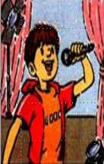
2d
Underline all the superlatives in the passage.
Then write sentences using at least four of them.
best singer: In my class, Tom is the best singer because he can sing fast songs very well.
most talented dancer:
Yang Liping is the most
talented dancer in China. She dances beautifully. …

Slide 31
谁是班级达人？填表同学名字，看看多少人赞同
2e
Who’s got talent in your class? Add more talents and write a
classmate’s name for each talent. Find out how many students
in your group agree with you.
Talent | Classmate’s name | How many students agree?
The faster runner
The best dancer
Deng Kai
6
…
…

Slide 32
Free talk
How can people make their dreams come true?
1. They must take the things they do seriously.
2. They must work hard./They need a lot of practice, because practice makes perfect(熟能生巧).
3. They should hold on to(坚持) their dreams.
If you have a dream,
just do it to let your dream fly high.

Slide 33
问题探究
▲watch为感官动词，意为“观看；注视”，watch sb. do sth.“观看某人做某事”（经常发生或已做过的事情）；watch sb. doing sth.“观看某人正在做某事”（强调所做的事正在进行中）。同watch这种结构一样的还有：see，look at，notice， hear等动词
▲That’s/ It’s up to sb. to do sth. 表示“由某人决定做某事”常用于口语交际中。
▲play a role in sth./ doing sth. 意为“在某方面发挥作用”。
导练：
1）When I walked past the park, I saw some old people doing Chinese Taiji.
2) It’s up to you to decide (decide) what to buy.
3) 学校在教育中起着最为重要的作用。

Slide 34
Schools play a role in education.
▲不定式作主语时常用it 作形式主语，而将真正的主语放在句末，其结构为：It’s +adj. +for sb. +to do sth.
▲ have … in common意为“有相同特征”。
导练：
1）It’s hard for me to dance (dance) well.
2) 我和我姐姐有很多相似之处。
I have a lot in common with my sister

Slide 35
课堂评价
单项选择。
1.—What do you think of the movie Zootopia?
—It is ______ one I’ve ever seen.
A．more excited B．more exciting
C．the most excited D．the most exciting
2．—His handwriting is very beautiful.
—Yeah. With the help of him, his sister writes as _____
as him.
A．beauty B．beautiful
C．beautifully D．more beautifully

Slide 36
3．—The scarves are all beautiful. I can't decide which one to choose.
—How about this red one? I think it's______．
A．beautiful B．more beautiful
C．the most beautiful D．less beautiful
4．So far, MERS(中东呼吸综合征)has become one of ______ illnesses in the world.
A．serious B．more serious
C． most serious D. the most serious
5．The movie Lost in Thailand is ______ one that I’ve ever seen these years.
A．funny B．the funniest
C．funnier D. more funnier

Slide 37
Homework
(1). Read the passage after class and try to retell the text and summarize the difficult phrases and expressions.
(2). Complete the investigation in 2e and write a survey report.

