Slide 1
Unit 4 My friends
第二课时
WWW.PPT818.COM

Slide 2
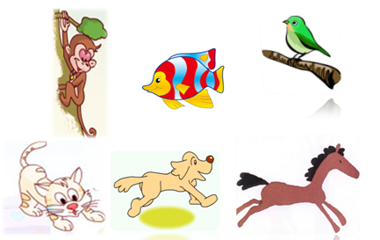
How many animals ?

Slide 3
What animal is it ? It’s ___ .

Slide 4
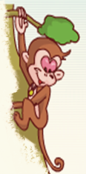
What is this ? It’s a ____ .
What can it do ? It can ____ .
swim
sing
climb

Slide 5
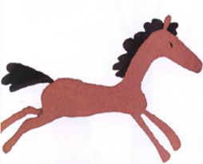
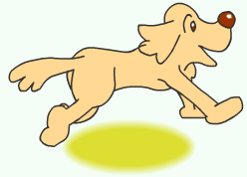
What is this ? It’s a ____ .
What can it do ? It can ____ .
walk
jump
run

Slide 6
1.Who are my
friends ?

Slide 7
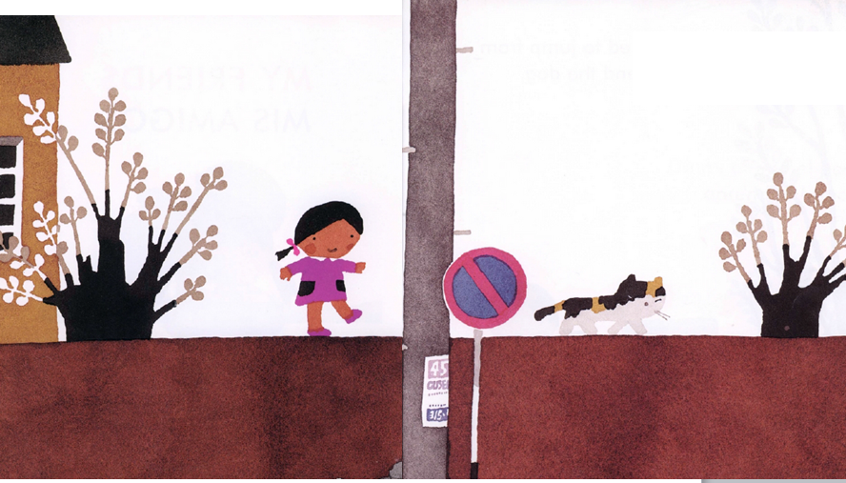
I learned to walk from
my friend the cat .

Slide 8
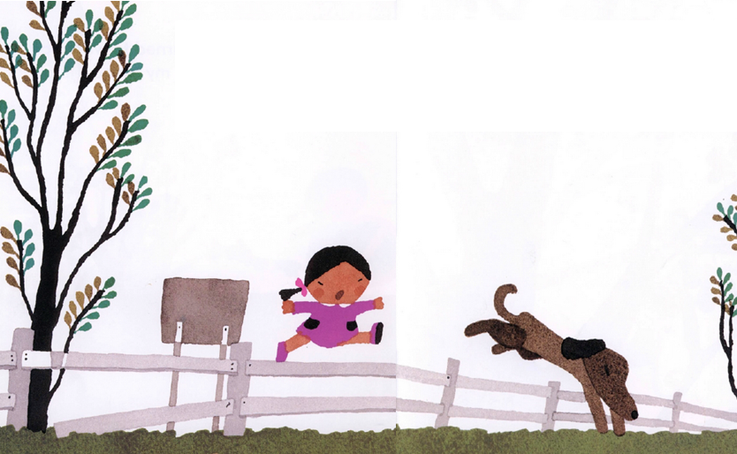
I learned to jump from my friend the dog .

Slide 9
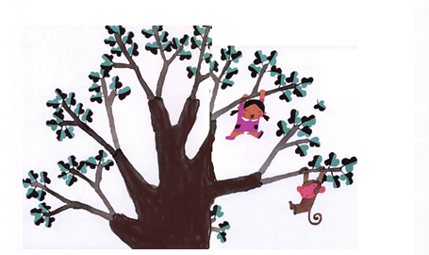
I learned to climb
from my friend
the monkey.

Slide 10
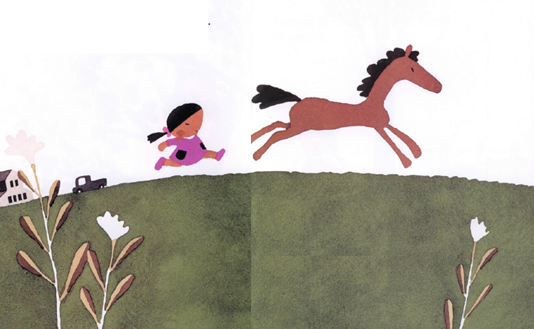
I learned to run from my friend the horse.

Slide 11
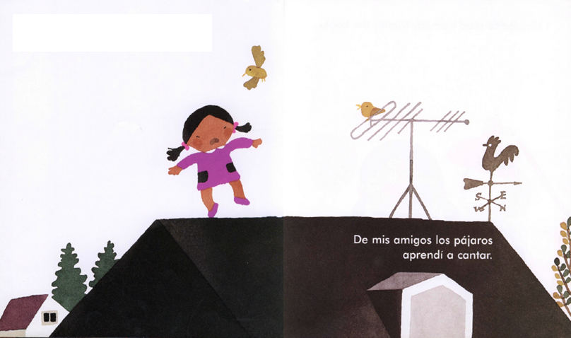
I learned to sing from my friend the bird.

Slide 12
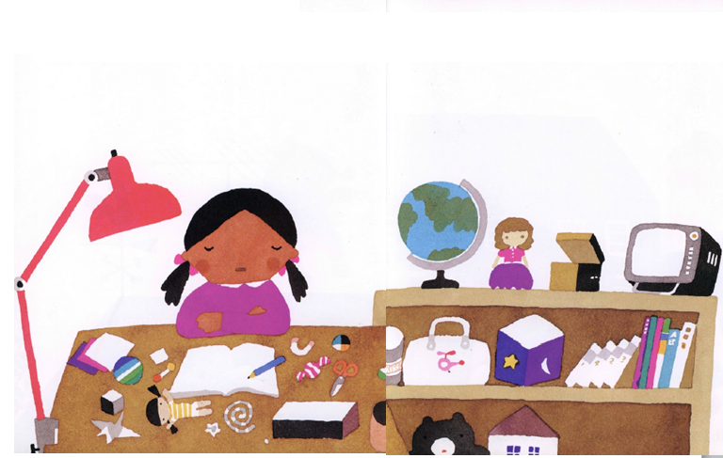
I learned to read from
my friends the books.

Slide 13
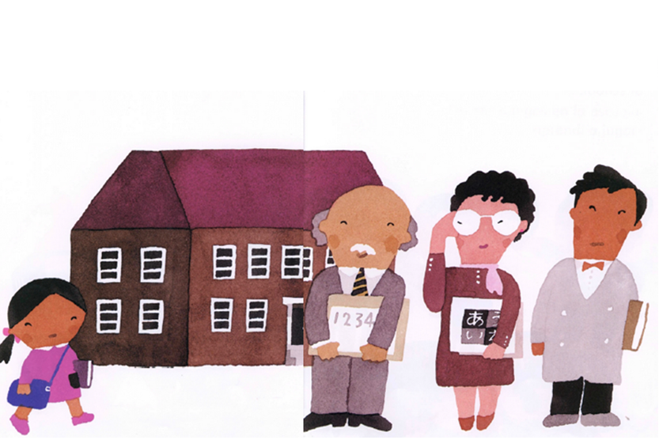
I learned to study from my friends the teachers.

Slide 14
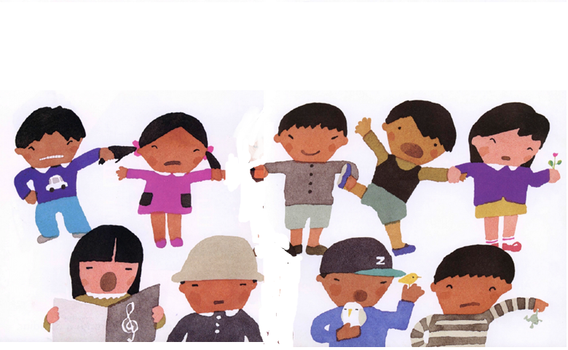
I learned to play from
my friends at school.

Slide 15
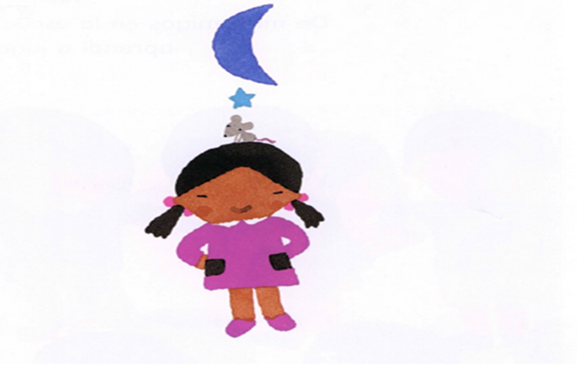
And I learned to love from a friend like you.

Slide 16
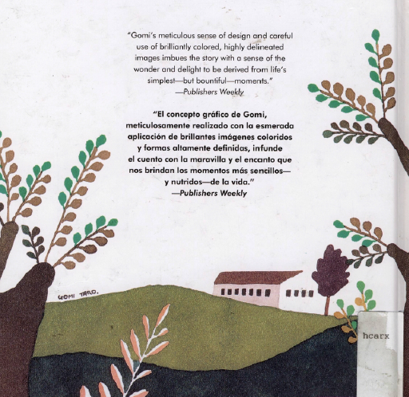

Slide 17
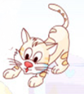
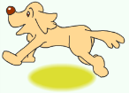
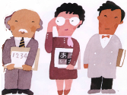
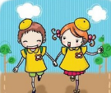
1.Who are my
friends ?

Slide 18
2.What did I learn
from my friends ?

Slide 19
I learned to walk from
my friend the cat .

Slide 20
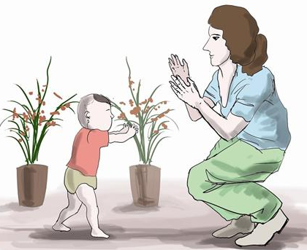
walk
learned to walk
I learned to walk .
I learned to walk from my friend .
I learned to walk from my friend the cat .

Slide 21
I learned to jump from
my friend the dog .

Slide 22
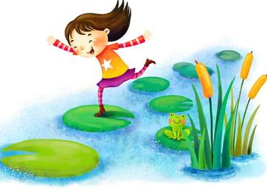
jump
learned to jump
I learned to jump .
I learned to jump from my friend .
I learned to jump from my friend the dog.

Slide 23
I learned to climb
from my friend
the monkey.

Slide 24
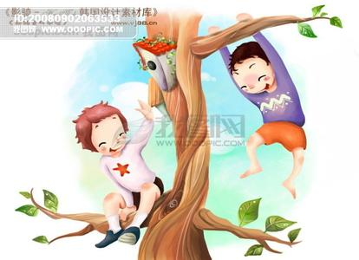
climb
learned to climb
I learned to climb .
I learned to climb from my friend .
I learned to climb from my friend the monkey.

Slide 25
I learned to run from my friend the horse.

Slide 26
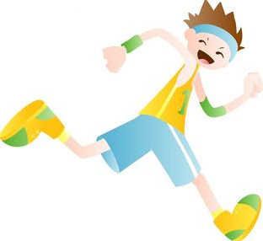
run
learned to run
I learned to run .
I learned to run from my friend .
I learned to run from my friend the horse.

Slide 27
I learned to sing from my friend the bird.

Slide 28
sing
learned to sing
I learned to sing .
I learned to sing from my friend .
I learned to sing from my friend the bird.

Slide 29
I learned to read from
my friends the books.

Slide 30
read
learned to read
I learned to read .
I learned to read from my friend .
I learned to read from my friends the books.

Slide 31
I learned to study from my friends the teachers.

Slide 32
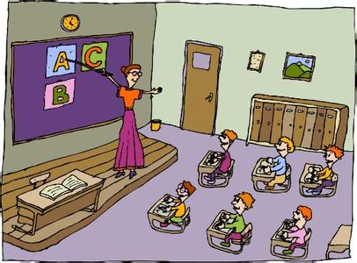
study
learned to study
I learned to study .
I learned to study from my friend .
I learned to study from my friends the teachers .

Slide 33
I learned to play from
my friends at school.

Slide 34
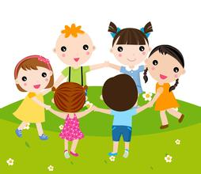
play
learned to play
I learned to play .
I learned to play from my friend .
I learned to play from my friend at school.

Slide 35
And I learned to love from a friends like you.

Slide 36
love
learned to love
I learned to love .
I learned to love from a friend .
I learned to love from a friend like you.

Slide 37
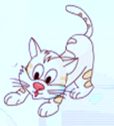
Play a game
walk
I learned to walk
from my friend the cat.

Slide 38
3.Read the story
together

Slide 39
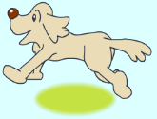
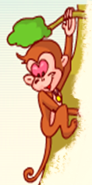
I learned to walk from
my friend the cat .
I learned to ____ from
my friend the____.
I ______________ from
my friend the _____ .

Slide 40
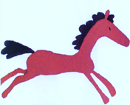
I ______________ from
____________the____.
I ______________ from
___________________.
I __________________
__________________.

Slide 41
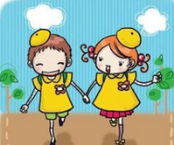
I ______________ from
___________________.
I _____________ from
____________at school.
I __________________
_________ like you.

Slide 42
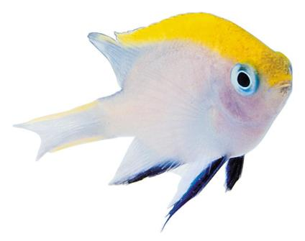
Continue the story
swim
I learned to ____ from my friend the____.

Slide 43
Continue the story
dance
I learned to ____ from my friend the____.

Slide 44
Homework
1.Read the story
2. Continue the story as you can.

