Slide 1
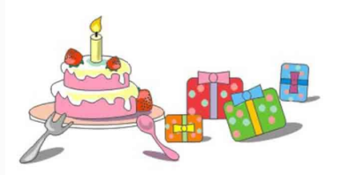
陕旅版
四年级下册
Unit6 Today Is Her Birthday
WWW.PPT818.COM

Slide 2
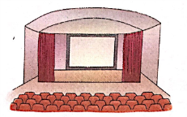
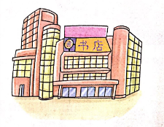
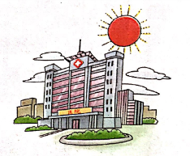
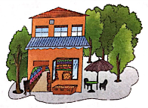
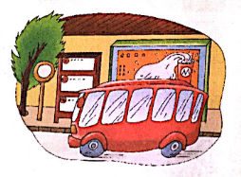
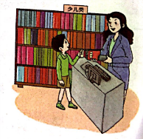
>>Review
Magic fingers

Slide 3
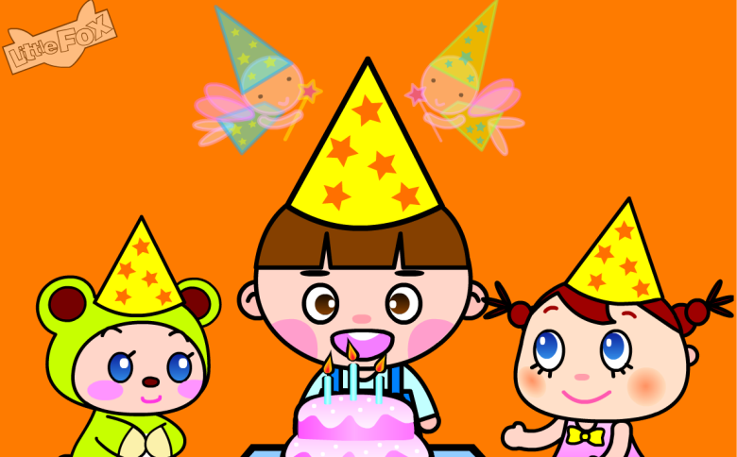
>>Warm-up

Slide 4
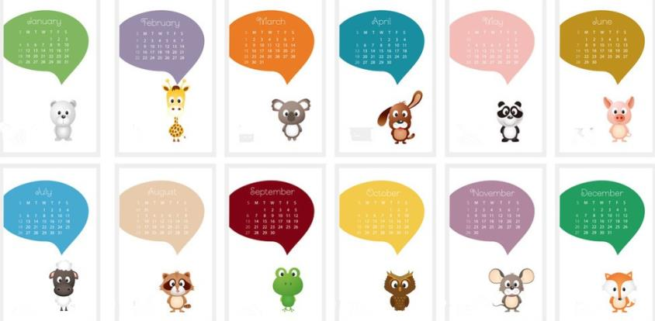
>>Lead-in
Free talk
When is your birthday?
What about your birthday?

Slide 5
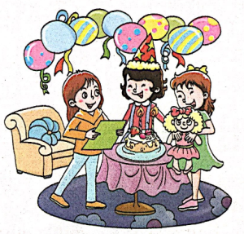
>>Presentation
Let’s learn
Jack is going to have a birthday party.
birthday party

Slide 6
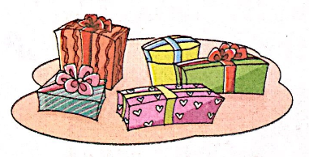
>>Presentation
Let’s learn
-What are these?
-They are gifts.
gifts

Slide 7
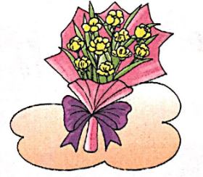
>>Presentation
Let’s learn
-What are these?
-They are flowers.
flowers

Slide 8
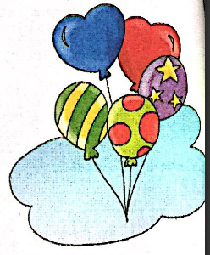
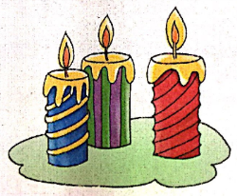
>>Presentation
Let’s learn
balloons
candles

Slide 9
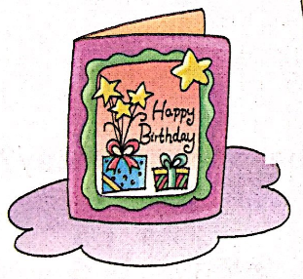
>>Presentation
Let’s learn
It’s a birthday card.
card

Slide 10
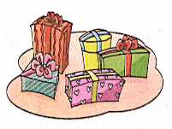
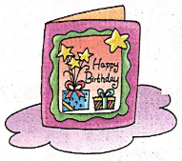
>>Practice
Magic fingers

Slide 11
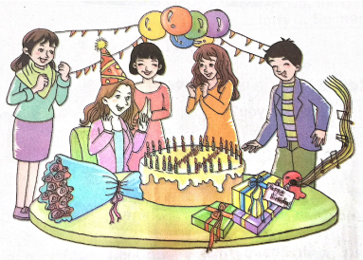
>>Practice
Look and write
What does Miss White have for her birthday?
birthday
She has a big _______ cake, six _______, twenty-seven _______, three ______, and some ______.
balloons
candles
gifts
flowers
答案

Slide 12
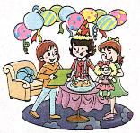
>> Summary
本课所学的重点单词：
gifts flowers birthday party

Slide 13
>> Summary
本课所学的重点单词：
cards candles balloons

Slide 14
>> Homework
1.听课文录音并跟读，按照正确的语音、语调朗读并表演课文对话。 2.同伴之间互相提问本节课所学的新单词，并默写一遍。
3.预习 Unit6 A Let’s talk。
close

