Slide 1
陕旅版英语六年级上册
Unit7 I Had a Good Time
第3课时
WWW.PPT818.COM

Slide 2
教学目标：
1.学会使用Last summer holiday, Su Nan… On the first day, …The next day, …The last day...有条理地描述过去的假期活动。
2.能在实际生活中运用一般过去时与他人谈论假期活动，做到语音自然、语言流畅，达到学以致用的目的。

Slide 3
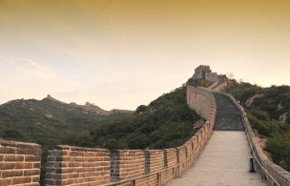
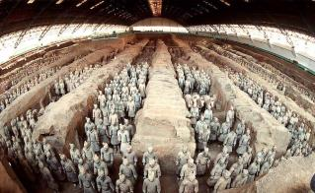
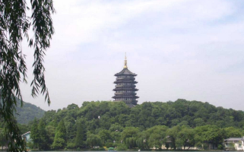
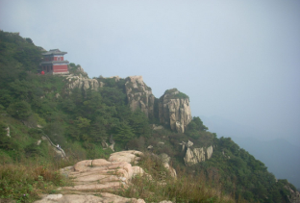
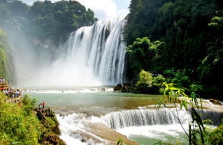
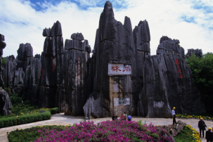
Which place do you want to go?

Slide 4
Think and write

Slide 5
Free talk
Did you go to ... last weekend?
Where did you go?
How did you go there?
What did you do?
Were you happy there?

Slide 6
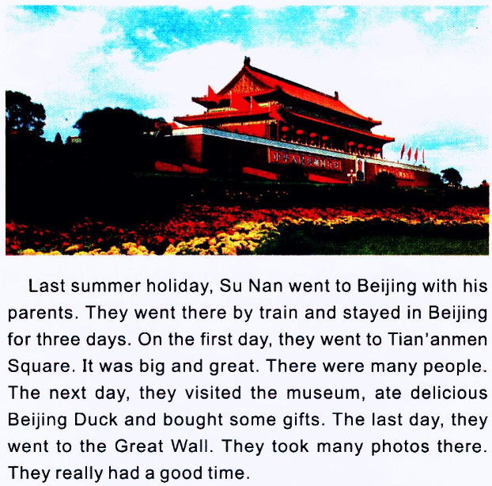
Let’s learn more
Where is it?
Did you go to Beijing last summer?
How did you go there?
What did you eat there?
What did you do there?
Who did you go with?

Slide 7
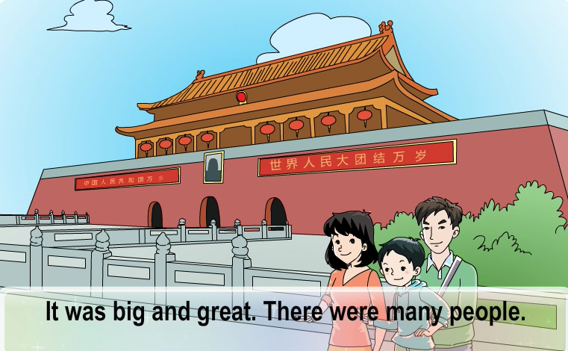
观看课文动画并大声跟读

Slide 8
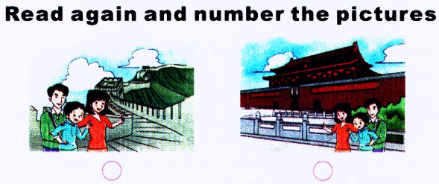
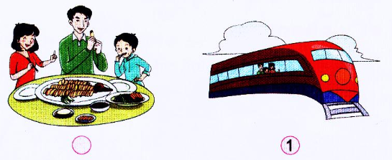
4
2
3

Slide 9
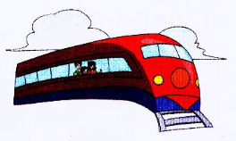
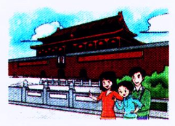
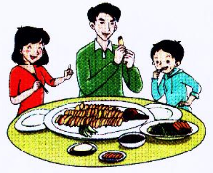
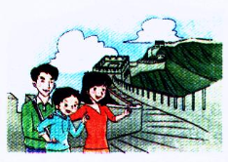
说一说

Slide 10
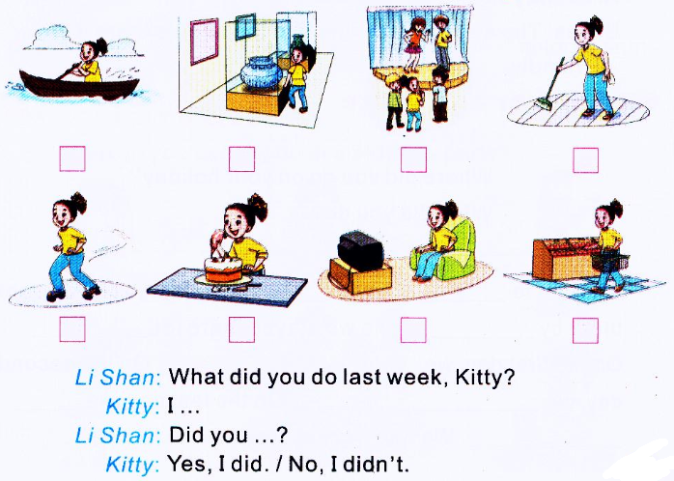
Tick or cross. Then talk with your friend

