Slide 1
Unit 6 Topic 1
There is a study next to my bedroom.
Section D
WWW.PPT818.COM

Slide 2
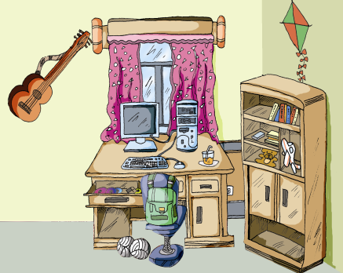
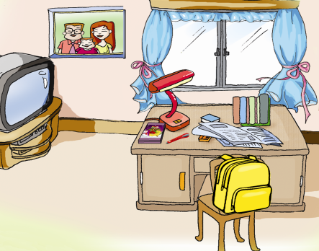
Talk about the differences between the two pictures.
Review
A
B

Slide 3
Grammar
There is/are
There ______ a sofa, a desk, some books and so on.
There _______ some model planes on it.
______ there a computer in your study?
Yes, there is. / No, there isn’t.
______ there two students in the front of the classroom?
Yes, there are. / No, there aren't.
is
are
Is
Are

Slide 4
Grammar
There is/are
What's on the desk?
There _______ some keys on it.
How many planes ______ there?
There are three.
How much water ______ there?
Only a little.
are
are
is

Slide 5
Grammar
Prepositions
在……里
在……上
在……后面
在……下面
在……旁边
在……近旁，紧邻
在……(外部的）前面
在……(内部的）前面
在……中央
在……左/右边
在……后面
in
on
behind
under
near
next to
in front of
in the front of
in the center of
on the left/right of
at the back of

Slide 6
Functions
Don’t
______ put it/them there.
Put it/them ______, please.
You must ______ ______ your things.
away
look after

Slide 7
Look at the pictures and fill in the blanks with in, on, under, behind or in front of.
A: Where is the guitar? B: It’s ___ the wall.
A: Where are the shoes? B: They’re ______ the bed.
on
under
P33 1 图1

Slide 8
Look at the pictures and fill in the blanks with in, on, under, behind or in front of.
P33 1 图2
A: Where is the computer?
B: It’s ____ the desk.
A: Where are the footballs?
B: They’re ____ the box.
on
in

Slide 9
Look at the pictures and fill in the blanks with in, on, under, behind or in front of.
A: There are two big trees _________ the house.
There is a red car ______ the trees. And there are
some books _____ the chair. Can you see the cat?
B: Yes, it’s ______ the chair.
in front of
under
on
behind

Slide 10
Suppose you are Wang Wei. Read the letter from your pen pal, Tom. And then reply to the letter.

Slide 11
Dear Tom,
I’m very glad to hear from you. I know your home is beautiful. My home is beautiful, too. Let me tell you something about it.
There is a small garden in front of my house. There are many beautiful flowers in the garden. Near the house, there is an apple tree. Some birds are singing in the tree.
On the first floor, there is a big living room, a kitchen and a dining room. Now my mother is cooking in the kitchen and my father is watering flowers in the living room.
On the second floor, there are two bedrooms, a study and a bathroom. I love playing games on the computer in the study.
I love my home very much.
Yours,
Wang Wei

Slide 12
Project
1. Survey your classmates about the things in their rooms and complete the table.
You can use A: What’s in your room?
B: There is/are …
A: Where is/are …?
B: It’s/They’re …
Name | Things and positions
Kangkang | TV/on the table, shoes/under the bed …
Michael | chair/near the desk, books/on the shelves …
…

Slide 13
Project
2. Report the result of the survey to the class.
You may begin like this:
In Kangkang’s room, there is/are … But in Michael’s room, there is/are …

Slide 14
Summary
There be 句型
肯定句: There is/are+主语+其他。
2. 否定句: There is/are+not+主语+其他。
3. 一般疑问句:
--Is/Are there+主语+其他？ --Yes, there is/are. --No, there isn't/aren't.

Slide 15
There be 与 have/has 的区别
There be 侧重 “存在关系”, 表示“某地或某时间存在某人/某物” 。如:
There is a book on the desk.
have/has侧重 “所属关系” ，表示“某人/某物拥有……”。如：
She has some interesting books.

Slide 16
Fill in the blanks with there be or have/has.
1.We _____________ no classes on Saturdays
and Sundays.
2. _______________ a bottle of water on the table.
3. Mr. Li _____________ a pet dog.
4. ________________ some gifts for our Chinese
teacher, Mr. Li.
5. How many letters _______________ in this
word?
6. _______________ a river in front of the house?
have
There is
has
There are
are there
Is there

Slide 17
Fill in the blanks with the proper prepositions.
1. Don’t play ______ the dog.
2. What can you see ______ the picture?
3. You must look______ your watch.
4. The apples are ______the tree. Now Tom is
______the tree.
5. I watch TV______ eight______ the morning.
6. Tom is standing ______ the left of Jimmy.
7. Bob is tall. He sits ______ the back of the
classroom.
with
in
after
on
in
at
in
on
at

Slide 18
Choose the best answers.
1. An old man lives _____ the _____ floor.
A. in; two B. on; second
C. under; second D. to; second
2. We usually do our homework in the _____.
A. study B. washroom
C. kitchen D. living room
3. Aunt Li isn’t at home. Can you help her _____ her baby?
A. look like B. look after
C. look around D. look for
4. Judy, don’t put your keys here. _____, please.
A. Put them away B. Put up them
C. Put them up D. Put away them
5. – What’s Jim doing?
– He is playing ______ the computer.
A. on B. at C. with D. in

Slide 19
Homework
1. Write down the result of the survey in class. You may begin like this: In Kangkang’s room, there is/are … But in Michael’s room, there is/are … 2. Preview Section A, Topic 2.

