Slide 1
外研版初中英语九年级
Module 12 Save our world
Unit 3 Language in use
WWW.PPT818.COM

Slide 2
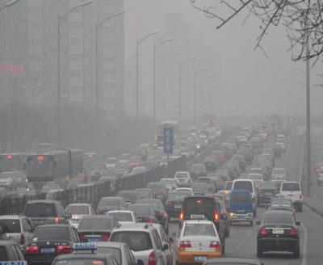
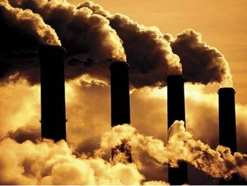
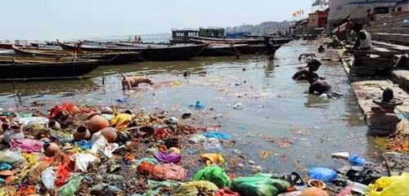
pollution

Slide 3
Do you live a green life?

Slide 4
Save the earth and save us.

Slide 5
Teaching aims:
知识目标：To master some words and expressions about save our world:
. factory, pollute, recycle, waste, enemy, crop, kill, oil, less, such as, hopeless…
能力目标：
1.To understand passages about pollution .
2. to learn to say why we need to save the world and how to be green.

Slide 6
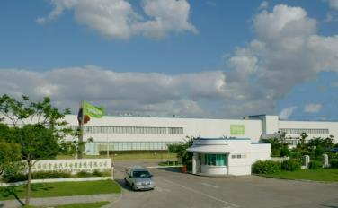
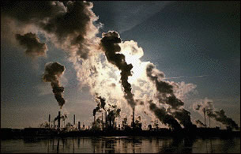
New words
pollute v. 污染
factory n.
制造厂; 工厂

Slide 7
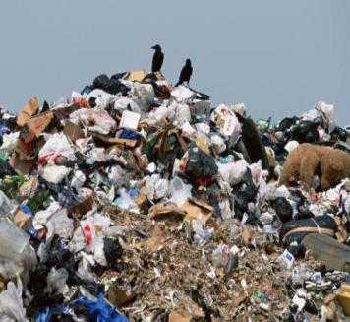
waste n.
废料; 废弃物
recycle v.
回收利用, 再使用(废品)

Slide 8
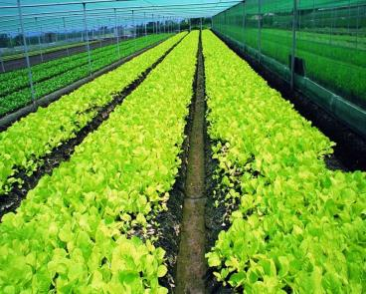
crop n.
庄稼; 作物
enemy n.
敌人; 仇人

Slide 9
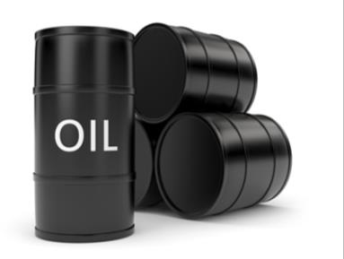
oil n. 石油
kill v.
杀死; 弄死

Slide 10
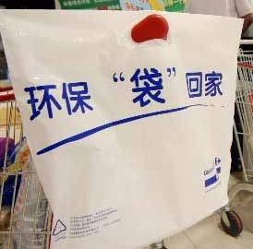
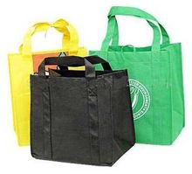
Repeated use
重复使用，多次利用

Slide 11
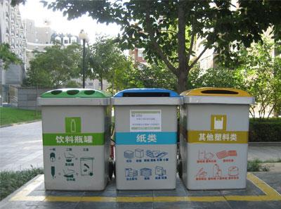
Recycling
分类回收，循环再生

Slide 12
policy n. 政策; 方针

Slide 13
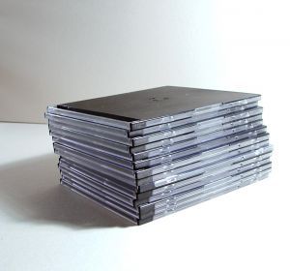
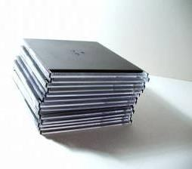
divide n. 分开; 分隔

Slide 14
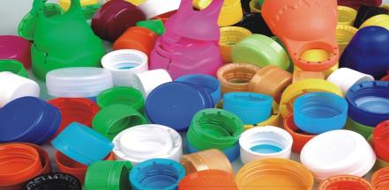
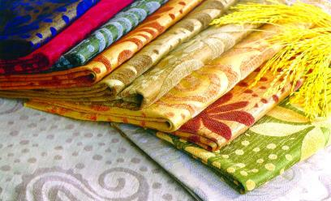
plastic
n. 塑料
adj. 塑料的
cloth n.
布; 布料

Slide 15
throw away 扔掉; 丢弃

Slide 16
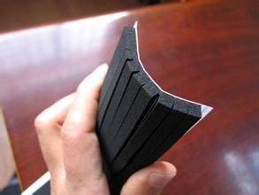
rubber n.
橡胶
ton n. 吨
tons of 许多, 很多

Slide 17
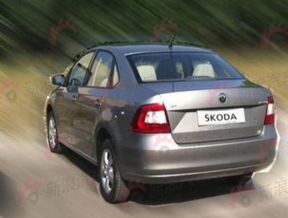
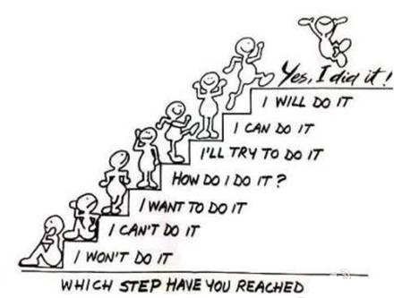
step n.
步骤; 措施
rapid adj.
快速的; 迅速的

Slide 18
recycling n. 回收利用
reuse v.
再次使用; 重复利用
reduce v.
减少; 减低; 缩小

Slide 19
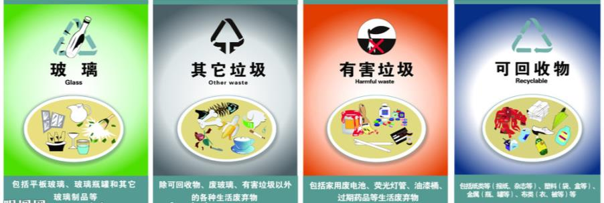
We should recycle rubbish because it can help us protect the environment.

Slide 20
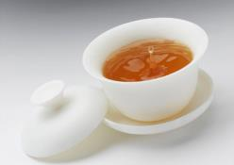
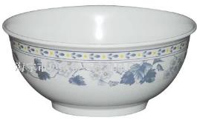
It is better to use china cups and bowls because they can be used many times.

Slide 21
What causes pollution ?
Pollution from factories spreads over cities and villages.If the rivers are polluted,If the rivers are polluted, farmers can’t use them to water their crops

Slide 22
The cars on the roads use so much oil and cause pollution

Slide 23
What causes pollution ?
1.Pollution from factories spreads over cities and villages.If the rivers are polluted, farmers can’t use them to water their crops .
2. In some places, pollution from factories spreads over cities and villages
3.The cars on the roads use so much oil and cause pollution .

Slide 24
What can students do ?
1.every class collects waste which can be recycled or used again .Then the school sells the waste to help students.
2. Order food that you can finish.
3. Use less electricity at home.
4. Learn ways to recycle rubbish.
5. Divide rubbish into different groups.
6. Use paper cups and paper bags.

Slide 25
7.Go to school on foot or by bike.
8. Do not throw away things made of glass, plastic and paper, but recycle them when possible.
9. Turn off lights when you do not need them.
10. Take a bag when you go shopping in stead of asking for a plastic bag.
11. Use things for as long as possible.

Slide 26
1. We throw tons of rubbish away each year, and we have to make a change.
ton n. 吨
tons of 许多, 很多
e.g 我们为今晚的聚会买了大量饮料。
We’ve bought tons of drinks for the
party tonight.

Slide 27
throw away 扔掉; 丢弃
e.g. When are you going to throw away those old magazines?
你打算什么时候扔掉那些旧杂志.
他已经失去了一个良好的机会。
He has thrown away a good chance

Slide 28
2. Repeat these three words daily: reduce, reuse and recycle.
repeat v. 重说; 重新做
前缀“re-”, 意思是“再, 重复”
e.g. I repeated after the teacher word by word. 我跟着老师一个字一个字地读。

Slide 29
reuse v. 再次使用; 重复利用
e.g. She often reuses old envelopes. 她经常重复使用旧信封。 这些瓶子可重复使用达20次。
The bottles can be reused up to
20 times.

Slide 30
3. Although it takes energy to change things into something else, it is better than throwing things away or burning them.
change … into …
把……变成……
e.g. You can’t change iron into gold. 你无法把铁变成金子。

Slide 31
4. We cannot hope for rapid change, but let’s take these simple steps today …
take steps 采取措施
e.g.我们需要采取一些措施了减少污 染。
We need to take some steps to reduce pollution

Slide 32
5. It’s no use talking about things we can’t do.
It’s no use doing sth. 做某事没有用处
e.g. It’s no use complaining.
抱怨没有用处。
Listen, George, 听着, 乔治, 活在过去是没有用的。
it’s no use living in the past.

Slide 33
构词法
合成法
将两个或两个以上独立且语义不同的单词合在一起构成新词的方法叫做合成法。合成法是一种比较灵活的构词方法，可以合成名词、形容词、副词、代词、动词等。例如：afternoon, sportsman, blackboard, sportsperson, newspaper,

Slide 34
2. 派生法
通过在词根前面加前缀或在词根后面加后缀构成一个新词的方法叫作派生法。要通过派生法理解和记忆单词, 我们需要掌握常见的前缀和后缀及派生规律。

Slide 35
(1) 常见前缀
前缀 | 含义 | 例词
dis- | 不 | disagree, dislike
en- | 使……处于某种状态 | enable, enrich
im-, in- | 不 | impossible, impatient, inexpensive
inter- | 在……之间, 相互 | international, interconnect

Slide 36
前缀 | 含义 | 例词
mis- | 错误地 | mislead, misunderstand
non- | 不, 非 | non-smoker, non-native
re- | 再, 重复 | rewrite, retell
un- | 不 | unable, unhappy, unpopular

Slide 37
后缀 | 功能 | 例词
-ment | 构成名词 | agreement, government
-ness |  | coldness, happiness, illness
-th |  | truth, warmth
-tion |  | competition, education, information, invitation
-ty |  | activity, safety

Slide 38
后缀 | 功能 | 例词
-able, -ible | 构成 形容词 | comfortable, eatable, enjoyable, possible,
-al |  | environmental, international, national, traditional
-ful |  | careful, helpful, useful
-ive |  | active, expensive
-less |  | careless, helpless, homeless, useless

Slide 39
后缀 | 功能 | 例词
-ly | 构成 形容词 | friendly, lovely, monthly, weekly
-ous |  | dangerous, famous
-teen | 构成数词 | eighteen, fifteen, seventeen
-th |  | fifteenth, fifth, fortieth, seventh
-ty |  | forty, sixty, twenty
-ly | 构成副词 | badly, carefully, carelessly, happily, quickly

Slide 40
(3) 派生规律
由一个词根加上相应的词缀可以派生出名词、形容词、副词等，掌握派生规律对扩充词汇有很大帮助。例如：
由 interest 可以派生出：
uninteresting
interest — interesting — interestingly
interested — uninterested

Slide 41
由 help 可以派生出：
helpless — helplessly
help — helpful — helpfully
由 able 可以派生出：
enable
able unable
ability
disable

Slide 42
3. 转化法
英语构词法中把一种词性转化为另一种词性而词形不变的方法称作转化法。常见的转化有：
(1) 动词转化为名词
— Let’s talk about it more.
咱们再谈谈这件事吧。
— I think we’d better finish the talk
now. 我想我们最好现在结束谈话。

Slide 43
(2) 名词转化为动词
She gave me a cup of water.
她给了我一杯水。
You should water the flowers twice a
day.
你应该每天给这些花浇两次水。

Slide 44
Exercises
Complete the sentences with the words in the box.
hopeful impossible reuse unhealthy wasteful
unhealthy
Polluted water is ____________.
2. It is _________ to throw so much food away.
wasteful

Slide 45
3. If you look after things well, you may ________ some of them later.
4. It is ___________ to clean up the whole river in such a short time.
5. If we pay attention to pollution now, the future will be __________.
reuse
impossible
hopeful

Slide 46
Complete the sentences with the correct form of the words in Activity 3.
She was hopeful that her new job would make her more successful.
The factory ___________ the river, and the fish died.
2. We often walk in the countryside. It is a(n) _______ activity for us.
polluted
usual

Slide 47
3. Do not use so much water. It is very __________.
4. To keep the flowers growing, you need to _________ them once a day.
wasteful
water

Slide 48
Complete the conversation with the correct form of the expressions in the box.
be good for throw away turn off worry about

Slide 49
Mike: I hear you are off to the Caribbean for a holiday! Lucky you! But aren’t you _______________ the pollution that such long plane journey may cause for the environment?
Ken: I know, but what can I do about it? I’ve already tried my best to protect the environment.
worried about

Slide 50
I recycle. I don’t ____________ things if I don’t want them any more. I ____________ the lights when I leave a room. Don’t tell me I shouldn’t travel by plane any more!
throw away
turn off

Slide 51
Ken: Good! So I can enjoy my holiday, and when I come back, I’ll plant some trees!
Mike: That’s the idea! Maybe we can all join in and start a small forest!

Slide 52
Listening
Listen and check (√) the true
sentences.
1. It is OK to throw used things away. Looking after them takes a lot of time.
2. Do not throw away things made of glass, plastic and paper, but recycle them when possible.
3. Take a bag when you go shopping.
√
√

Slide 53
Advice | Reasons
3. Use less electricity and oil to _______________. 4. Don’t leave lights on and _______________. 5. ____________ and do not often drive your car. | Producing electricity and using oil may cause ___________.
reduce pollution
waste electricity
pollution
Walk or cycle

Slide 54
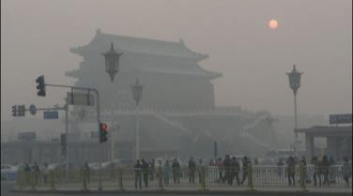
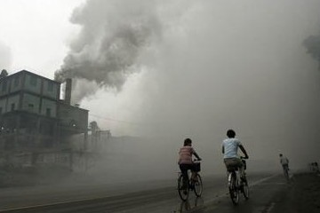
Module task
Discussing what you can do about pollution
Work in groups..

Slide 55
Discussion
Discuss your subject.
Take turns to say what you think about the problem and what can be done.

