Slide 1
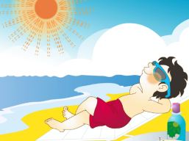
Unit1 I went to Sanya for my holidays.
人教精通版六年级下册
WWW.PPT818.COM

Slide 2
>>Warm-up
Let’s sing
（单击图片可播放动画）

Slide 3
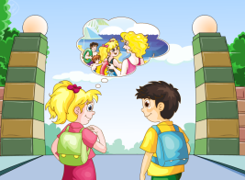
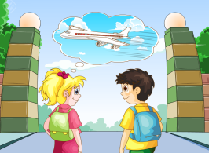
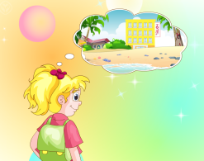
>>Warm-up
Review
What did you do during your holidays?
I went to ...
I went there by ...
I stayed in…

Slide 4
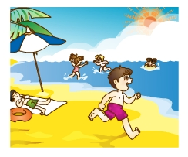
>>Presentation
Look and say
What did you do during your holidays?
I went to the beach.
PPT模板：www.1ppt.com/moban/ PPT素材：www.1ppt.com/sucai/
PPT背景：www.1ppt.com/beijing/ PPT图表：www.1ppt.com/tubiao/
PPT下载：www.1ppt.com/xiazai/ PPT教程： www.1ppt.com/powerpoint/
资料下载：www.1ppt.com/ziliao/ 范文下载：www.1ppt.com/fanwen/
试卷下载：www.1ppt.com/shiti/ 教案下载：www.1ppt.com/jiaoan/
PPT论坛：www.1ppt.cn PPT课件：www.1ppt.com/kejian/
语文课件：www.1ppt.com/kejian/yuwen/ 数学课件：www.1ppt.com/kejian/shuxue/
英语课件：www.1ppt.com/kejian/yingyu/ 美术课件：www.1ppt.com/kejian/meishu/
科学课件：www.1ppt.com/kejian/kexue/ 物理课件：www.1ppt.com/kejian/wuli/
化学课件：www.1ppt.com/kejian/huaxue/ 生物课件：www.1ppt.com/kejian/shengwu/
地理课件：www.1ppt.com/kejian/dili/ 历史课件：www.1ppt.com/kejian/lishi/
go to the beach

Slide 5
>>Presentation
Look and say
What did you do during your holidays?
I enjoyed sunbathing.
enjoy sunbathing

Slide 6
>>Presentation
Look and say
What did you do during your holidays?
I enjoyed the moon and stars.
enjoy the moon and stars

Slide 7
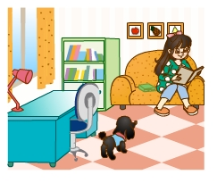
>>Presentation
Look and say
What did you do during your holidays?
I stayed at home.
stay at home

Slide 8
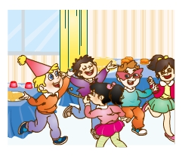
>>Presentation
Look and say
What did you do during your holidays?
I had a party.
have a party

Slide 9
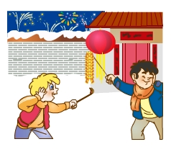
>>Presentation
Look and say
What did you do during your holidays?
I enjoyed Spring Festival.
enjoy Spring Festival

Slide 10
>>Practice
Game 1
朗读对抗赛
go to the beach
stay at home
enjoy sunbathing
have a party
enjoy the moon
and stars
enjoy Spring
Festival

Slide 11
>>Practice
Game 2
Which is missing?

Slide 12
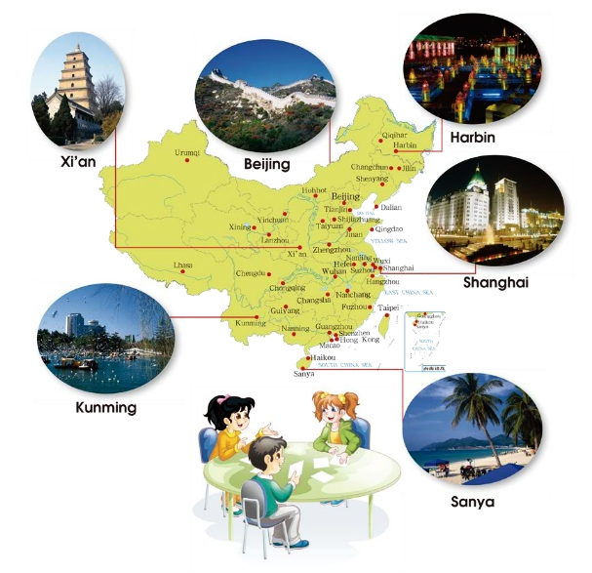
>>Presentation
Let’s interview
What did you do on your holidays?
I went to Shanghai.

Slide 13
>>Practice
活动1
Do a survey
What did you do during the holidays?
City
Sanya
…
How
by plane
…
What
go to the beach
…

Slide 14
>>Practice
活动2
Interview Show
What did you do during
the holidays?
I …

Slide 15
>>Presentation
Let’s chant
（单击图片可播放动画）

Slide 16
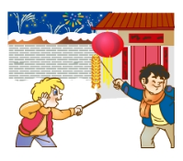
>>Summary
What did you do during the holidays?
I …

Slide 17
>>Homework
1.在四线三格中正确抄写Just practise和Just write部分的单词和短语， 三英一汉。
2. 预习 Lesson3。

