Slide 1
Unit 4
When do you have class?
WWW.PPT818.COM

Slide 2
What time is it?
It’s 7 o’ clock.

Slide 3
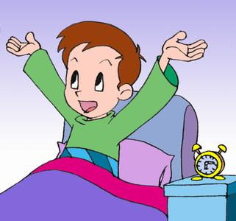
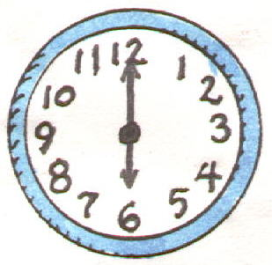
six o’clock

Slide 4
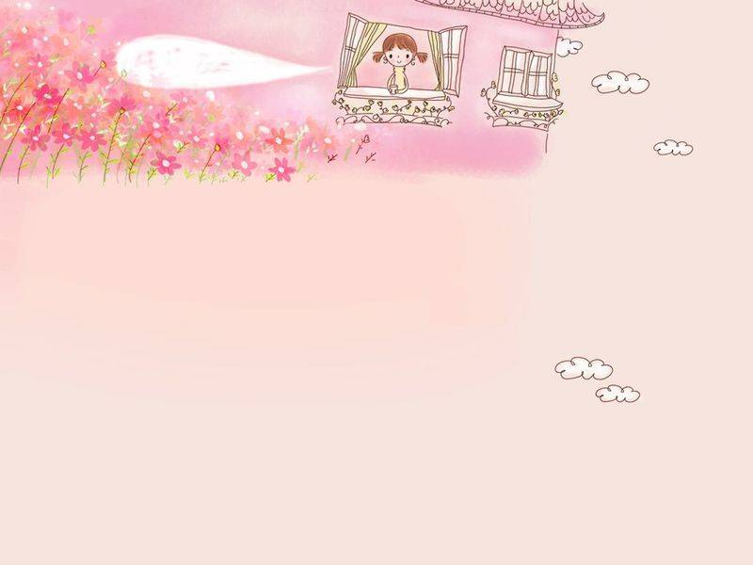
get up
have breakfast
go to school

Slide 5
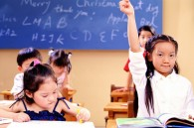

Slide 6
have a class
复
数
have classes
go home

Slide 7
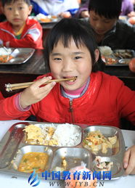

Slide 8
have lunch

Slide 9
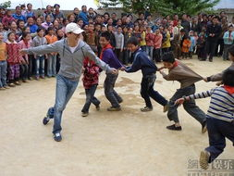

Slide 10
play games
have dinner

Slide 11
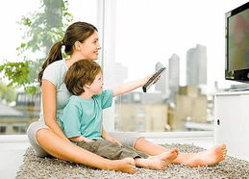

Slide 12
watch TV
名词：手表
watch
动词：观看

Slide 14
go to bed

Slide 15
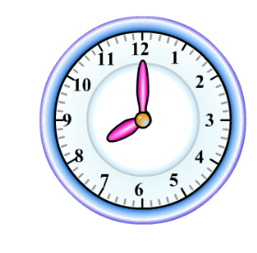
When do you have classes ?
I have classes at eight in the morning

Slide 16
four o’ clock
When do you play games ?
I play games at four in the afternoon
When do you +动词短语?
I/We+动词短语+at+具体的时间

Slide 17
Do you play games at school?
No we don’t
Do you+动词短语+at+具体的时间？
Yes ,I/we do
No ,I/we don’t

Slide 18
Practice:
When do you get up
When do you have breakfast
When do you go to school
When do you have a classes
in the morning ?
在早上

Slide 19
When do you play games
When do you go home
When do you watch TV
When do you go to bed
in the afternoon?
在下午
in the evening?
在晚上

Slide 20
根据中文提示完成句子：
1.你通常什么时候吃早餐？
_____ do you _____ breakfast?
2.他们通常什么时候去上学？
______ do they ____ ____ _______?
3.我们每天下午5点回家。
we ______ ______ _____ 5:00 ___ the afternoon.
5.我的小黑狗每天晚上9点睡觉。
My little black dogs _____ ____ _____ at 9 every night.
When
have
When
go to school
go home at
in
go to bed

Slide 21
get up
起床
have breakfast
吃早饭
take a bus
乘车
go to school
去上学
have lunch
吃午饭
play games
做游戏
go home
回家
have dinner
吃晚饭
do homework
做作业
watch TV
看电视
go to bed
睡觉
class
复数
classes

Slide 22
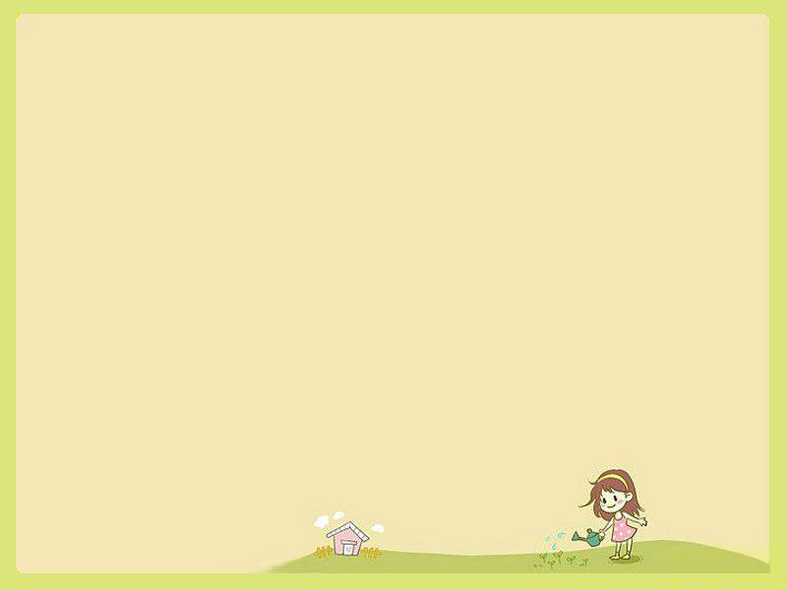
Homework:
1.练习单词，短语。
2.运用句型和搭档编对话。
3.做练习册中的题目。
4.很流利的背诵对话。

Slide 23
再 见

