Slide 1
Unit 3 Topic 1
Does he speak Chinese?
Section C
WWW.PPT818.COM

Slide 2
Teaching aims and demands
1. Learn some useful words and expressions:
many, lot, all, not…at all, so, study, each other,
little, them, very, much
2. (1)Review questions and answers with do/does:
① —Do you have a pen pal?
—Yes, I do./ No, I don’t.
② —Does he speak Chinese?
—Yes, he does./ No, he doesn’t.
(2) Review the personal pronouns, including subject pronouns and object pronouns.

Slide 3
Teaching aims and demands
3. Grasp the useful expressions in this topic:
(1) —Excuse me, could you please tell me your name?
—Sure. My name is Jane.
(2) —Do you like English?
—Yes, I like it a little/ very much/ a lot.
—No, I don’t like it at all.
(3) —Could you please help me with my English?
—No problem.

Slide 4
Ask and answer
1. Do you speak Chinese?
2. What colour are your pants? Do you like them?
3. Could you please tell me your English name?
4. Do you have a good friend? Tell me her/his name.
5. Do you like a pet? What’s your pet’s name?
6. What does your pet look like?
7. Do you want to visit the Great Wall?
8. Could you help me with my English?

Slide 5
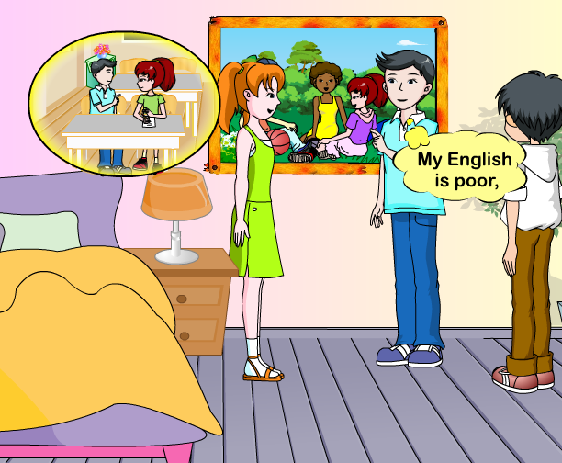
1a Read and understand
需要播放时请点击图片

Slide 6
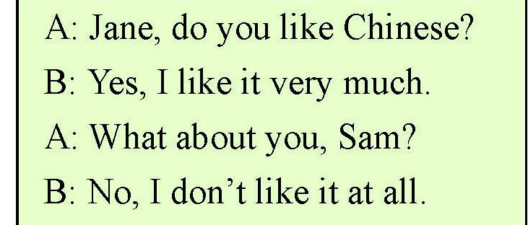
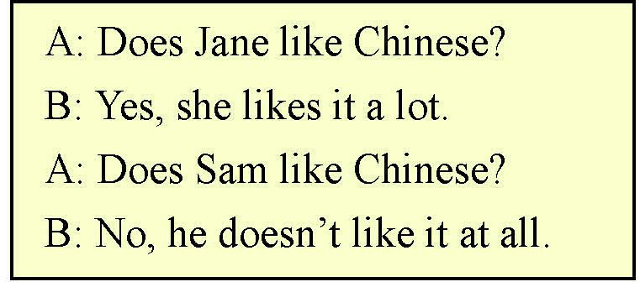
Listen, read and learn

Slide 7
Change the following sentences according to the example.
Example:
He speaks Chinese.
→Does he speak Chinese?
Yes, he does.

Slide 8
1. I have a pen pal.
2. Li Hong likes oranges a lot.
3. They often help Wang Fei.
4. Jane wants to visit China.
5. Your pet has blue eyes.

Slide 9
Practice
1. My English is poor, so __(她) often helps __(我).
2. Where do (你们) live? (我们) live in Beijing.
3. I don’t know (他们).
4. He wants (我们) to go to his home.
5. What is (它)? (它) is a jacket.
she; me 2. you; We 3. them 4. us 5. this; It

Slide 10
Work alone
1. Maria has some friends here.（改为否定句）
____________________________.
2. The letter is from my pen pal.（对划线部分提问）
____________________________.
3. by, what, way, he, the, does, say, in, letter, the (连词成句)
____________________________.
4. He lives in Brazil. （对划线部分提问）
____________________________.
5. What’s this? It’s a toy. (改为复数形式)
____________________________.

Slide 11
Project
1 Write a passage about your pets and your friend’s pets.
2 教师先让学生分组讨论，然后鼓励学生单独完成写作部分。
3 抽查3名同学。
4 让每组的小组长检查其他同学的作业，然后各小组互查。
5 最后教师总结。
11

Slide 12
活动设计
Welcome to English Corner Time: 6:00 p.m. Place: Playground(操场) Topic(话题): Like English or not Host: Class 2, Grade 7

Slide 13
Example:
T: Excuse me, could you please tell me your English name?
S1: Sure. …
T: My English is poor. Could you help me?
S1: No problem.

Slide 14
Name | Question
××× | Do you like English?
×××
×××
×××

Slide 15
Ask and answer
(1) Do you like the English corner?
(2) Do you often come here?
(3) Does your friend like it?
(4) Does your friend speak English at the English corner?

Slide 16
Sing this song.

Slide 17
Homework
(1) 以“English Corner”为题，写一篇40字左右的短文予以介绍参照幻灯片展示的材料，要求包括时间、地点、话题及主办方等。
(2) 翻译句子：
① 王飞非常喜欢英语。
② 我经常帮助我的同班同学学英语。
③ —你姐姐喜欢苹果吗？
—不,一点也不喜欢。

