Slide 1
Lesson 2
I have a new pen.
WWW.PPT818.COM

Slide 2
New Words

Slide 3
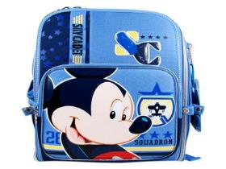
schoolbag
I have a schoolbag .

Slide 4
book
I have a book.

Slide 5
pen
I have a pen .

Slide 6
pencil
I have a pencil .

Slide 7
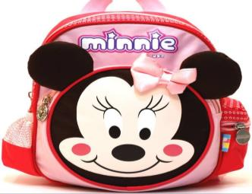
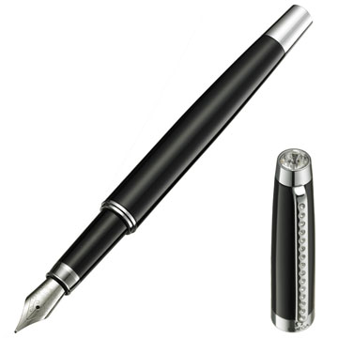
Let’s guess!

Slide 8
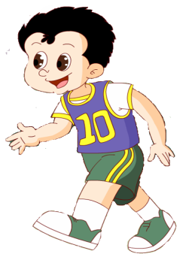
I have a new pen.
It’s nice.

Slide 9
I have a pencil.
Me, too.

Slide 10
I have a book.
It’s nice.

Slide 11
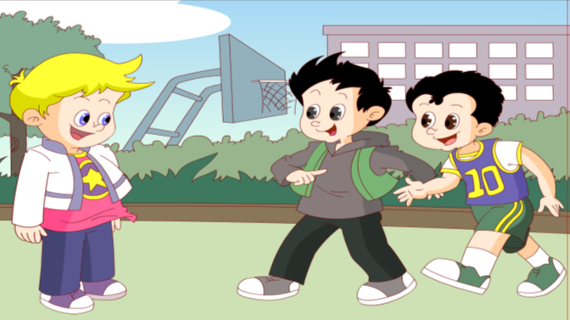
I have a new schoolbag.
It’s nice.

Slide 12
Let’s read!
Book , book. I have a book.
Pencil , pencil. I have a pencil.
Schoolbag , schoolbag. I have a schoolbag .
Pen , pen. I have a new pen.

Slide 13
Let’s talk!
A: I have a ...
B: Me, too.
A: I have a new ...
B：It’s nice!

Slide 16
Homework
1. Listen and imitate.
(听录音，模仿跟读。)
2. Introduce your stationery to
your parents .
（向父母介绍你的文具。）

Slide 17
Goodbye！

