Slide 1
Unit 1
The King’s new clothes
WWW.PPT818.COM

Slide 2
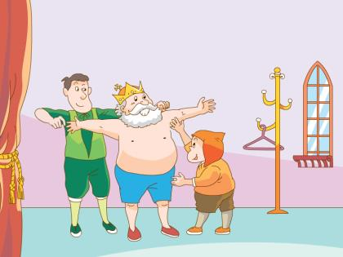
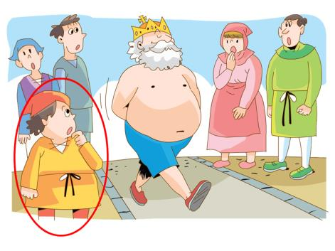
Let’s talk
Talk about the characters on the picture.
There is / are… She/ He is…

Slide 3
About he writer
Hans Christian Anderson
writed many fairy tales.
The Little Match Girl
The Ugly Duckling
The Little Mermaid

Slide 4
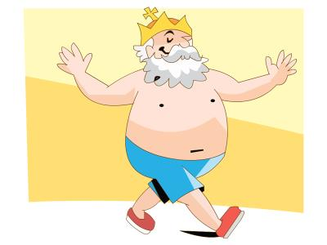
Let’s talk
What do you know about the story?
liked new clothes
met two men
ironic

Slide 5
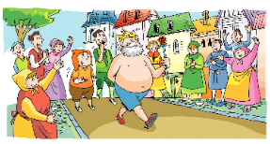
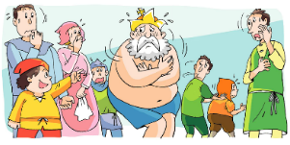
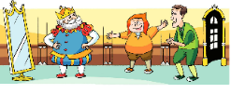
Predict and order
3
What's the correct order?
Make a prediction first.
2
4
1

Slide 6
Let’s find
When did the story happen?
A. three days ago
B. two hours ago
C. long long ago
D. one year ago
the past tense

Slide 7
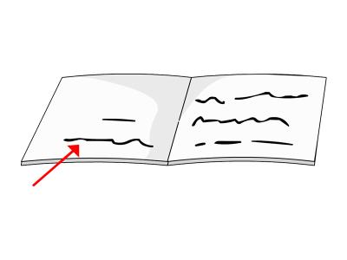
Let’s find
Choose the correct words and complete the sentences.
Long long ago, there( is, was) a king. There (are, were) two men. They (are, were) cheats. There (are, were) a lot of people in the street. There (is, was) a little boy in the street too.

Slide 8
Watch and judge
1. The king was foolish.
2. People could see the king’s new clothes.
3.The boy was foolish because he could not see the king’s new clothes.

Slide 9
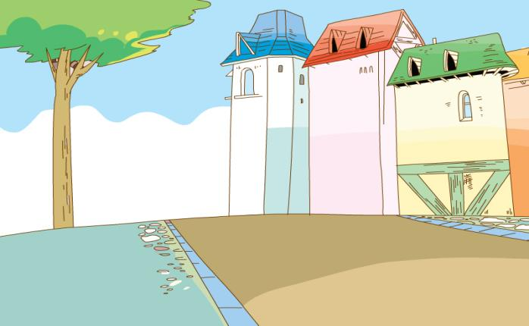
Watch and judge

Slide 10
Watch and judge
1. The king was foolish.
2. People could see the king’s new clothes.
3.The boy was foolish because he could not see the king’s new clothes.
could not
clever
He was honest.

Slide 11
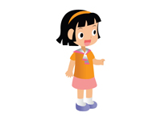
Read and underline
Read the story carefully and answer the following questions. Underline the key sentences.
What did the king do after wearing the new clothes?
Did the people in the street like the new clothes? What did they say?
Who said the truth at last?

Slide 12
Read and underline
What did the king do after wearing the new clothes?
cross over
The king walked through the city in his new clothes. There were a lot of people in the street.. They looked at the king and shouted, “What a beautiful clothes!”

Slide 13
Read and underline
Did the people in the street like the new clothes? What did they say?
The king walked through the city in his new clothes. There were a lot of people in the street.. They looked at the king and shouted, “What a beautiful clothes!”
They didn’t tell the truth.

Slide 14
Read and underline
Who said the truth at last?
A little boy pointed at the king and laughed, “Ha! Ha! The king isn’t wearing any clothes!”
ed
ed
the past tense
Find more words like these.

Slide 15
Let’s imagine
What would happen then? Work in groups and create an ending for the story.
?

Slide 16
Let’s retell
Retell the story with your endings in groups of four. Each one choose one picture.
…

Slide 17
Keep sincere and be an honest man.
We Know it

Slide 18
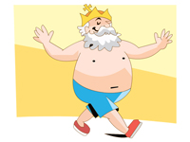
Homework
1. Tell the story to your parents in English.
2.Write down your ending of the story.

Slide 19
Goodbye!

